Slide 1
Web Design Lifecycle
Usability – Accessibility – Testing – Implementation and Marketing
Essentials of Web Design
CSCI 1210

Slide 2
Designing for Universal Usability

Slide 3
Two facets of diversity
Technology diversity
Web is a very diverse deployment environment
Cannot design for one browser, platform, resolution, device, etc
User diversity
Not every user has same abilities. People with certain handicaps may need special accommodations

Slide 4
Two facets of diversity
Purpose of the Web is large-scale open communication
Approx. 20 percent of U.S. has some kind of disability.
Approx. 14.1% of the U.S. is over the age of 65
Practically: Market exists. People need to be served
Legally: failing to do so may open up lawsuits

Slide 5
Accessibility
Accessible—able to be used by people with handicaps. Usable for this audience
Accessibility—focus on creation of sites that are accessible

Slide 6
Accessibility
Primary concerns:
Visual impairment—low vision or no vision (blind)
Motor impairment—difficulty using traditional pointing devices and/or keyboard
Designing for accessibility is often neglected
Requires particular effort on part of designer

Slide 7
Web Accessibility Initiative (WAI)
Research sponsored by the World Wide Web Consortium (W3C) (www.w3.org)
“The power of the Web is in its universality. Access by everyone regardless of disability is an essential aspect.”
“The Web is fundamentally designed to work for all people, whatever their hardware, software, language, culture, location, or physical or mental ability. When the Web meets this goal, it is accessible to people with a diverse range of hearing, movement, sight, and cognitive ability.”
http://www.w3.org/WAI/

Slide 8
Web Accessibility Initiative (WAI)
W3C/WAI recommends:
Establish a team or individual whose purpose is to learn about accessible design
Have the above promote and educate design team(s) about importance, techniques, etc

Slide 9
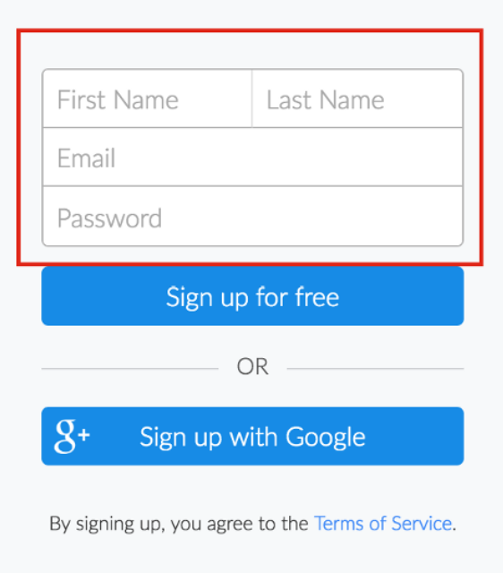
Accessibility Example: Poor Contrast
The gray color used for the font and border of this login interface fails the contrast ratio guideline
Affects: users with vision impairments (low vision, color blindness, etc.), and even users with good vision in brightly lit situations or low-contrast displays
Guideline: The visual presentation of text and images of text has a contrast ratio of at least 4.5:1 — WCAG 1.4.3 Contrast
Tools: Use the Google developer tools to determine if the color contrast on the page follows. Under “Audits”, you can check “Accessibility” to run an audit your current webpage

Slide 10
Accessibility Example: Contrast
Principle: Make sure contrast between text and background yields readable text
Why? Many people are colorblind or lose visual acuity with age or handicap. Fully sighted people may experience eye strain
Test: View on monochrome monitor, or print web page with background showing (non-color printer) and examine output (Paletton/other services)
Turn on print background color in browser
Remedy: Adjust contrast as needed
Notes:
Between 10 and 20 percent of the white male population in this country experience color blindness.

Slide 11
Accessibility Tools
https://www.w3.org/WAI/ER/tools/
http://www.checkmycolours.com/
http://www.accesskeys.org/tools/color-contrast.html
http://colorfilter.wickline.org/
http://wave.webaim.org/
Notes:
Between 10 and 20 percent of the white male population in this country experience color blindness.

Slide 12
Notes:
Can you see the navigation options at the top and bottom of this page?

Slide 13
Accessibility Example: Mouse
Principle: Make sure page is usable without mouse
Why? Special devices may be used or fine motor skills lacking
Test: Use keyboard only to navigate your site. Make sure you can access all links and controls. Check tab order.
Remedy: Remove controls or provide alternatives when problems discovered. Make sure all non-accessible navigation is paired with accessible alternative

Slide 14
Easy Checks – A First Review of Web Accessibility
W3C WAI has a Working Draft on some guidelines for first review of a website for web accessibility. These items include:
Page Title
Image Text Alternatives (alt attribute)
Headings
Contrast Ratio (“Color Contrast”)
Resize Text
Keyboard Access and Visual Focus
Forms, Labels, and Errors
Multimedia (video, audio) alternatives
Basic Structure Check
For more, visit: http://www.w3.org/WAI/eval/preliminary.html

Slide 15
Bad Practices
Using Flash animations
Using images as links
Using underlined text
Using too many colors
Not using any color contrast
Not using captions
Not using alt text
Not having a clear heading hierarchy
Using a web font that is not easy to read
Using only visual design elements without providing any text
Not providing any accessible content at all
Using a fixed font size that is too small to read

Slide 16
Accessibility
Be aware of the need for accessibility and factor accessibility needs into your design process
Test accessibility before site deployment. Use human testers with accessibility needs if possible
Be attentive to new tools or techniques that improve accessibility, and cautious of techniques that create accessibility problems
Set a goal of progressively improving your development team's knowledge of accessibility

Slide 17
Testing

Slide 18
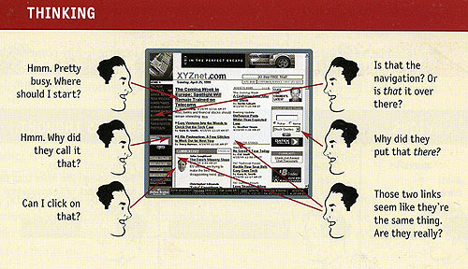
Usability Testing
https://www.amazon.com/Dont-Make-Think-Revisited-Usability/dp/0321965515

Slide 19
Usability Testing
When creating a site, we’ve already thought about the audience’s:
Desires and goals
Computer and Internet skills
Education, gender, age, occupation

Slide 20
Usability Testing
Usability testing is a way to check if the site is meeting those needs
Usefulness and utility can be measured
Their satisfaction with the site – “likes” and “dislikes” – can be recorded as well
There are several types of testing, but the most common one involves watching users use the site and gathering data about what they’re thinking and doing

Slide 21
Choosing Participants
People who match the personas are a good starting point
Find representative users from each of your audience groups
Within groups, try to find a mix of skill and experience levels
Most tests are done with 5 – 10 users, but even 1 or 2 may give you some good information

Slide 22
Tasks
Include the most commonly completed and most important tasks
Tasks should not be leading, and if possible, shouldn’t contain the names of links or buttons to be clicked
When you write them, decide what defines a “success”
How long should it take?
What steps are required to complete the task?
Do errors or different paths matter?

Slide 23
Legalities for Major Studies
Institutional Review Board (https://www.etsu.edu/irb/)
Certifications for Human Subject Research
Consent forms
Audio recording
Video recording
Participation in a research study

Slide 24
Legalities for Major Studies
Stanford Prison Experiment: http://www.prisonexp.org/
Tuskegee Study of Untreated Syphilis in the Negro Male: https://www.cdc.gov/tuskegee/timeline.htm
The Milgram Experiment: https://www.simplypsychology.org/milgram.html

Slide 25
Test Setup
Morae is software that can be installed on a laptop to record a test
It can record the user’s face with a webcam
It records what happens on the screen along with mouse clicks and keystrokes
https://csci1210.com/video_lectures/morae.php
If something like this isn’t available, you can record with a video camera, use screen capture software like Camtasia or OBS (Open Source), or just take good notes

Slide 26
Conducting a Test
Introduce yourself and explain the purpose and process for the test
Let them know that you’re testing the site, not their abilities
Give them the tasks
Watch what they do, and be sure to take note of anything that gave them trouble
Try to remain neutral and try not to help them complete the tasks
This is much harder when you’re testing your own design

Slide 27
Conducting a Test
If they get stuck somewhere or you’re not sure what is happening, ask neutral questions like “What do you think about X?” or “What are you doing now?”
Remember that users are more likely to be nervous and unsure of themselves when they’re being watched
After the tasks are finished, you may want to wrap up with a questionnaire to gather their overall opinions about the site
Depending on the size of the site, a test should take about 30 minutes – 2 hours

Slide 28
Conducting a Test
https://csci1210.com/video_lectures/testing.php

Slide 29
Reports
Reports from a usability test include information about what happened in the test
Major usability issues that were uncovered, with recommendations for how to fix them
Description of user demographics
Objective measurements (time, number of errors, completion rate)
Subjective measurements (satisfaction and opinions)

Slide 30
Reports
Ideally, this is part of an iterative process
Design, test, redesign, test, design, test, redesign, test, design, test, redesign, test, design, test, redesign, test, design, test, redesign, test, design, test, redesign, test, design, test, redesign, test, design, test, redesign, test, design, test, redesign, test, design, test, redesign, test, design, test, redesign, test, design, test, redesign, test, design, test, redesign, test, design, test, redesign, test, design, test, redesign, test, etc.
https://www.youtube.com/watch?v=BrVnBdW6_rE

Slide 31
Implementation and Marketing

Slide 32
"Publishing" a web site
Either self-host the site or outsource to a hosting company
Self-hosting:
Establish computer system and needed software
Find an ISP to provide Internet connection (Bandwidth is key issue)
Work with ISP and/or InterNIC for an IP address
Associate Domain Name with IP address
Outsource to hosting company:
Contract with company for server space, functionality, and bandwidth

Slide 33
Drawing visitors to our site
"If you build it, they will come"--doesn't (necessarily) work on the web
Have a memorable domain name and promote
In other media (TV, print, signs, bags, packages, etc.)
In paid online advertising
Using affiliates and cross-promotion
Search engine placement (free and paid ad)
Social Media

Slide 34
Promotion of site-affiliate programs
Other web sites that promote ours to receive:
Our promotion of their site on ours
A commission every time someone clicks on our ad or visits our site from theirs and makes a purchase
Pay-per-click vs. pay-per-sale
Establishing an effective affiliate program takes time, ongoing oversight, and legal consultation

Slide 35
Promotion of site-affiliate programs
Pay per Sale (PPS)
Publisher is paid on the basis of referral sales
Example - Publisher is only paid if user clicks the ad on publisher site and then makes a sale on the advertised site
As very low percentage people ends up doing the sale , The percentage commission is highest in case of PPS programs
They pay between 4-20% of each sale

Slide 36
Promotion of site-affiliate programs
Pay per Click (PPC)
Publisher is paid on the basis of Ad clicks that take the user to the advertised site
As Average number of people clicks the ads so this program offers less percentage commission than PPS
They pay between $.25 to $1.25 for each click depending on the product and number of unique clicks

Slide 37
Promotion

Slide 38
The power of search engines

Slide 39
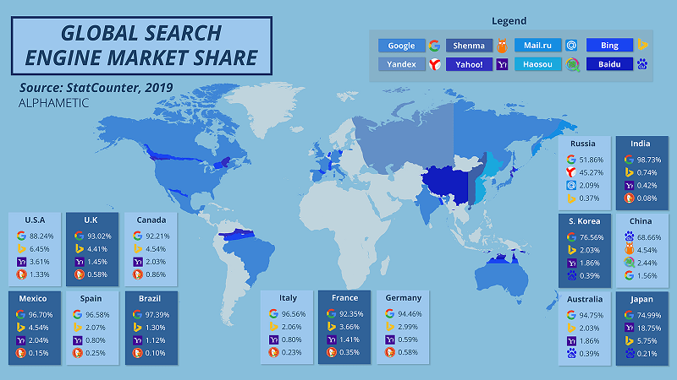
The power of search engines

Slide 40
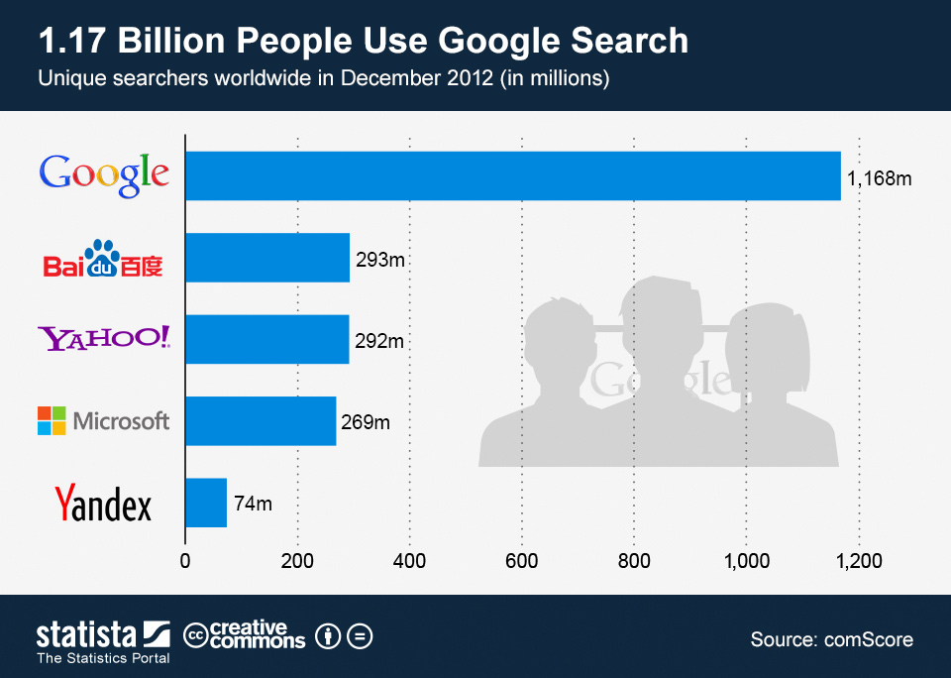

Slide 41
Fostering search engine placement
Make sure that, where possible, you request that a search engine add your site
http://search.yahoo.com/info/submit.html
https://www.google.com/webmasters/tools/submit-url?pli=1
http://www.bing.com/toolbox/webmaster/
Keyword advertising placement may be worthwhile investment
Many search engines rely on spiders and robots. Make sure meta information provides keywords and descriptions

Slide 42
How do search engines work?
Seems trivial, actually very complex to do well.
1st generation search engines:
Keyword-based searches
Problems with synonyms and retrieval quality
Only information on the pages are used
Easy to cheat/fool (adding keywords multiple times in hidden text)
Modern search engines
Site hyperlink structure important
Links to documents represent a deliberate act and a “quality indicator”

Slide 43
Summary
Accessibility
Almost 20% of users
Vision
Motor
W3C Web Accessibility Initiative

Slide 44
Summary
Testing
IRB
Representative users
Morae / Video
Reports

Slide 45
Summary
Implementation and Marketing
Publishing a website
Search engines
Plan for drawing audience
Plan for fostering loyalty

Slide 46
Review Questions
1. Approximately how many people in the US live with some form of impairment?
One in four
One in three
One in nine
One in five

Slide 47
Review Questions
2. What are the two forms of diversity cited in Web Design?
Technology
Content
Designer
User

Slide 48
Review Questions
3. What are the two primary impairments that affect user experience (UX) and the Web?
Vision
Hearing
Motor
Math

Slide 49
Review Questions
4. What is the most important concern relating to vision impairment and web design
Contrast
Color
Hue
Saturation

Slide 50
Review Questions
5. In testing a web site, what observations are relevant to site design?
Navigation
Ease of Use
User ability
User observations/feedback

Slide 51
Review Questions
6. Using an affiliate program is a quick way to guarantee increased traffic to a web site.
True
False

Slide 52
Review Questions
7. You can register a site directly with some search engines to improve its likelihood of appearing nearer the top of search results.
True
False

Slide 53
Sources
“Nearly 1 in 5 people Have a Disability in the U.S., Census Bureau Reports”, United States Census Bureau, Retrieved from https://www.census.gov/newsroom/releases/archives/miscellaneous/cb12-134.html
“State & County QuickFacts”, United States Census Bureau, Retrieved from http://quickfacts.census.gov/qfd/states/00000.html
“EasyChecks – A First Review of Web Accessibility”, W3C Web Accessibility Initiative, Retrieved from http://www.w3.org/WAI/eval/preliminary.html
https://www.smartinsights.com/search-engine-marketing/search-engine-statistics/
https://usabilitygeek.com/bad-vs-good-accessible-designs/

Slide 54
Copyrights
Presentation prepared by and copyright of John Ramsey, East Tennessee State University, Department of Computing . (ramseyjw@etsu.edu)
Microsoft, Windows, Excel, Outlook, and PowerPoint are registered trademarks of Microsoft Corporation.
IBM, DB2, DB2 Universal Database, System i, System i5, System p, System p5, System x, System z, System z10, System z9, z10, z9, iSeries, pSeries, xSeries, zSeries, eServer, z/VM, z/OS, i5/OS, S/390, OS/390, OS/400, AS/400, S/390 Parallel Enterprise Server, PowerVM, Power Architecture, POWER6+, POWER6, POWER5+, POWER5, POWER, OpenPower, PowerPC, BatchPipes, BladeCenter, System Storage, GPFS, HACMP, RETAIN, DB2 Connect, RACF, Redbooks, OS/2, Parallel Sysplex, MVS/ESA, AIX, Intelligent Miner, WebSphere, Netfinity, Tivoli and Informix are trademarks or registered trademarks of IBM Corporation.
Linux is the registered trademark of Linus Torvalds in the U.S. and other countries.
Oracle is a registered trademark of Oracle Corporation.
HTML, XML, XHTML and W3C are trademarks or registered trademarks of W3C®, World Wide Web Consortium, Massachusetts Institute of Technology.
Java is a registered trademark of Sun Microsystems, Inc.
JavaScript is a registered trademark of Sun Microsystems, Inc., used under license for technology invented and implemented by Netscape.
SAP, R/3, SAP NetWeaver, Duet, PartnerEdge, ByDesign, SAP Business ByDesign, and other SAP products and services mentioned herein as well as their respective logos are trademarks or registered trademarks of SAP AG in Germany and other countries.
Business Objects and the Business Objects logo, BusinessObjects, Crystal Reports, Crystal Decisions, Web Intelligence, Xcelsius, and other Business Objects products and services mentioned herein as well as their respective logos are trademarks or registered trademarks of Business Objects S.A. in the United States and in other countries. Business Objects is an SAP company.
ERPsim is a registered copyright of ERPsim Labs, HEC Montreal.
Other products mentioned in this presentation are trademarks of their respective owners.

