Slide 1
Colors/Tables
CSCI 1210
Essentials of Web Design

Slide 2
CSS Review

Slide 3
Review
HTML == Structure
CSS == Style
We use CSS to modify the presentation of our web pages
The preferred method of including CSS with our HTML is through use of External stylesheets
For special situations, however, we can use Embedded (whole page) or Inline (specific element) CSS

Slide 4
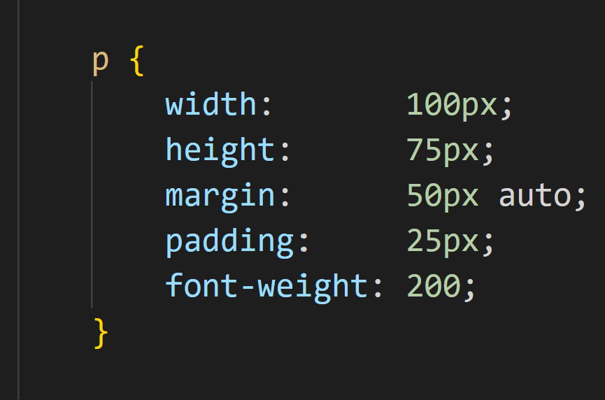
Review
PROPERTY
VALUE
SELECTOR

Slide 5
Review
Three parts:
Selector -> Identifies (or “selects”) the element you want to style
Property -> What you want to change (e.g., “margin”)
Value -> How you want to change it (e.g., 25px) [px == pixels; it is important that you don’t put a space between 25 and px]

Slide 6
Review (OK, this is actually new)
So “px” is pixels
There are other units of measure we can use
% - percentage em - literally, the width of the letter ‘m’ rem - font size of the root element vw - 1% of the viewport width vh - 1% of the viewport height cm - centimeters in - inches pc - picas pt - points
In this class, we’ll mostly use px
It is an absolute length unit that displays the same size regardless of the display size
Other units (e.g., em and rem) display differently on different sized displays (more on that in CSCI 1720)

Slide 7
More on CSS & Color
Choosing Colors

Slide 8
Choosing Colors
As we learned from our first homework assignment, poor choice of display colors can ruin an otherwise good web site, and potentially a visitor’s eyesight
All joking aside, a badly executed color scheme will encourage users to find other sites
Several online tools are available that can help a developer select an effective set of colors for a web site (this, by the way, may actually be decided by the client)
(If you were worried, you won’t have to do hexadecimal math)

Slide 9
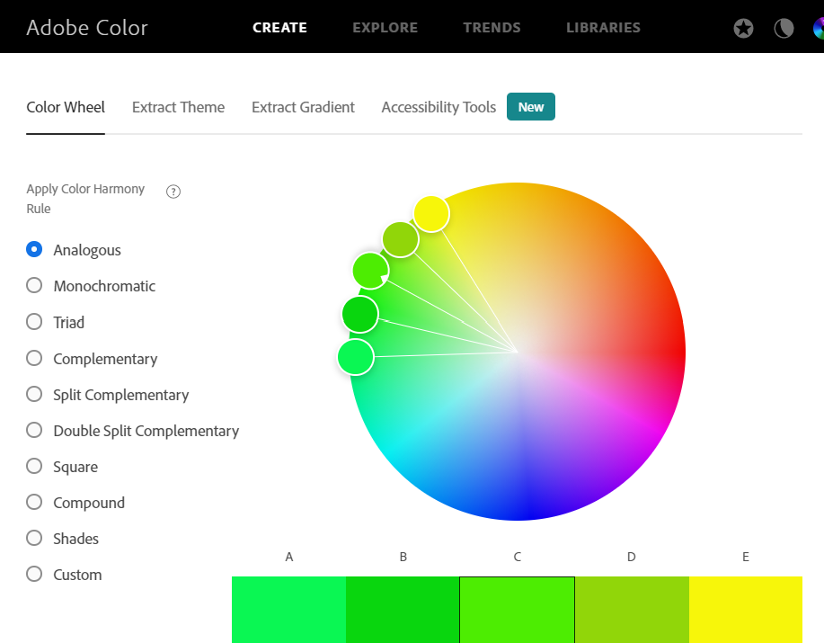
Choosing Colors
Adobe Color Wheel CC
https://color.adobe.com/create/color-wheel/

Slide 10
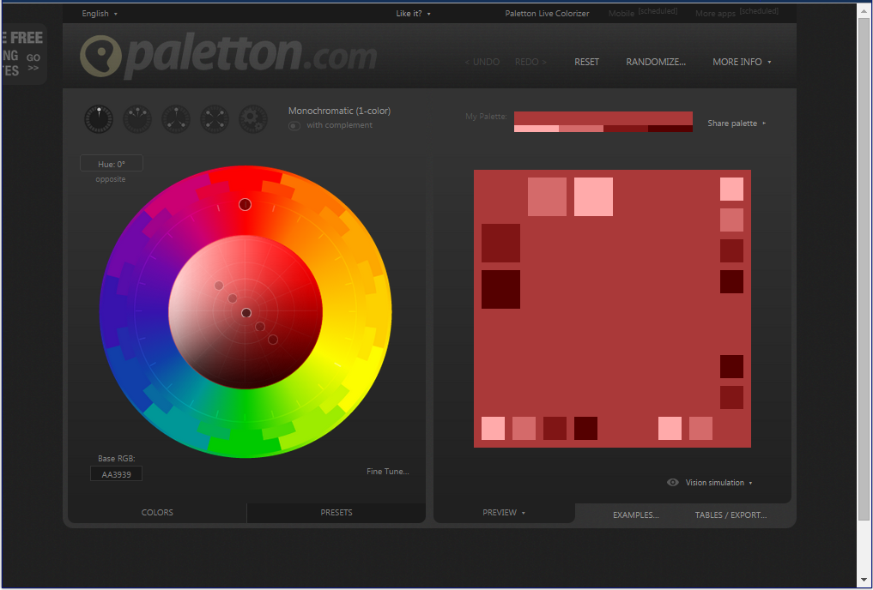
Choosing Colors
Paletton
http://www.paletton.com

Slide 11
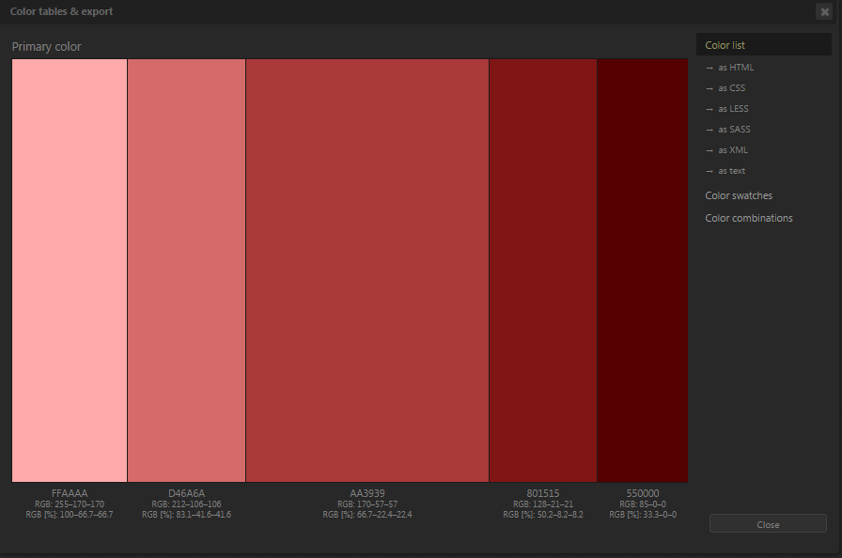
Choosing Colors
One of the tasks in Phase 3 of the semester project is submitting the color palette you intend to use for your web site
Paletton
Adobe

Slide 12
Choosing Colors
For this phase, DO NOT say, ‘I intend to use shades of blue and gray,’ or something like that. Pick a color palette, take a screen shot, and include it in your submission
Paletton
Adobe

Slide 13
The Most Important Thing About Colors
The single most important issue with color selection is -- Contrast
When designing websites, it’s important to make sure that you’re creating sufficient color contrast
Color contrast is part of a broader set of web standards that fall under the umbrella of accessibility
They’re meant to make sure that everyone – including those with visual, motor/mobility, auditory or cognitive impairments, or seizures – are not presented with barriers that prevent interaction with websites

Slide 14
The Most Important Thing About Colors
Seriously, how easy is it to read this slide, compared to all of the others?
Even for folks who aren’t visually impaired, low contrast can result in eye strain
This is part of what is referred to as a “negative user experience”
User experience (a positive one) is an over-arching goal of effective design
About 8% of all men and about 0.5% of all women are suffering from color blindness (color vision deficiency)
To put the percentages into perspective – there are close to 300 million people who are colorblind

Slide 15
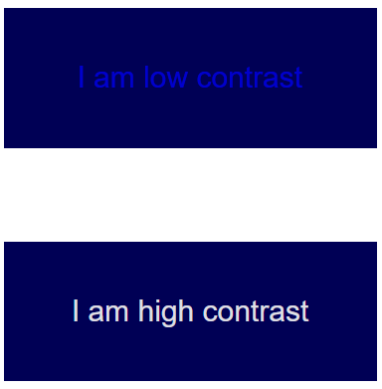
The Most Important Thing About Colors
This is what we mean by contrast
Contrast is the difference between the foreground of an element and its background
The top image would be very difficult for someone with vision impairment to read
We’ll talk about this later -- but accessibility to the web for everyone is a HUGE issue

Slide 16
The Most Important Thing About Colors
Adobe Color and Paletton (and, incidentally, the web developer tools included in all modern browsers) will provide feedback regarding the contrast between the colors you’ve chosen
It is impossible to over-emphasize the importance of color selection
Many of us don’t consider ourselves to be ‘creative’ in the sense of color selection -- these tools can help us overcome our shortcomings…

Slide 17
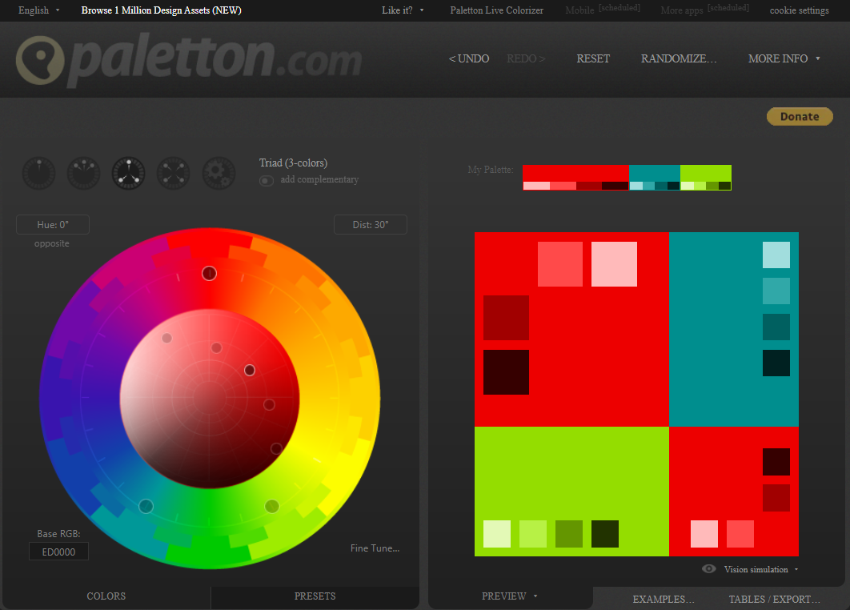
Let’s take a color sample swatch from paletton.com

Slide 18
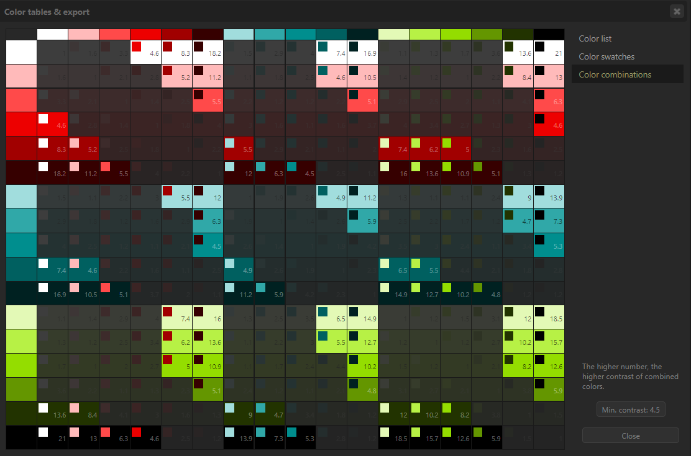
The minimum contrast accepted for accessibility is 4.5:1
Paletton.com will display the color combinations that meet this standard

Slide 19
Contrast
This, historically, has been a ticklish subject for our class
Again, a lot of us computing students don’t think in these terms
But, web development includes a lot of folks with different educational backgrounds
It is important that we all have at least some understanding of what other folks’ responsibilities are
That includes graphic design, digital media, marketing, computer science, sales, marketing, advertising, and a bunch of other stakeholders
“Stakeholder” == ANYONE who has an interest in the success of a web site

Slide 20
CSS - The Box Model
Kind of a big deal

Slide 21
The Box Model
You ever seen those Russian nesting (“Matroyska”) dolls?
The CSS Box Model is conceptually similar

Slide 22
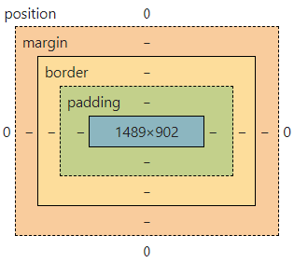
The Box Model
A very important concept in CSS
Applies to block level elements
Each is regarded as a nested box with four parts:
Margin
Border
Padding
Content

Slide 23
The Box Model
Content: The space where the element’s content is displayed
Padding: Space between a box’s border and content. Adding padding can improve readability of the content. Default = 0
Border: Wraps around the padding and content. Doesn’t include the margin . Default = 0
Margin: Area outside of the border. Can create a gap between adjacent boxes . Default = 0

Slide 24
The Box Model
By default, padding, border, and margin are 0
We can modify any or all of the three to modify the presentation of our content using CSS

Slide 25
Box Dimensions
width, height
By default, a box is sized by a browser to be just big enough to hold its content
You can explicitly set the width and height in CSS
Height doesn’t always work very well

Slide 26
The Box Model
MARGIN
PADDING
CONTENT
BORDER

Slide 27
The Box Model
MARGIN
MARGIN
PADDING
PADDING
CONTENT
CONTENT
BORDER
BORDER

Slide 28
The Box Model - Margin Collapse
MARGIN
PADDING
CONTENT
If two block-level elements are stacked one on top of the other, the distance will be whichever top or bottom margin is greatest
I.e., if the top box has a bottom margin of 25px and the bottom box has a top margin of 20px, the distance between them will be 25px
BORDER
MARGIN
PADDING
CONTENT
BORDER

Slide 29
The Box Model
So the box can be modified to visually separate one block of content from another, improving its presentation
Web design is about more than just writing code
Arranging content based on established best practices to make it attractive for visitors and thus likely to engage them in the future
Again, the concept falls under “User Experience,” or UX

Slide 30
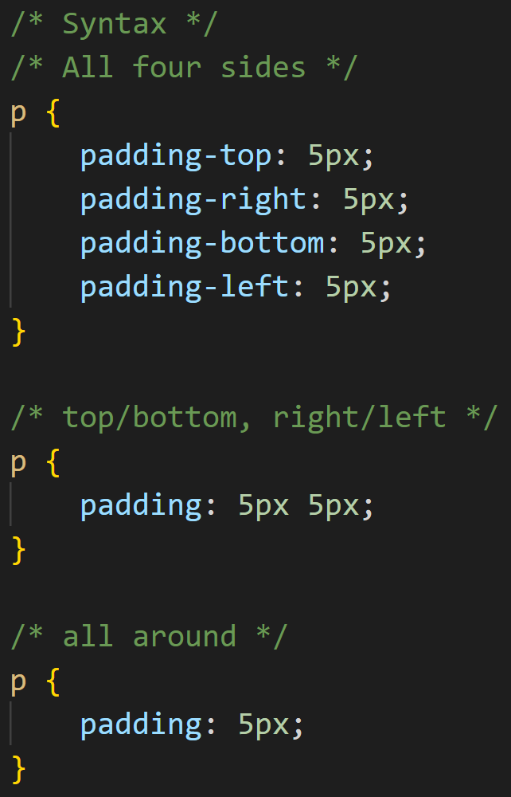
The Box Model
Padding, border, and margin can be set one of four ways:
Specifying top, right, bottom, and left values
Specifing top/bottom and right/left values
Specifying a single value that applies to top, right, bottom, and left

Slide 31
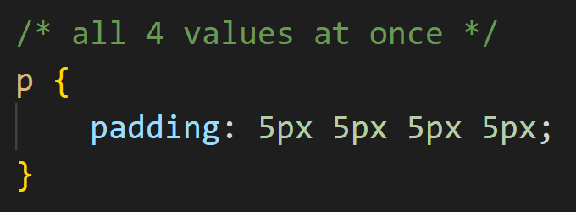
The Box Model
Padding, border, and margin can be set one of four ways:
Specifying all four on one line
The order of the values is top, right, bottom, left (clockwise, starting from the top)

Slide 32
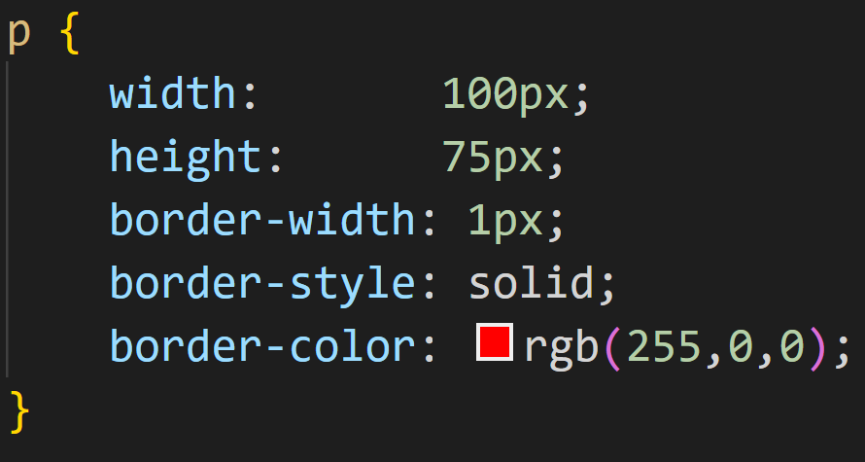
A Note about Borders
To make a border work, you have to modify three properties:
border-width border-style border-color

Slide 33
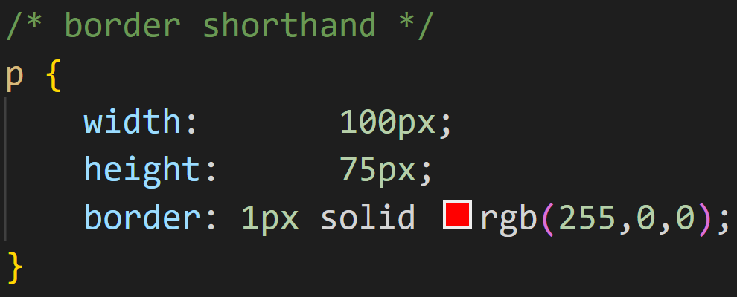
A Note about Borders
We can (I usually do) write this in shorthand
border

Slide 34
A Note about Borders
Border styles
dotted - Defines a dotted border
dashed - Defines a dashed border
solid - Defines a solid border
double - Defines a double border
groove - Defines a 3D grooved border. The effect depends on the border-color value
ridge - Defines a 3D ridged border. The effect depends on the border-color value
inset - Defines a 3D inset border. The effect depends on the border-color value
outset - Defines a 3D outset border. The effect depends on the border-color value
none - Defines no border
hidden - Defines a hidden border

Slide 35
A Note about Borders
padding and margin can be modified alone, without additional values
But border alone won’t work unless all three properties are set (actually, you can leave off border-color; it defaults to black)

Slide 36
Tables

Slide 37
Tables
Tables have also been a part of the HTML language since Day 1
Historically, tables often used in HTML for page layout and text alignment. CSS techniques now used for this
HTML tables should only be used for rendering data that belongs naturally in a grid, in other words where the data describe a number of objects that have the same properties
Tables should never be used for layout

Slide 38
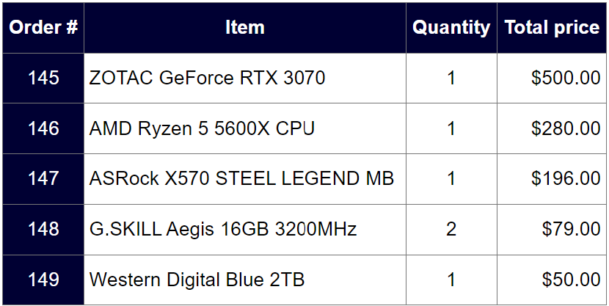
Tables
* Note: I styled this example using CSS - We’ll learn how to do that later

Slide 39
Taxonomy of tables
Row
Column
Cell
Cell
Cell
Cell
Cells merged together

Slide 40
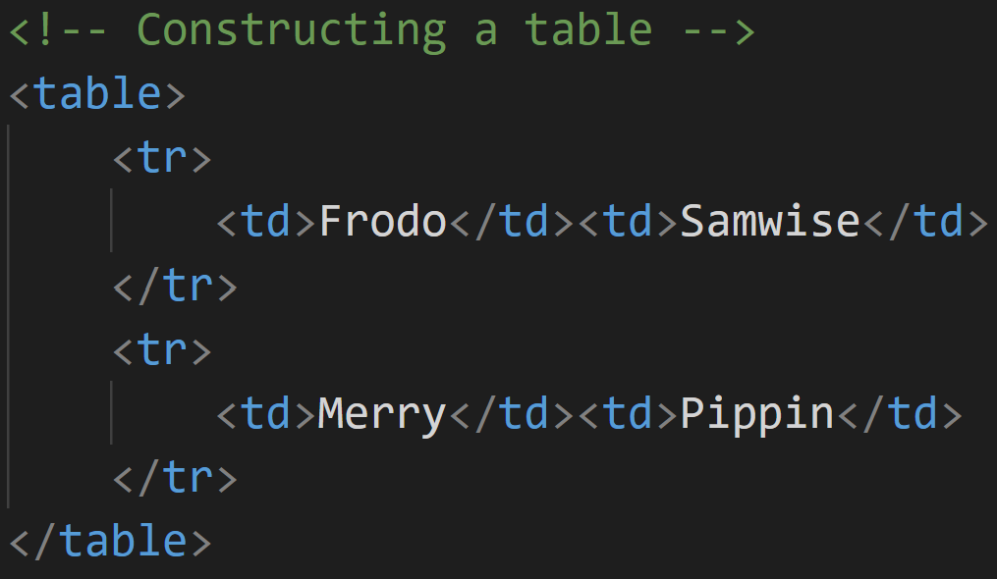
Table Tags
<table></table> beginning and end of a table
<tr></tr> (table row) beginning and end of a row
<td></td> (table data) beginning and end of a cell
Tables are laid out row by row, top to bottom, left to right

Slide 41
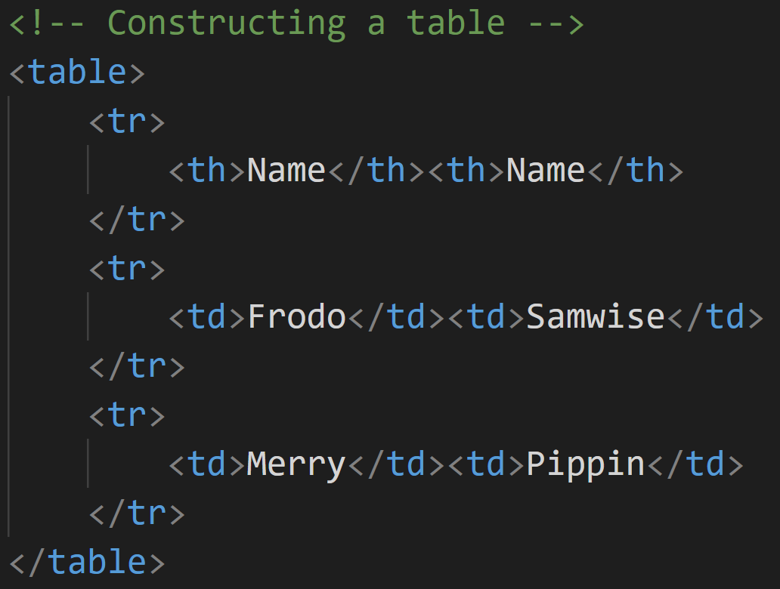
Table headings
We often want to include column headings with our tables
<th></th> (table heading) beginning and end of a table heading
By default, all major browsers display <th> as bold and center

Slide 42
Tables, programmatically (an algorithm)
Write table opening tag <table>
If there is a heading row
Write heading row opening tag <tr>
Write current header cell opening tag <th>
Write current header cell data
Write current header cell closing tag </th>
Write heading row closing tag </tr>
While there are still rows
Write current row opening tag <tr>
While there are still cells for the current row
Write current cell opening tag <td>
Enter table data
Write current cell closing tag </td>
Write current row closing tag </tr>
Write table end tag </table>
If there’s another…
If there’s another…

Slide 43
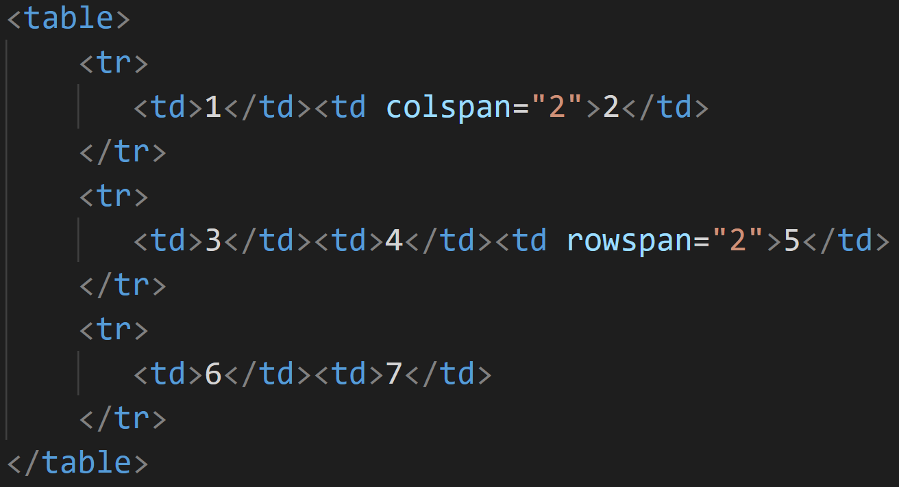
Spanning Cells
Cells can be joined using rowspan (for vertical joining) and colspan (for horizontal joining) attribute on td tag
rowspan=“n” or colspan=“n”
n represents number of rows or columns to span across

Slide 44
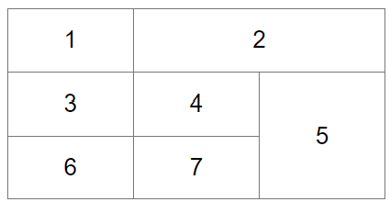
Spanning Cells

Slide 45
Spanning Cells
When writing code for a table that includes merged cells, pencil and paper can make the job easier
Remember, HTML draws tables row by row
Draw out the proposed table by hand
It may help to put <tr> tags around each row and <td> tags above each column

Slide 46
Spanning Cells
<td>
<td>
<td>
<td>
<tr>
<td>
<td colspan=“3”>
</tr>
<tr>
<td rowspan=“3”>
<td>
<td>
<td>
</tr>
<tr>
<td rowspan=“2”>
<td>
<td>
</tr>
<tr>
<td colspan=“2”>
</tr>
Later (not in this class), when you’re writing code that “writes the code” this can help. Think: Ebay -- search results are displayed in dynamically generated tables

Slide 47
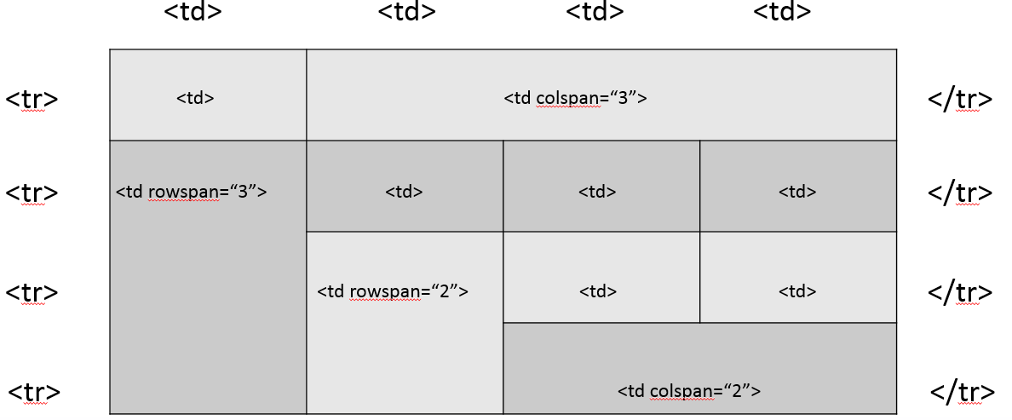
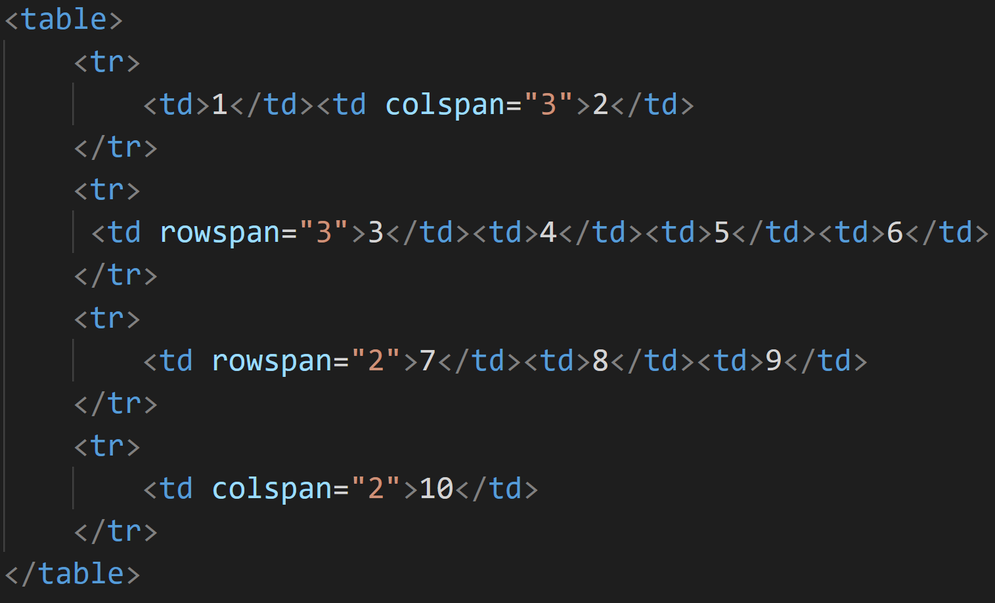
Spanning Cells
1
2
3
4
5
6
7
8
9
10

Slide 48
Spanning Cells
So, using our hand drawn diagram, the code for a complex table can easily be written
Remember, the number of cells in each row must be equal
Cells that span rows or columns have to be accounted for

Slide 49
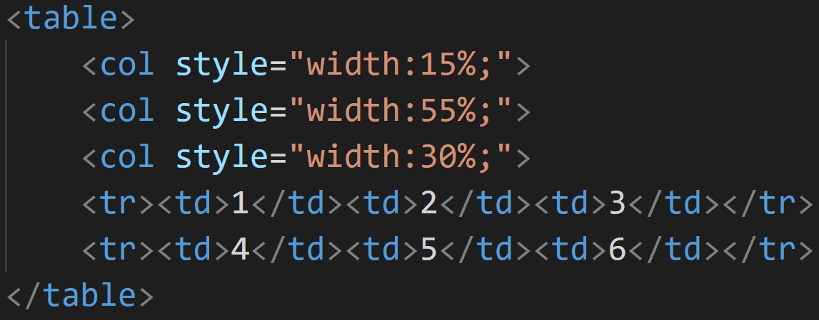
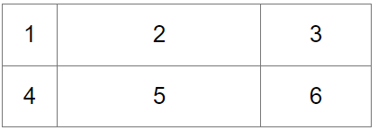
Tables – Fixing Column Width
We can fix the width of tables’ columns by using standalone tags inside the table element in the HTML with inline CSS

Slide 50
Dynamic Table-Building

Slide 51
Dynamic Tables
This is outside the scope of this class, but I want to illustrate how tables can be built dynamically
Again, think Ebay - you enter a search term, the application fetches the results from a database, and the results are displayed in a table
The table doesn’t exist until the results are back

Slide 52
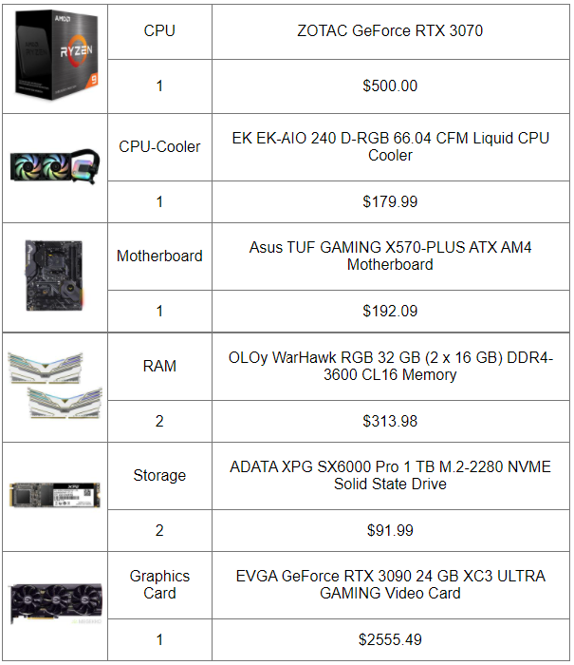
Dynamic Tables
We’ll see how this table is built (using JavaScript) when the user clicks the button

Slide 53
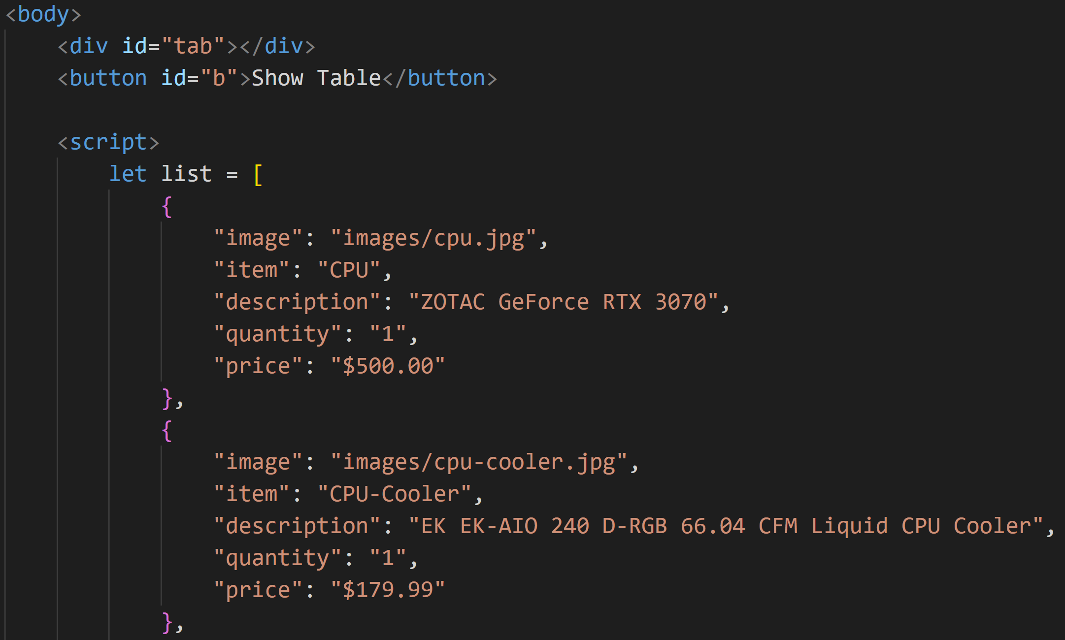
<div> starts out empty
Button
List of items (retrieved, IRL, from a database)
These are keys. Notice how they repeat (with different values) for each item

Slide 54
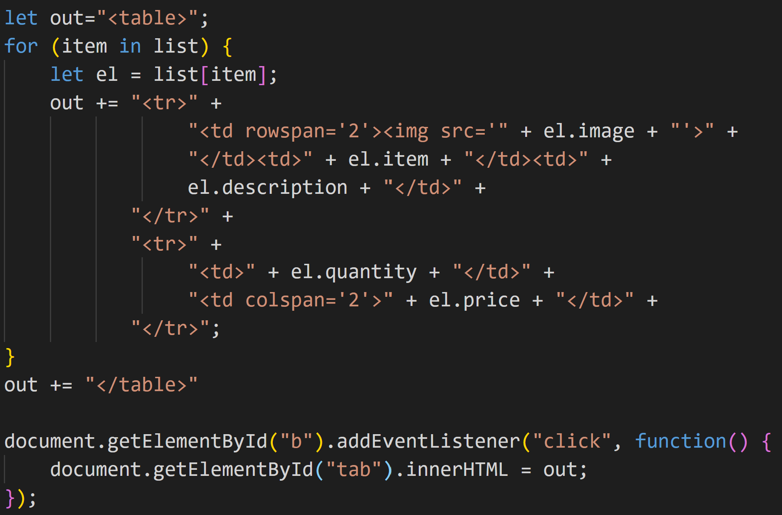
Output string (this will hold the HTML for the table)
For each item in the list
Build each pair of rows and add them to the table
When the button is clicked,
Add the code to the page

Slide 55
Dynamic Tables
We’ll see how this table is built (using JavaScript) when the user clicks the button

Slide 56
Dynamic Tables
Again, don’t feel intimidated if the last two slides read like Greek to you
The point is, a lot of what we’ll be learning this semester will form the basis for future classes (like CSCI 1720, CSCI 2910, and CSCI 3110)
A little preview can’t hurt

Slide 57
Styling Tables

Slide 58
Styling Tables
The basic, un-styled table, can be awful un-inspiring
Cells automatically adjust to the content of the widest cell in the column
No borders
No padding

Slide 59
Styling Tables
We can add styling rules to tables to make them more attractive
It’s a little more complicated, though, because of the fact that there are four elements - table, table row, table heading, and table data that comprise a table
There are actually some other table elements, but these are the ones we’re focusing on

Slide 60
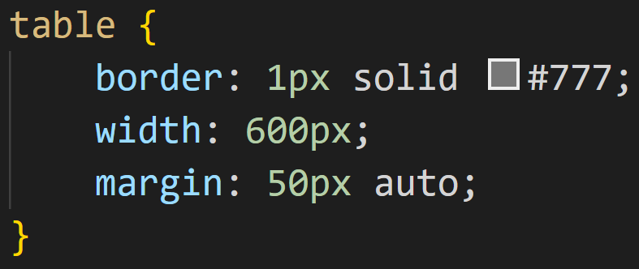
Styling Tables
Let’s start with the table element
So, we added a border. Notice, though, that the border only goes around the table, not the cells
Also, we set a width, which spaces things out more nicely
Notice the margin. When we set the left and right margins on a block element to ‘auto,’ the element will be centered in its parent container (you can’t really tell from the screenshot)

Slide 61
Styling Tables
If we want borders around the cells, also:
That’s a little better
But that “double-border” is kind of ugly
Let’s fix that
BTW, using the comma (‘,’), we can apply the same rules to multiple selectors. We’ll talk more about that later

Slide 62
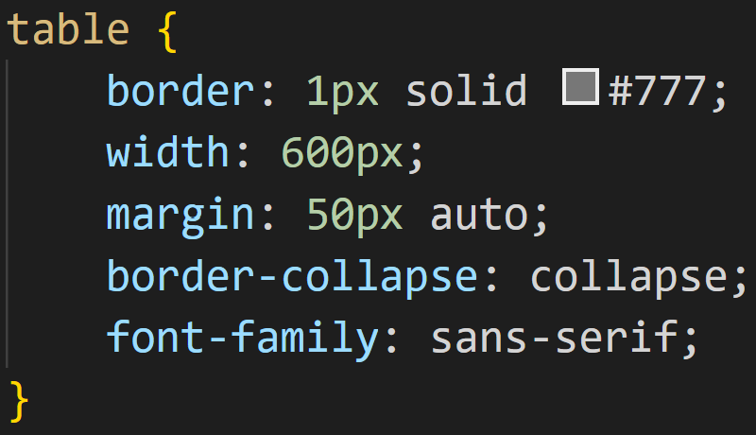
Styling Tables
Let’s fix the borders:
The border-collapse property applies to tables and, well, makes the borders collapse
I also changed the font-family to ‘sans-serif,’ well, because I kind of hate serif fonts

Slide 63
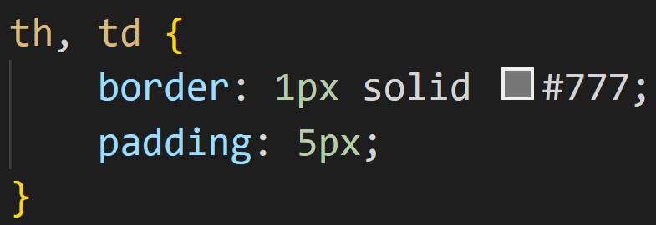
Styling Tables
Now, it looks a lot better, but things are still kind of “scrunched up.” Let’s fix that:
This is what the padding property does - remember: it adds space between the content and the border

Slide 64
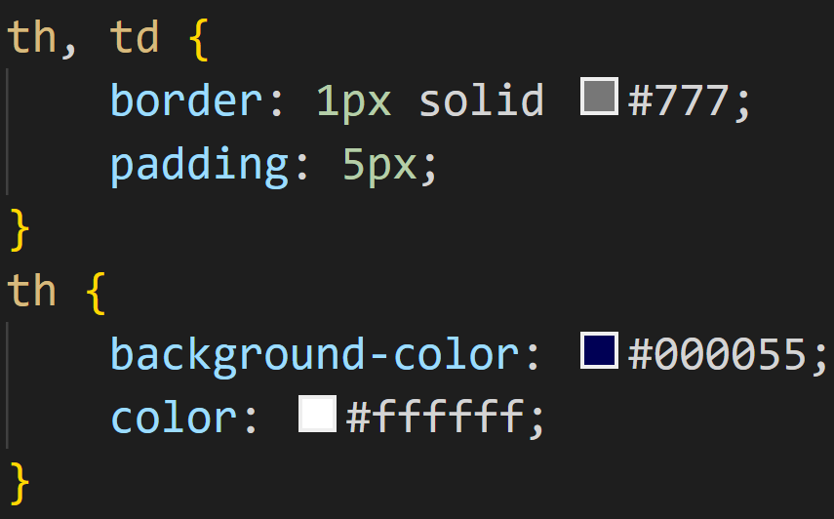
Styling Tables
How about this?
This illustrates the ‘cascading’ part of Cascading Style Sheets
We added rules that apply to both the <th> & <td> elements, then a more specific rule that applies only to <th> elements

Slide 65
Styling Tables
Now, what we’ve created so far still doesn’t look like the examples from earlier
There’s a lot more fun stuff we can do to style tables
But, I guess, that’s enough for today ☺

Slide 66
Styling Tables
How do we get from here to there?
…time will tell…

Slide 67
Questions?

Slide 68
Lecture Quiz
1. What is the most important issue with regard to color selection?
Contrast
What tools you use
Hue
Saturation

Slide 69
Lecture Quiz
2. What is contrast?
A color’s hue
A color’s saturation
How pleasing a color may be for a given user
The difference between foreground and background colors

Slide 70
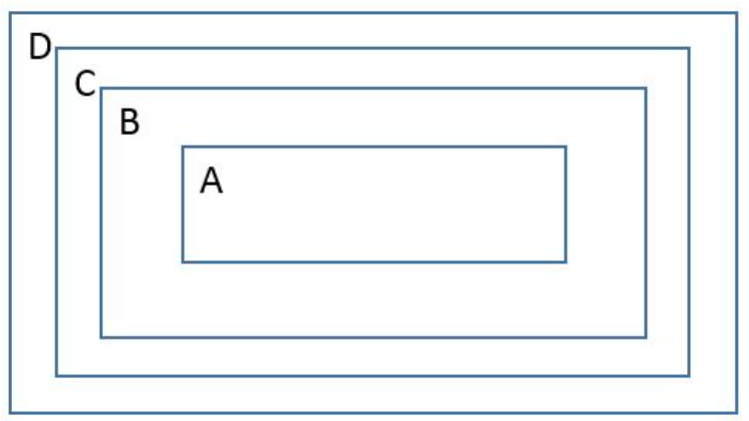
Lecture Quiz
3. CSS uses the Box Model when calculating the box properties. In the picture below, what does 'D' represent??
Content
Padding
Border
Margin

Slide 71
Lecture Quiz
4. The box model can be applied to both block and inline elements
True
False

Slide 72
Lecture Quiz
5. Tables are a relatively new element in HTML
True
False

Slide 73
Lecture Quiz
6. Which of the following is used to create a cell in a table?
<table>
<tr>
<td>
<tbody>

Slide 74
Lecture Quiz
7. Which attribute is used to create cell #5 in this table?
spancol
rowspan
colspan
spanrow

Slide 75
Lecture Quiz
8. Which of the following represents high contrast?

Slide 76
Lecture Quiz
9. If I don’t want my table to have double borders, how can I fix it?
border-collapse: collapse;
collapse-border: true;
border-collapse: true;
collapse-border: collapse;

Slide 77
Lecture Quiz
10. By default, the <th> element displays text bold and centered
True
False

Slide 78
Sources
“HTML Reference”, W3Schools, Retrieved from http://www.w3schools.com/tags/default.asp
“HTML Tables”, W3Schools, Retrieved from http://www.w3schools.com/html/html_tables.asp
“CSS Reference”, W3Schools, Retrieved from http://www.w3schools.com/cssref/default.asp
“HTML Tables – when and how to use tables in HTML”, Ben Hunt’s Web Design from Scratch, Retrieved from http://webdesignfromscratch.com/html-css/html-tables/

Slide 79
Copyrights
Presentation prepared by and copyright of John Ramsey, East Tennessee State University, Department of Computing . (ramseyjw@etsu.edu)
Microsoft, Windows, Excel, Outlook, and PowerPoint are registered trademarks of Microsoft Corporation.
IBM, DB2, DB2 Universal Database, System i, System i5, System p, System p5, System x, System z, System z10, System z9, z10, z9, iSeries, pSeries, xSeries, zSeries, eServer, z/VM, z/OS, i5/OS, S/390, OS/390, OS/400, AS/400, S/390 Parallel Enterprise Server, PowerVM, Power Architecture, POWER6+, POWER6, POWER5+, POWER5, POWER, OpenPower, PowerPC, BatchPipes, BladeCenter, System Storage, GPFS, HACMP, RETAIN, DB2 Connect, RACF, Redbooks, OS/2, Parallel Sysplex, MVS/ESA, AIX, Intelligent Miner, WebSphere, Netfinity, Tivoli and Informix are trademarks or registered trademarks of IBM Corporation.
Linux is the registered trademark of Linus Torvalds in the U.S. and other countries.
Oracle is a registered trademark of Oracle Corporation.
HTML, XML, XHTML and W3C are trademarks or registered trademarks of W3C®, World Wide Web Consortium, Massachusetts Institute of Technology.
Java is a registered trademark of Sun Microsystems, Inc.
JavaScript is a registered trademark of Sun Microsystems, Inc., used under license for technology invented and implemented by Netscape.
SAP, R/3, SAP NetWeaver, Duet, PartnerEdge, ByDesign, SAP Business ByDesign, and other SAP products and services mentioned herein as well as their respective logos are trademarks or registered trademarks of SAP AG in Germany and other countries.
Business Objects and the Business Objects logo, BusinessObjects, Crystal Reports, Crystal Decisions, Web Intelligence, Xcelsius, and other Business Objects products and services mentioned herein as well as their respective logos are trademarks or registered trademarks of Business Objects S.A. in the United States and in other countries. Business Objects is an SAP company.
ERPsim is a registered copyright of ERPsim Labs, HEC Montreal.
Other products mentioned in this presentation are trademarks of their respective owners.

