Slide 1
CSCI 1210 Essentials of Web Development
Links and Images

Slide 2
Links
CSCI 1210 Essentials of Web Development

Slide 3
Links
What makes the Web the Web
One of the things that makes the web unique is hyperlinks, or ‘links’
Changed the way consumers interact with content
No longer a linear, start-to-finish activity
Users can follow a ‘breadcrumb trail,’ jumping from site to site, or to different locations within a site to find the content they want

Slide 4
The Anchor Element
<a>
This tells the browser that whatever appears between <a> and </a> is a link to another location
By default, links are displayed blue in color and underlined

Slide 5
Links
Let’s think about this for a second
We use <a> to specify a link
That’s great
Now what?
Well, if we’re going to tell the browser to go somewhere when the user clicks on a link, it’d be nice if the browser know where it is we want the user to go

Slide 6
Where to go? -- href
This is one of the places we need to add an attribute to the opening tag
Will display like this

Slide 7
Where to go? -- href
href == “hypertext reference”
This is an HTML-speak way of saying “address”
Tells the browser where to go when the user clicks the link
Remember, we talked about attributes a couple of lectures ago
They provide the browser with additional information to make the page behave the way we want

Slide 8
href - Two types
There are two types of hypertext references -
An absolute URL - points to another web site (like href="http://www.example.com/default.html")
A relative URL - points to a file within a web site (like href="default.html")
* We can also link to an element with a specified id within the page (like href="#top")
Other protocols (like https://, ftp://, mailto:, file:, etc..)

Slide 9
href - Absolute
An absolute reference provides the entire URL to the browser
(Remember what ‘URL’ means)
The address is a unique ‘point’ on the web that doesn’t change
Easy to distinguish from relative URLs because of “http://” (or “https://”)
Any text
here

Slide 10
href - Relative
A relative reference provides the location of a resource with respect to the location of the current page
The browser starts “looking” for the requested resource at the location that the page is stored on the server
So, here, the browser will check the “labs” folder for another subfolder named “lab1” and a file named index.html
Any text
here

Slide 11
Making an Internal Link
Internal Link
Link within your own website
Relative URL may (should) be used
The pathname can be used to specify the location relative to the location of the current document

Slide 12
Navigating the File Tree
If you think of your computer’s file system as a tree, you’ll see that there are several big branches (main folders)
…smaller branches (sub-folders)
…and leaves (files)
Any of the branches can have 0, 1, or many leaves

Slide 13
Making an Internal Link
Zabc3
index.html
If the file you are linking to is:
Within the same directory:
Only the filename is necessary
Ex. Linking to MyInterests.html from index.html <a href=“myinterests.html”>My Interests</a>
myinterests.html
Homework
homework.html
HW1
HW2
Homework2.html

Slide 14
Making an Internal Link
Zabc3
index.html
If the file you are linking to is:
Within a lower directory
Pathname, including the directory will be necessary
Ex. Linking to homework2.html from homework.html
<a href=“hw2/homework2.html”>Homework 2</a>
myinterests.html
Homework
homework.html
HW1
Notice, no ‘/’ in front!
HW2
Homework2.html

Slide 15
Making an Internal Link
../
Zabc3
index.html
If the file you are linking to is:
Within a higher directory
../ must be used to “back out” of a directory
Ex. Linking to index.html from homework2.html <a href=“../../index.html”> Home </a>
myinterests.html
../
Homework
homework.html
HW1
HW2
Homework2.html

Slide 16
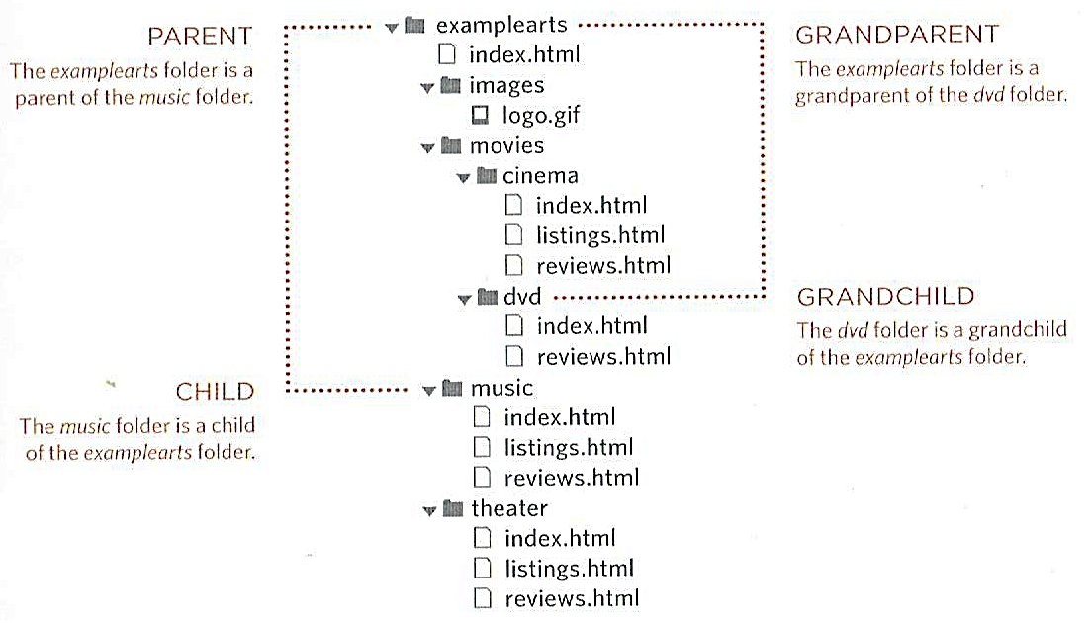
‘WEB ROOT’
LANDING PAGE
SUBFOLDERS

Slide 17
FILEZILLA PERSPECTIVE
‘WEB ROOT’
SUBFOLDERS
FILES & SUBFOLDERS

Slide 18
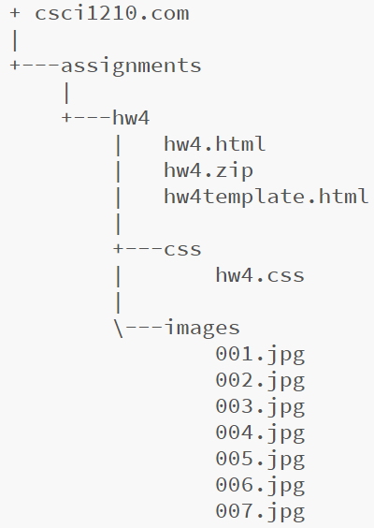
File Structure Navigation
This is the output from the DOS 'tree' command, which shows a listing of folders, subfolders, and files in each folder for a given directory.
It also illustrates how files and folders are arranged in relationship with one another

Slide 19
Making an Internal Link
Why would you want to use relative links in a website?
Why not just use all absolute links in a website?
What happens when you have to move your website?

Slide 20
Absolute vs. Relative URLs
Two reasons to use relative URLs instead of absolute
Absolute URLs can take longer (DNS lookups)
What if you have to move your site to a new provider, server, or domain?
The rule is: If you’re linking to any resource on your site, use relative URLs; Any other site, use absolute URLs

Slide 21
Making a link within a page
This will cause the user to be sent to a certain section within the same page
Naming a fragment (section)
<a name=“text”></a>
Linking to a fragment
<a href=“#text”>…</a>
Note the use of the # here

Slide 22
Making a link within a page (Example)
<a href=“#footer”>Go to bottom of page</a>
.
.
.
<p id=“footer”>This is the bottom</p>
Go to bottom of page
.
.
.
This is the bottom
Will Display

Slide 23
Mail Links
mailto: command
Allows the browser to open a new mail message addressed to the e-mail address indicated
Ex:
For mailto: to work, the client computer has to have a default email client
It isn’t used much, if at all, anymore

Slide 24
Links Summary
Provide a way for users to navigate to resources within and outside a site
HTML anchor tag, <a href=“#”>Link</a>
href = “hypertext reference”
Inside a site, use relative links
Outside a site, use absolute links
Use relative links whenever possible
Path is important

Slide 25
Images
Essentials of Web Development
CSCI 1210

Slide 26
Images
Obviously, images are an important part of the Web experience
The old saying, “A picture is worth a thousand words” is still true, as much for the Web as anywhere else
Knowing how to make a raw image suitable for use of the Web is a critical skill for a developer
First, let’s look at how to add an image to a web page
Then, we’ll see how we can take raw images from the camera to the web page

Slide 27
Images
<img>
This is a standalone, inline element
Like the <a> element, we have to provide the browser with a little additional information to make it work
Attributes:
src specifies the source or URL for the image (Required)
alt specifies alternative text (Required)
title specifies the title for the image (Optional)

Slide 28
<img> – src, alt, title
The attribute src identifies the source URL for the image.
This can be expressed as either an absolute or relative URL (and behaves in the same manor as the attribute href on the anchor tag)

Slide 29
Images – src, alt, title
The attribute alt defines the alternative text
This is important for those with visual impairments using browsers that “read” the page
In some browsers, if you hover over the image, the alternative text will appear.
Required attribute for validation
The attribute title defines a title for the image. Works similar to the alt attribute

Slide 30
Images – types of images
There are three basic formats of images: GIF
Graphics Interchange Format
Smaller File Sizes
Supports only 256 colors
Not very good for photos
Good for logos, icons, cartoons, etc
Can have transparent backgrounds
Can be animated (…and potentially annoying)

Slide 31
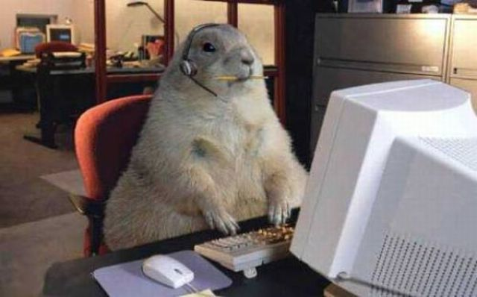
Images – types of images
There are three basic formats of images: JPG / JPEG
Joint Photographic Experts Group
Lossy Compression
Smaller file sizes
Supports 16+ million colors
Good for photos
Good (but not ideal) for logos, icons, cartoons, etc
Cannot have transparent backgrounds
Cannot be animated
34 KB
150 KB

Slide 32
Images – types of images
There are three basic formats of images: PNG
Portable Network Graphics
Lossless Compression
Larger file sizes
Supports 16+ million colors
Good for photos (can be larger file sizes vs jpg)
Good for logos, icons, cartoons, etc
Can have transparent backgrounds (PNG-24 and PNG-32)
Cannot be animated

Slide 33
Captions
<figure>
Sometimes, we want to include captions for our images
The <figure></figure> element makes this possible

Slide 34
<figcaption>

Slide 35
Image Links
Instead of using text for a link’s display, we can use an image
See here, the <img> is nested inside the anchor
We’ll do a lot of nesting in this class
Notice, also, target="_blank"

Slide 36
Image Links

Slide 37
Resolution
Resolution refers the number of pixels per inch the graphic contains
The standard resolution for the Web is 72ppi (pixels per inch). For printing a picture, the standard resolution is 300ppi
So why not use 300ppi for web graphics?
Two words:
File Size
Notes:
http://www.cnet.com/news/3-percent-of-american-adults-still-cling-to-dial-up-internet/

Slide 38
Resolution
Many users still connect through dial-up
3G/4G/5G (mobile phones) are faster, but still a lot slower than cable/fiber
“Slower” broadband (cough, cough) - Satellite
File size of images is the most significant factor in page load time
Notes:
http://www.cnet.com/news/3-percent-of-american-adults-still-cling-to-dial-up-internet/

Slide 39
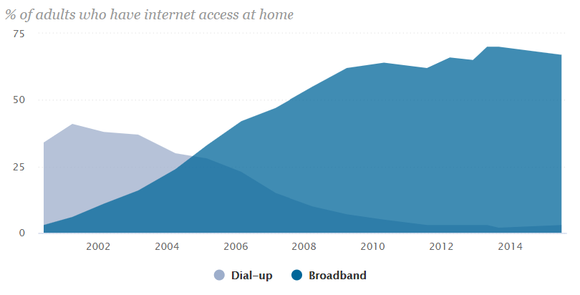
Resolution
According to a the Pew Research Center, 3% of the entire United States still connects to the world wide web via a dial-up connection. That’s more than 9.4 million Americans (https://www.pewresearch.org/internet/chart/broadband-vs-dial-up-adoption-over-time/)
Notes:
http://www.cnet.com/news/3-percent-of-american-adults-still-cling-to-dial-up-internet/

Slide 40
Resolution
Since browsers cache recently accessed files, you can save your users download time by always loading the same graphic files from the same location
Example: If we use the company logo on every page of our website, it would be better to use one logo and every page access the same logo from the same location on our server
* “cache” means that the computer stores a local copy of a downloaded file for a while so if you revisit a site, it doesn’t have to download it all over again
Notes:
http://www.cnet.com/news/3-percent-of-american-adults-still-cling-to-dial-up-internet/

Slide 41
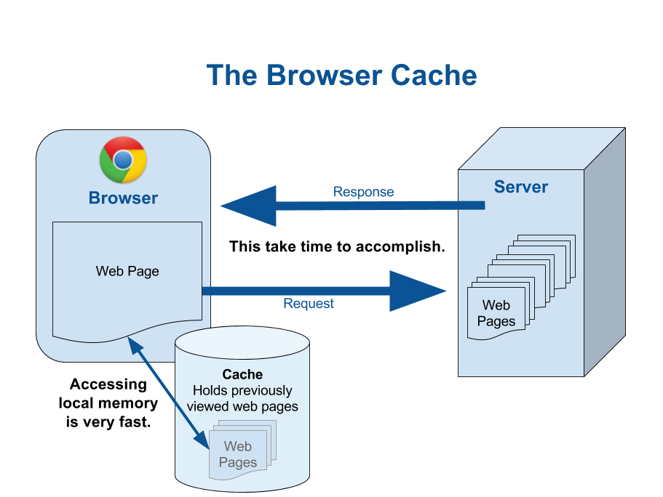
Resolution
Notes:
http://www.cnet.com/news/3-percent-of-american-adults-still-cling-to-dial-up-internet/

Slide 42
Resolution
While caching helps page load times, the files still have to be downloaded the first time the page is accessed
It’s important, then to optimize images for the Web
By ‘optimize,’ we mean edit the files so that their resulting file size is as small as possible without losing resolution
Page download times are the most important factor in overall user satisfaction with a site
Notes:
http://www.cnet.com/news/3-percent-of-american-adults-still-cling-to-dial-up-internet/

Slide 43
Photo Editing Basics

Slide 44
Photo Editors
Most cameras – even cell phone cameras – take pictures that are way too big for web pages
Such photos should be edited to reduce their size before being posted to the web
Web services such as Facebook and Instagram to this automatically when files are uploaded
Adobe - Best photo editor (not free)
GIMP - Just as good (according to users - free)

Slide 45
Optimizing Photos
Several ways
Cutting out unimportant parts
Resizing
Resolution
Dimensions
Increasing compression ratio (JPEG)

Slide 46
Welcome to GIMP
Tools
Canvas
Tool Options

Slide 47
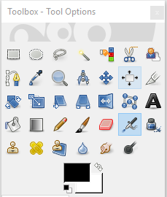
Welcome to GIMP
Lasso tool
Select tool
Crop tool
(v. 2.10.6)

Slide 48
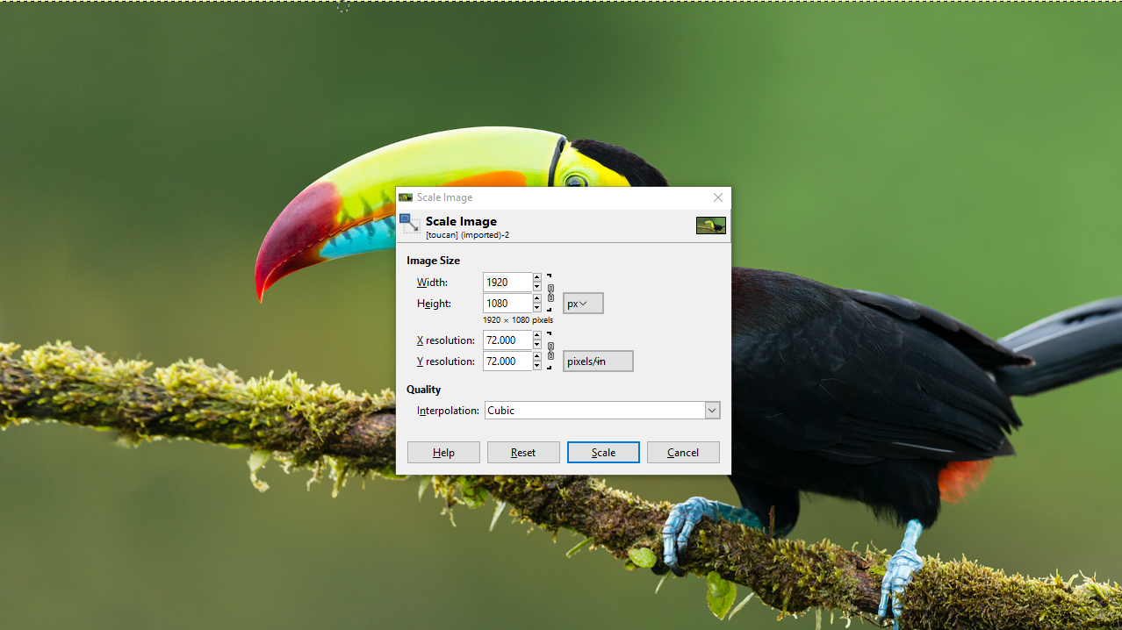
0riginal image:
Waaaaay too big!
Change to 72ppi
Image -> Scale Image

Slide 49
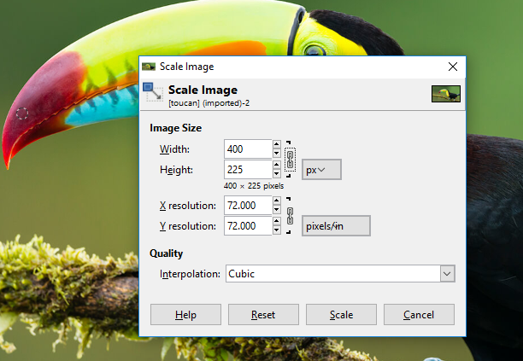

Slide 50
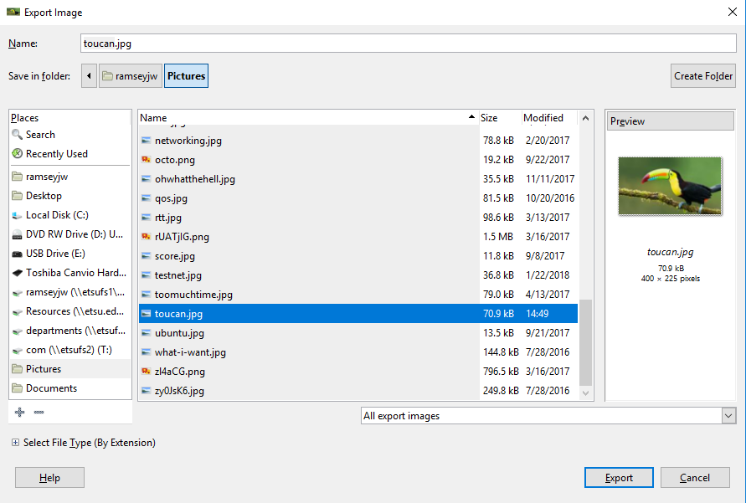
Web Images - Resizing

Slide 51
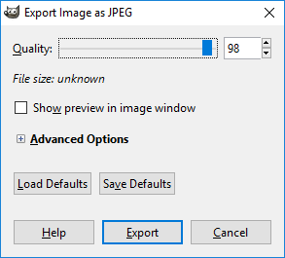
Web Images - Resizing

Slide 52
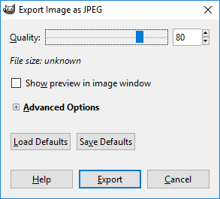
Web Images - Resizing

Slide 53
Web Images
By modifying the image’s resolution, dimensions, and compression ratio, the file size went from
552,000 bytes
to
24,000 bytes (!)
That’s 4.3% of its original file size
But still displays fine on a web page!
Very important, particularly with mobile platforms

Slide 54
Cropping
Another way to modify images, and present them more creatively, is cropping
Often, images will capture more than a photographer really wants to include
Cropping allows the photographer/image editor/web site designers to include only the content that is desired
Typically, when I frame a photo, I zoom out a little to give myself a little “wiggle room” artistically
Also, along with resizing, changing dimensions, and modifying the compression ratio, cropping will further serve to reduce file size

Slide 55
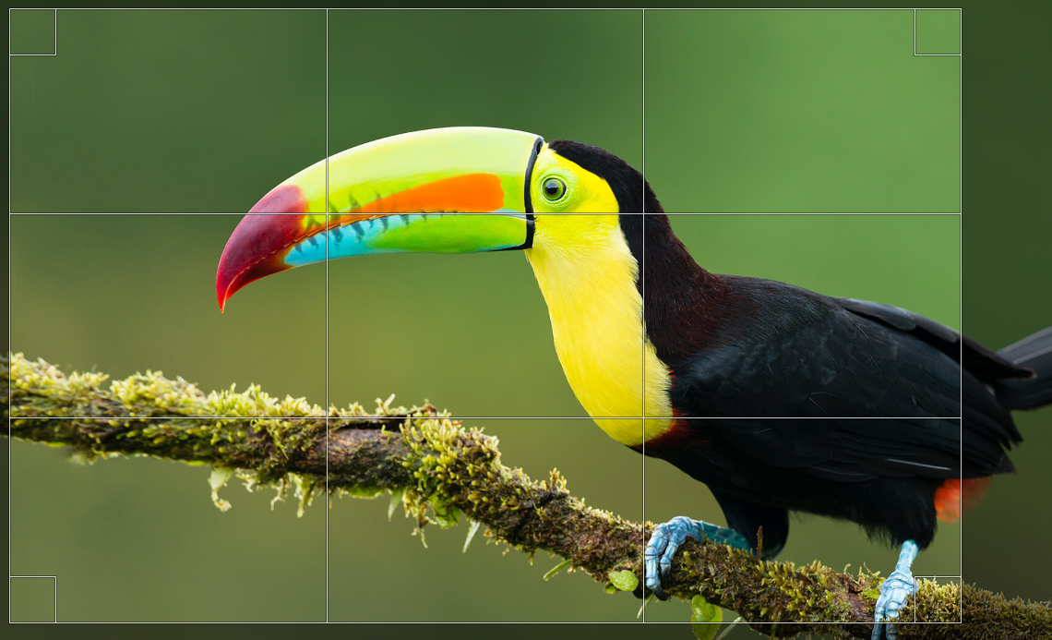
Cropping
GIMP’s cropping tool
resizing handles

Slide 56
Cropping
rule of thirds

Slide 57
Cropping
Double-click to crop – file size goes from 58M to 26M

Slide 58
Web Images - Cropping
With the same resolution, dimension, and compression, final file size: 53.7K

Slide 59
Photo Editing
We’ll cover the mechanics of resizing, cropping, and compressing images in lab
It’s much the same with Photoshop
Again, this is the bare basics of photo editing
Enough, though, for optimizing for the web

Slide 60
Web Design Lifecycle
Targeting Users & Requirements Gathering

Slide 61
Targeted Site Users

Slide 62
Users
Every well designed site has a targeted set of site users
Cannot create a site that appeals to everyone
Profile of targeted users based on site mission and goals of site owner
Define groups of targeted users to focus design
Once we know who to target, we can plan what content and design will (and won't) appeal to them
Will often create user personas to aid in planning

Slide 63
Users
Information can come from:
Customer's company marketing department
Sales / marketing employees
Existing web site analysis
Surveys and research of existing customer base
Any other ideas?

Slide 64
Creating User Profiles
What groups of people will visit this site if it is successful?
Build a set of different group profiles along with identifying elements
May want to create a persona — describing a hypothetical site user and his/her interests—for each targeted group

Slide 65
Creating User Personas
Who will visit this site?
What do they have in common?
Interests?
Goals?
Likes / dislikes?

Slide 66
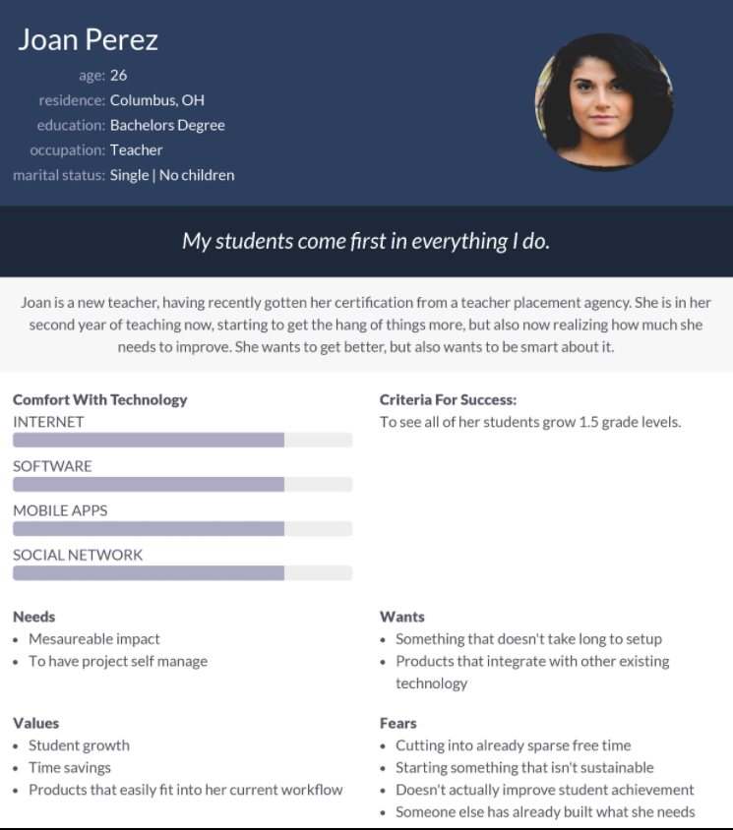
Example Persona
Notes:
http://chopsticker.files.wordpress.com/2007/09/personasample2-p1.jpg

Slide 67
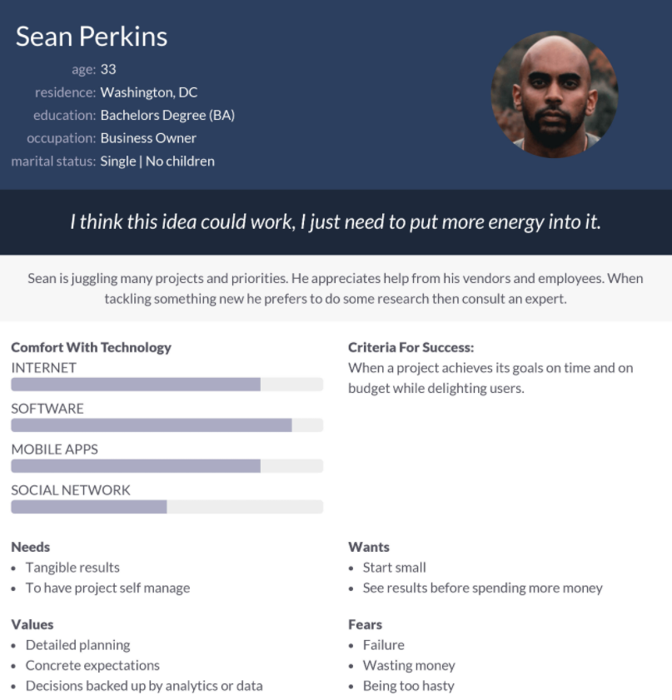
Example Persona
Notes:
http://chopsticker.files.wordpress.com/2007/09/personasample2-p1.jpg

Slide 68
User groups
Sites often exist for more than one type of user
We can group these users according to characteristics they have in common, but which distinguish them for other groups
Example - A university web site:
Faculty/staff Students Prospective students / parents Alumni

Slide 69
Site focal user groups - Common elements:
Age ranges
Gender (one dominant?)
Education level
Occupation
Hobbies and interests
Experience level—computer and/or Web
Personal goals
Equipment used (desktop, laptop, PDA, cell phone, etc.)

Slide 70
In-class Activity
You’ve contracted to design a web site for an auto parts store
What distinct groups of people might visit this site?
For each group, identify one overall characteristic/concern that distinguishes that group from others

Slide 71
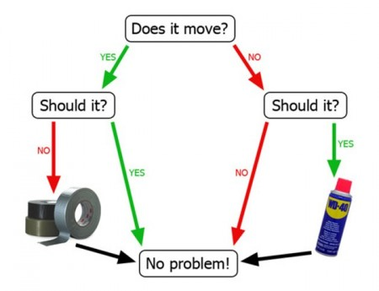
Maintenance Flow Chart

Slide 72
In-class Activity
Car parts site design—example user groups:
Professional car mechanics
Hobbyists and car enthusiasts
"Do It Yourself" car repair people
Suppliers and resellers of components

Slide 73
In-class Activity
Mechanics
Use: Search inventory by part number and availability
Major concern: Delivery speed

Slide 74
In-class Activity
Hobbyists
Use: Search by make/model/ year; getting the right part
Major concern: Getting the parts they want

Slide 75
In-class Activity
DIY
Use: Finding parts by pictures / tutorials
Major concern: Price

Slide 76
In-class Activity
Did anyone notice anything peculiar about the preceding three photographs?
That’s right! They were all male
While it is not safe to assume that no women are interested in cars or are professional mechanics, I think we can agree that it is primarily the domain of men

Slide 77
Prioritizing
Oops! Did we forget one? What about resellers?
Creating user profiles or personas helps us to know who to target (and who not to target) in our design
May be helpful to rank or prioritize different groups
Although component resellers might be interested in visiting our site, our hypothetical client is not particularly interested in dealing with them, so we're not going to incorporate them into our design. So we can omit them from the design process
Remember, the designer is not making the decisions. The designer is working with client to build user profiles and associated prioritization

Slide 78
Audience Splitting
May be possible to explicitly target different user groups and partition presentation relevant for each group.
http://www.etsu.edu

Slide 79
Benefits of Understanding Site Users
Building user personas and groups can aid in determining:
Overall tone, personality, and attitude of site
Organizational structure of site, navigation
Text, terminology/jargon, writing style
Appropriate pictures and graphics
Functional features of site

Slide 80
Requirements Gathering
Notes:
Requirements gathering is a critical skill in creating an effective website. Often, the client has a general sense of what he or she wants, but lacks knowledge about implementation details that are needed to create a successful site. It is the job of the design team to obtain, or elicit, those details from the client and other sources.

Slide 81
Requirements
Requirements: those elements that must be present in our final product to achieve success
General requirements may come from the designer, but specific requirements come from end users and customers
Notes:
Requirements are specific statements that describe elements of the final product that must be present for the product to be successful. General requirements can be identified by the designer and are generally common to all projects. But each project’s needs will be unique, or will include unique requirements that must be identified early in the design process. Requirements must be identified on behalf of the client, the site users, and other parties with an interest in the site, or stakeholders. For example, if a team was designing a website for a public education institution, knowledge of the Federal Education Rights and Privacy Act would be critical to ensure that there were no inadvertent violations of the act in the final product. In this case, the Federal Government would also be considered to be a stakeholder.

Slide 82
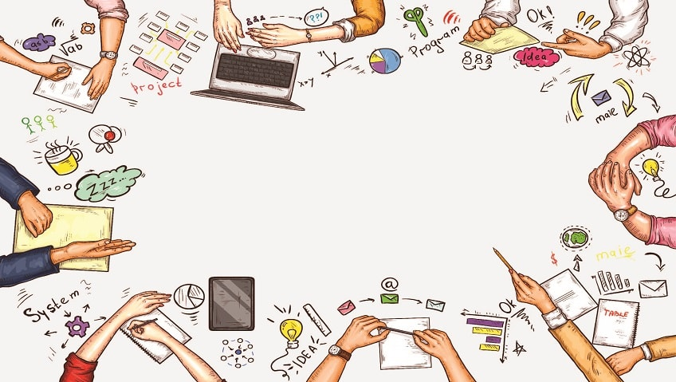
Requirements
Designer:
Site must have correct utility and be usable
My customer (site owner):
Site must allow the sale of products
Site end user:
Site must allow me to select products by browsing by color, style, product name, or size
Notes:
Requirements are specific statements that describe elements of the final product that must be present for the product to be successful. General requirements can be identified by the designer and are generally common to all projects. But each project’s needs will be unique, or will include unique requirements that must be identified early in the design process. Requirements must be identified on behalf of the client, the site users, and other parties with an interest in the site, or stakeholders. For example, if a team was designing a website for a public education institution, knowledge of the Federal Education Rights and Privacy Act would be critical to ensure that there were no inadvertent violations of the act in the final product. In this case, the Federal Government would also be considered to be a stakeholder.

Slide 83
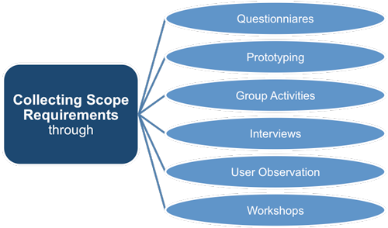
User Requirements Elicitation
Requirements Analysis: process used to learn and understand the needs of our targeted users
What do they need/want to do?
Requirements Elicitation: discovering requirements by communicating with end users and others
User Task Analysis: determining how a requirements can best be implemented and supported in a design
Begin by determining what functionality needs to be supported. Then consider how it should be presented and accomplished
Notes:
The process used to learn and understand the needs of a site’s users is requirements analysis. Requirements analysis includes requirements elicitation - communicating with end users, clients, and other stakeholders to discover what is required for a successful product. There are a variety of tasks that can be used to elicit requirements. Another component of requirements analysis is user task analysis - the determination of how the requirements, once identified, can best be implemented and supported by the site’s design. Thus, designers must first determine what functionality must be present in the site’s implementation. Then they have to determine how that functionality should be implemented.

Slide 84
Requirements Elicitation
Designers do not determine site requirements, they gather requirements specified by others
Comes from meeting with clients and end users (when possible), and asking specific questions
Requires effort on the designers’ part to learn requirements through skillful use of questions
Customer may say “I want an online store” but there are many different kinds and design alternatives
Users must be guided in the process of stating their requirements. They generally will not have thought through this in advance
Notes:
If you meet with a group of users and simply ask "What do you want?" you'll likely get some general information that may be helpful. (Top of mind information) The key to getting truly useful information is asking probing questions that force the customer to further reflect and consider. This can be considered as much art as science. Thorough knowledge of web design and implementation, coupled with experience, enables the designer to ask more pointed questions, or “drill down” to find out the specific information they need to meet the needs of all of the project’s stakeholders.

Slide 85
Requirements Elicitation Techniques
Interviews and questionnaires
Ask specific questions to determine wants/needs
"What do you want?" may elicit general requirements, but detailed questions needed
Brain storming sessions
Meet with groups and discuss ideas and variations
Notes:
There are several techniques that can be employed to elicit requirements. Some of the more popular techniques include interviews and questionnaires; brain storming sessions; storyboards; role playing; and prototyping. Prototyping, in particular, plays a valuable role in the design process. In its initial stages, the designer is trying to determine the client’s wishes with regard to site organization, appearance, and navigation, not specific content. A series of well-prepared drawings can quickly and efficiently accomplish this instead of wasting a lot of coding time producing a more limited set of options, which may well all prove to be unsatisfactory to the client. Requirements elicitation can be an iterative process, meaning that you have to repeat the steps several times before the client is satisfied. Bear in mind also, your client is probably also a busy person, and scheduling lengthy meetings to interview or brainstorm may prove to be a challenge. This is particularly true in the event that the client doesn’t really know much about the design process and doesn’t understand the need for all the questions you’re asking. “Can’t you just make me a site? Everybody else has one!”

Slide 86
Requirements Elicitation Techniques
Storyboards
Diagram alternatives; discuss pros/cons and changes
Role playing
Walk through particular requirement
Prototyping
Produce rough drafts of potential "solutions" for examination
Notes:
There are several techniques that can be employed to elicit requirements. Some of the more popular techniques include interviews and questionnaires; brain storming sessions; storyboards; role playing; and prototyping. Prototyping, in particular, plays a valuable role in the design process. In its initial stages, the designer is trying to determine the client’s wishes with regard to site organization, appearance, and navigation, not specific content. A series of well-prepared drawings can quickly and efficiently accomplish this instead of wasting a lot of coding time producing a more limited set of options, which may well all prove to be unsatisfactory to the client. Requirements elicitation can be an iterative process, meaning that you have to repeat the steps several times before the client is satisfied. Bear in mind also, your client is probably also a busy person, and scheduling lengthy meetings to interview or brainstorm may prove to be a challenge. This is particularly true in the event that the client doesn’t really know much about the design process and doesn’t understand the need for all the questions you’re asking. “Can’t you just make me a site? Everybody else has one!”

Slide 87
Types of Requirements
Specific requirements tie to functional demands or design attributes of the site
“Our company color is royal blue; we’d like that to be featured in the design” “We’d like site visitors to be able to chat with technical support via our site”
General requirements can be derived from attributes of and knowledge of our targeted users
Since AARP site visitors are mostly older-aged, “flashy” presentation not valued Color contrast is important for readability Larger text
Notes:
There are several techniques that can be employed to elicit requirements. Some of the more popular techniques include interviews and questionnaires; brain storming sessions; storyboards; role playing; and prototyping. Prototyping, in particular, plays a valuable role in the design process. In its initial stages, the designer is trying to determine the client’s wishes with regard to site organization, appearance, and navigation, not specific content. A series of well-prepared drawings can quickly and efficiently accomplish this instead of wasting a lot of coding time producing a more limited set of options, which may well all prove to be unsatisfactory to the client. Requirements elicitation can be an iterative process, meaning that you have to repeat the steps several times before the client is satisfied. Bear in mind also, your client is probably also a busy person, and scheduling lengthy meetings to interview or brainstorm may prove to be a challenge. This is particularly true in the event that the client doesn’t really know much about the design process and doesn’t understand the need for all the questions you’re asking. “Can’t you just make me a site? Everybody else has one!”

Slide 88
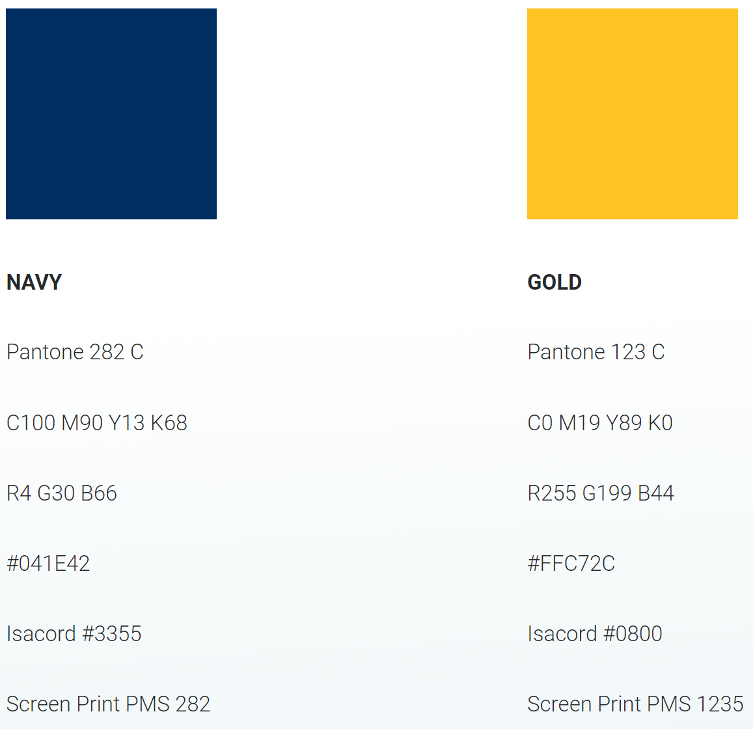
Types of Requirements
These are ETSU’s official colors
Notes:
There are several techniques that can be employed to elicit requirements. Some of the more popular techniques include interviews and questionnaires; brain storming sessions; storyboards; role playing; and prototyping. Prototyping, in particular, plays a valuable role in the design process. In its initial stages, the designer is trying to determine the client’s wishes with regard to site organization, appearance, and navigation, not specific content. A series of well-prepared drawings can quickly and efficiently accomplish this instead of wasting a lot of coding time producing a more limited set of options, which may well all prove to be unsatisfactory to the client. Requirements elicitation can be an iterative process, meaning that you have to repeat the steps several times before the client is satisfied. Bear in mind also, your client is probably also a busy person, and scheduling lengthy meetings to interview or brainstorm may prove to be a challenge. This is particularly true in the event that the client doesn’t really know much about the design process and doesn’t understand the need for all the questions you’re asking. “Can’t you just make me a site? Everybody else has one!”

Slide 89
In Class Exercise
You've been hired by Super Toyland Toy Store to create their new site. The customer has arranged for you to meet with a group of people who regularly shop in their physical store
What questions would you ask at this meeting to learn about these customers and their requirements? After the meeting with the customers you have a meeting scheduled with representatives of Super Toyland management to discuss the site
Work with a couple of neighbors to create a list of at least 4 questions for each of the meetings
Notes:
Customers:
Why do you shop at Super Toyland?
What other toy stores do you shop?
Have you shopped other toy store web sites? What things did you like/dislike?
When you enter Super Toyland do you typically go to just one section of the store or do you browse several sections? Where do you go?
Management:
Why do you want a web site for Super Toyland?
Have you examined the web sites of your competitors? What things do you like/dislike?

Slide 90
Requirements vs. Site Mission Statement
Occasionally stated requirements may conflict with site mission statement
Can the requirement be met in a manner consistent with the mission statement?
Client/site owner must be made aware of conflict so they can decide how conflict will be handled
Notes:
Example of conflict: End users want site to notify them when a product goes on sale so they don't have to visit the site daily. Site mission says that a goal of the site is to entice users to visit daily.
Solution? Send customer emails about sales (if they opt in) but don't include all sale items so they still must visit site to check on particular products of interest.

Slide 91
Questions

Slide 92
Lecture Quiz
1. Which element do we use to create a link?
<href>
<a>
<img>
<link>

Slide 93
Lecture Quiz
2. How are links displayed by default?
Like this
Like this
Like this
Like this

Slide 94
Lecture Quiz
3. Which two attributes are required for an <img> element?
src & alt
src & title
title & figcaption
alt & title

Slide 95
Lecture Quiz
4. Images can be used in place of text for hyperlinks
True
False

Slide 96
Lecture Quiz
5. Which image format is most likely being used for the following image?
.bmp
.jpg
.svg
.gif

Slide 97
Lecture Quiz
6. Designers determine specific requirements
True
False

Slide 98
Lecture Quiz
7. A site mission statement is usually identical to an organization’s mission statement
True
False

Slide 99
Lecture Quiz
8. What instrument/technique can we use to understand our site's users?
Persona
Surveys / research
Client’s marketing/sales department
All of the above

Slide 100
Lecture Quiz
9. Which of the following is a user characteristic we would want to identify as we build personas?
Age ranges
Gender (one dominant?)
Education level
Occupation
Hobbies and interests
Experience level—computer and/or Web
Personal goals
Equipment used (desktop, laptop, PDA, cell phone, etc.)
All of the above

Slide 101
Lecture Quiz
10. What does the target="_blank" attribute/value pair do?
Makes a page launch in a new tab
Overwrites the current page with a new one
Nothing. target="_blank" is deprecated and no longer used

Slide 102
Sources
“HTML Reference”, W3Schools, Retrieved from http://www.w3schools.com/tags/default.asp
“HTML Tables”, W3Schools, Retrieved from http://www.w3schools.com/html/html_tables.asp
“CSS Reference”, W3Schools, Retrieved from http://www.w3schools.com/cssref/default.asp
“HTML Symbols”, W3Schools, Retrieved from http://www.w3schools.com/html/html_symbols.asp
Kooser, A. “3 percent of American adults still cling to dial-up Internet”, W3Schools, August 2013, Retrieved From http://www.cnet.com/news/3-percent-of-american-adults-still-cling-to-dial-up-internet/

Slide 103
Copyrights
Presentation prepared by and copyright of John Ramsey, East Tennessee State University, Department of Computing . (ramseyjw@etsu.edu)
Microsoft, Windows, Excel, Outlook, and PowerPoint are registered trademarks of Microsoft Corporation.
IBM, DB2, DB2 Universal Database, System i, System i5, System p, System p5, System x, System z, System z10, System z9, z10, z9, iSeries, pSeries, xSeries, zSeries, eServer, z/VM, z/OS, i5/OS, S/390, OS/390, OS/400, AS/400, S/390 Parallel Enterprise Server, PowerVM, Power Architecture, POWER6+, POWER6, POWER5+, POWER5, POWER, OpenPower, PowerPC, BatchPipes, BladeCenter, System Storage, GPFS, HACMP, RETAIN, DB2 Connect, RACF, Redbooks, OS/2, Parallel Sysplex, MVS/ESA, AIX, Intelligent Miner, WebSphere, Netfinity, Tivoli and Informix are trademarks or registered trademarks of IBM Corporation.
Linux is the registered trademark of Linus Torvalds in the U.S. and other countries.
Oracle is a registered trademark of Oracle Corporation.
HTML, XML, XHTML and W3C are trademarks or registered trademarks of W3C®, World Wide Web Consortium, Massachusetts Institute of Technology.
Java is a registered trademark of Sun Microsystems, Inc.
JavaScript is a registered trademark of Sun Microsystems, Inc., used under license for technology invented and implemented by Netscape.
SAP, R/3, SAP NetWeaver, Duet, PartnerEdge, ByDesign, SAP Business ByDesign, and other SAP products and services mentioned herein as well as their respective logos are trademarks or registered trademarks of SAP AG in Germany and other countries.
Business Objects and the Business Objects logo, BusinessObjects, Crystal Reports, Crystal Decisions, Web Intelligence, Xcelsius, and other Business Objects products and services mentioned herein as well as their respective logos are trademarks or registered trademarks of Business Objects S.A. in the United States and in other countries. Business Objects is an SAP company.
ERPsim is a registered copyright of ERPsim Labs, HEC Montreal.
Other products mentioned in this presentation are trademarks of their respective owners.

