Slide 1
Intro To HTML & Formatting, Part 2
CSCI1210
Essentials of Web Design

Slide 2
HTML Elements
Defining document structure
HTML has a lot of elements that are defined to create documents for the web

Slide 3
Why do we need different elements?
  Written Language
  Written text, in any language, includes rules and conventions for constructing documents so that they effectively present their content
  In the English language, our documents can include articles, sections, asides, headings, lists, tables, images, and so on that are used to arrange the document's information in a logical fashion that conveys meaning to the reader
  We can drill down further with paragraphs, each of which consists of one or more sentences

Slide 4
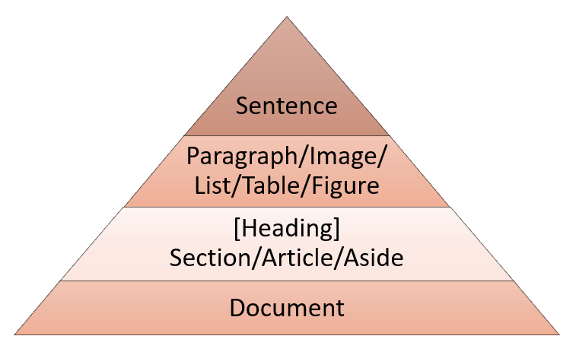
Why do we need different elements?

Slide 5
Inline Elements
Elements we can apply at the ‘sentence level’
We call these ‘sentence level’ elements Inline Elements
These elements modify content within a sentence (or sentences) without breaking it/them up

Slide 6
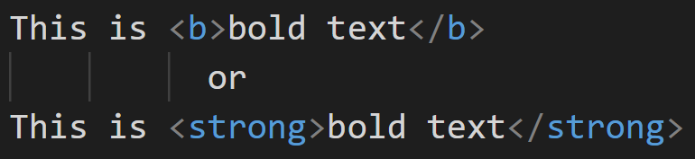
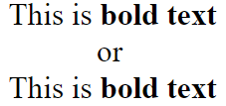
<b> / <strong>
Modifies text, making it appear bold

Slide 7
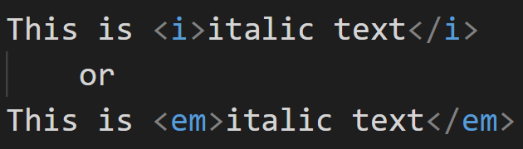
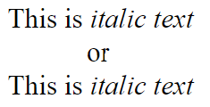
<i> / <em>
Modifies text, making it appear italic

Slide 8
Inline Elements
<a>
<abbr>
<acronym>
<button>
<cite>
<code>
<img>
<input>
<kbd>
<label>
<q>
<script>
<select>
<span>
<sub>
<sup>
<textarea>

Slide 9
The Flow
We’ll see, when we start with CSS, that we can modify the default appearance of each of these elements to suit our needs
These elements, however, provide us with a way to modify the structure of a document as well as its appearance
The big takeaway here is that they are structural elements that don’t break the flow of the document
When the document is rendered by a browser, it starts in the upper left corner and ‘flows’ across the display until it reaches its right edge
It then starts at the beginning of the next line, and so on, rendering the document line-by-line

Slide 10
Paragraph
              <p>…</p>
  The first of these elements we’re going to talk about, appropriately enough, is the paragraph element - <p>
  As with writing, a paragraph consists of one or more sentences
  Using HTML, other elements can be included inside the paragraph element, but it usually consists of text (and inline elements) only
  They ‘break the flow’ of the document’s rendering, reset the cursor at the beginning of the next line, add whitespace, display, and add more whitespace

Slide 11
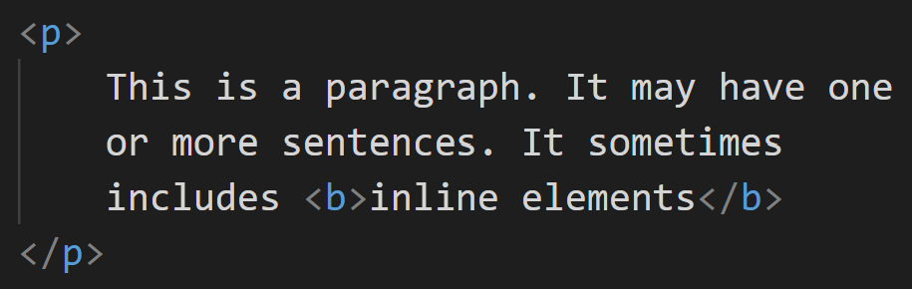

<p>

Slide 12
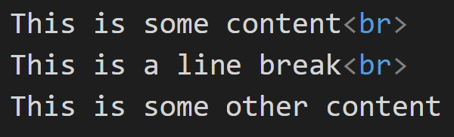

<br> (or <br />)
  Standalone (void) element
  Causes a line break, with no extra space
  Equivalent to hitting the return key once

Slide 13
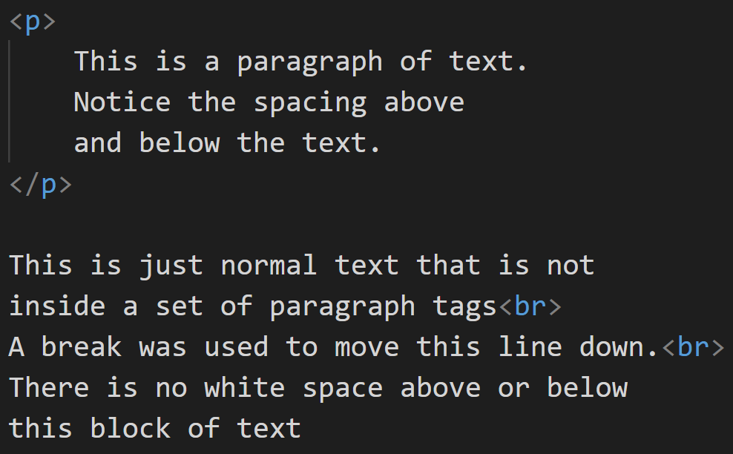
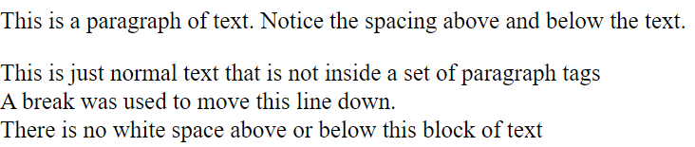
Paragraph vs Break Example
Spacing above and below
the paragraph
Only a break tag was
used here, so no
spacing above and below

Slide 14
<hr> (or <hr />)
Standalone element
Inserts a horizontal line in the document
Used to separate sections of text

Slide 15
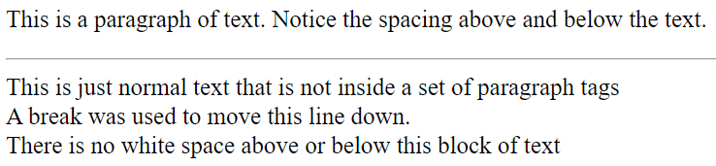
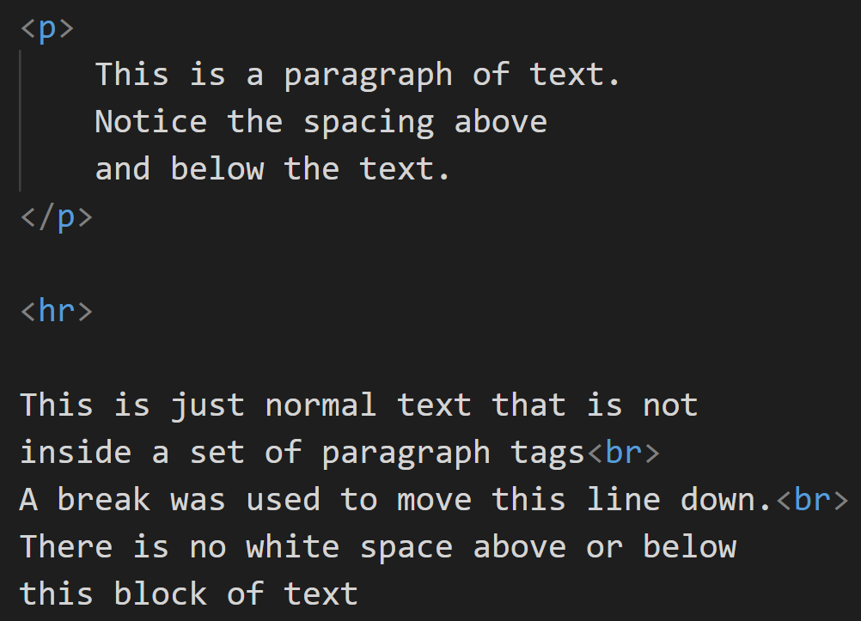
<hr>
The <hr> element inserted a horizontal line. We will learn how to change the look and size of the horizontal line when we learn CSS.
The <hr > element is a standalone (or void) element

Slide 16
What’s with the slash (/)?
<br /> <hr />
This is an old convention that’s still valid
It dates back to the old XHTML standard
Either is OK, but I usually omit the slash
Visual Studio Code still defaults to the slash, when you use autocomplete

Slide 17
<h1> <h2> <h3> <h4> <h5> <h6>
  Causes text in between to be displayed as formatted headings
  1 is the largest, 6 is the smallest
  Logically groups related content
  Will create a blank line after the heading
  Makes the text bold as well as resizing it
  <h3> is about the default font size

Slide 18
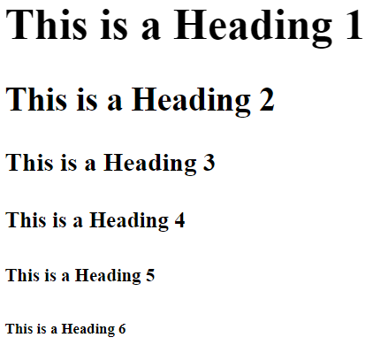
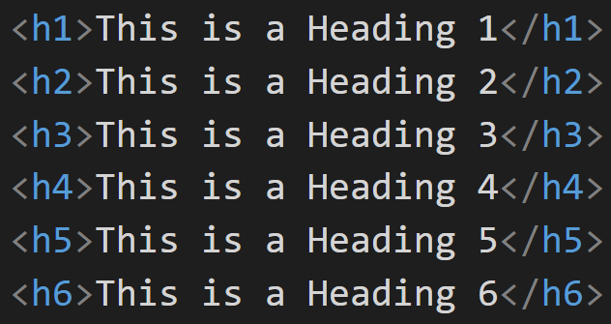
<h1> <h2> <h3> <h4> <h5> <h6>
Anything below h3 (h4-h6) is usually smaller than regular text and rarely used. Most of the time, a heading is used to make the text larger and bold.
Notice the spacing above and below each heading. Also, it is automatically resized and bolded.

Slide 19
<blockquote>
Will indent the left (and sometimes right, depending on the browser) margin for longer blocks of quoted text

Slide 20
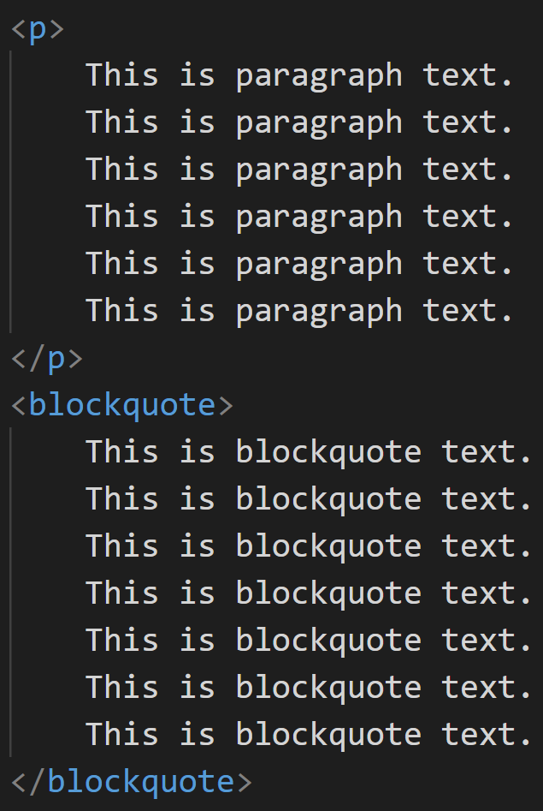
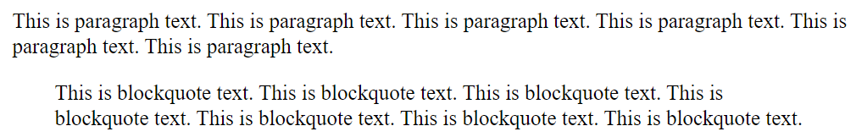
Blockquote Example
Notice the indenting from both the left and right margin for the text that is inside the blockquote tags.

Slide 21


Special Characters
To include special characters (like ©, ã, Δ, and so on) in an HTML document you must use character codes
Character codes always begin with & and end with ;
    http://www.tntluoma.com/sidebars/codes/
Example codes:
    < = &lt; or &#60;
    > = &gt; or &#62;
  Example: To output <p> as part of output, you cannot put <p> in your code
  You must instead use:

Slide 22
Special Characters
If you want to insert several spaces, you cannot just press the space bar several times (it will insert space in the code, but remember that the browser will ignore extra spaces. To do this you must use the code
&nbsp;
This stands for non-breaking space. Putting several of these in a row will give you several spaces in the output on the page
  Example: &nbsp; &nbsp; &nbsp; &nbsp; &nbsp; would give you 5 spaces on the page in the browser

Slide 23
More Special Characters
Some common special characters
Quotation Mark &quot;
Copyright Symbol &copy;
Ampersand &amp;
Less Than Symbol &lt;
Greater Than Symbol &gt;
Empty Space &nbsp;
For more: http://www.w3schools.com/html/html_symbols.asp

Slide 24
Going Bigger
Thinking back to our pyramid, paragraphs (and related elements) are usually contained by larger elements
Primary among these is the <div> element
<div> is the ‘workhorse’ of HTML document structure
There are others - derivatives of <div> - that we’ll talk about later

Slide 25
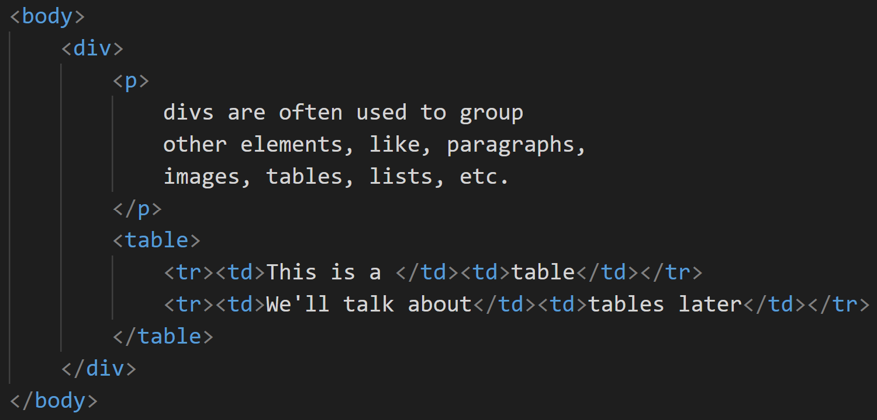
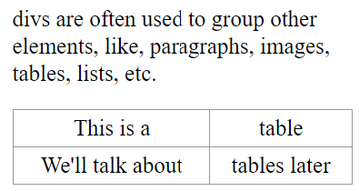
<div>

Slide 26
Lists

Slide 27
Lists
We love our lists!
Shopping lists, to-do lists, ingredients lists, pros/cons - many data types are best presented in this format
Lists have been part of HTML since Day 1
From a design perspective, it’s better to use a list, when possible, instead of a long paragraph
Remember: Users typically scan web pages for information, rather than reading start to finish

Slide 28
Formatting Text using Lists
There are 3 types of lists:
  Ordered (numbered)
  Unordered (bulleted)
  Definition (terms & definitions)
    This list is somewhat different…mainly because it doesn’t really look like a “list”. It is mainly used to achieve indenting of one line underneath another line since there is no tag that does that
These two are what you think of as normal lists.
They work similar to lists that you would create
in a Word document

Slide 29
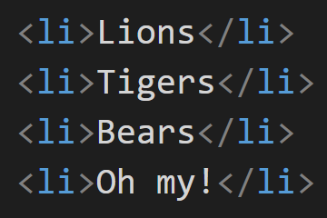
Formatting Text using Lists
Individual items in a list are inserted using a List Item tag.
<li>…</li>
Every list consists of one or more list items
A single-item list wouldn’t be much use, though
List items are nested inside the outer list element

Slide 30
<ol>
Ordered List
  Automatically inserts a number before each item (YOU DO NOT TYPE IT YOURSELF)
  Indented
  Each item must be contained in a List Item tag

Slide 31
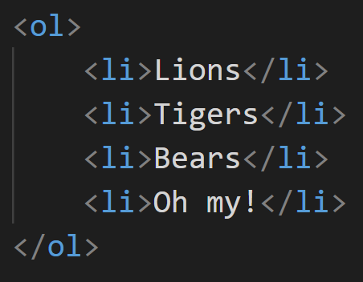
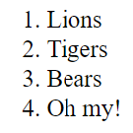
<ol>

Slide 32
<ol>
Attributes:
  type = “1 or A or a or I or i” (e.g., <ol type=“A”>)
    1 – numbers
    A – uppercase letters
    a – lowercase letters
    I – uppercase roman numerals (this is a capital i)
    i – lowercase roman numerals

Slide 33
<ol>
Attributes:
  start=“n” <e.g., <ol start=“5”>
    n is some number representing the number or letter to begin numbering the list with
    Ex. if start=“3” was used, it would start numbering at 3, or C, or c, or iii or III depending on the type that was chosen

Slide 34
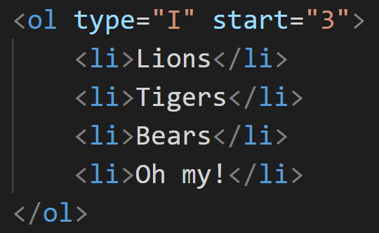
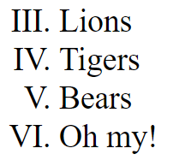
<ol>

Slide 35
<ul>
Often, the order of the list items doesn’t matter
In this case, we usually use a bulleted list
In HTML-speak, we call this an Unordered List
Unordered lists are defined with the <ul> element

Slide 36
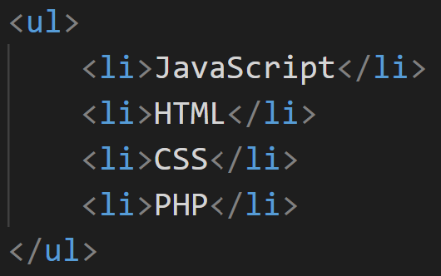
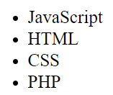
<ul>

Slide 37
Formatting Text using Lists
Attribute:
  type=“disc or circle or square” (e.g., <ul type=“circle”>)
  Specifies the bullet type
  Disc is usually the default (meaning if you don’t specify a type, it will automatically use disc)

Slide 38
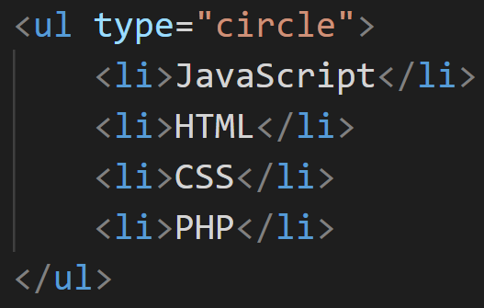
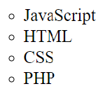
<ul>

Slide 39
<dl>
Definition lists are a little different - they have two ‘list item’ elements
Dictionary Term
  <dt>…</dt>
  displayed on left margin
Dictionary Definition
  <dd>…</dd>
  indented from left

Slide 40
<dl>
Used for lists of words with blocks of descriptive text
  But most commonly used when you want to indent a line of text underneath another line (because there is no tag that will simply indent or tab over)
  Ex.
  Contact Us
  (423) 123-4567

Slide 41
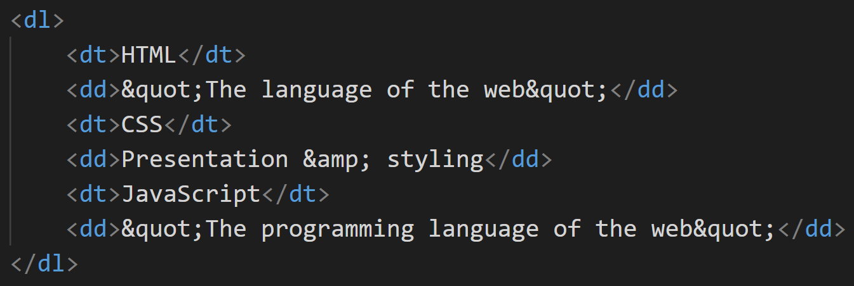
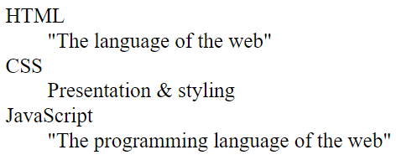
<dl>

Slide 42
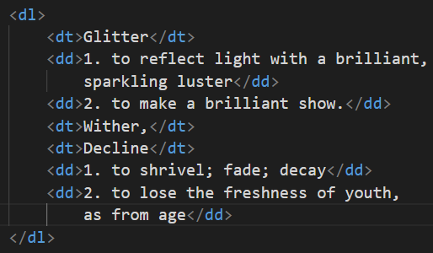
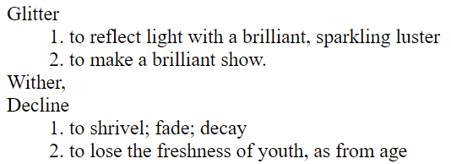
<dl>
If you have synonyms - multiple <dt>s
If you have multiple definitions – multiple <dd>s
Note that, in this case, if you want numbers, you do have to add them

Slide 43
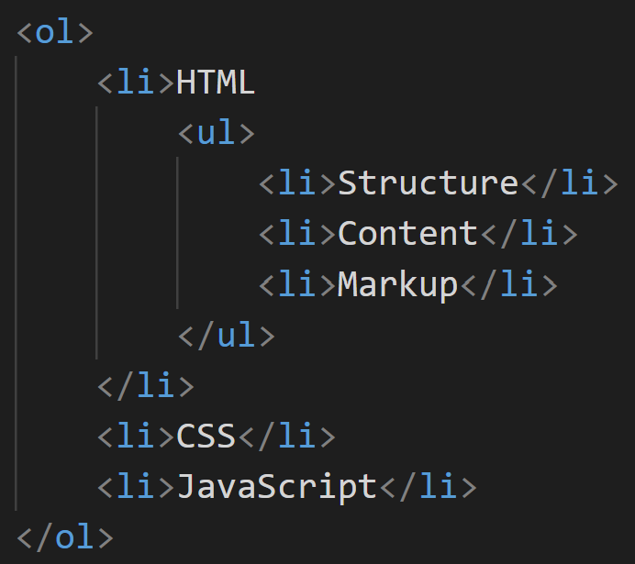
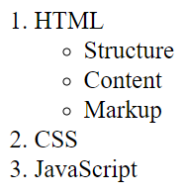
Nesting Lists

Slide 44
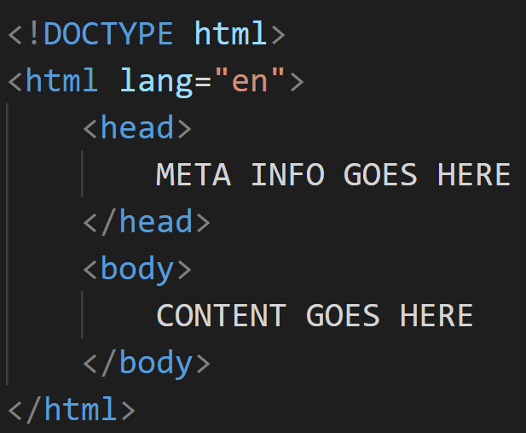
HTML5 Document Structure - Revisited

Slide 45
HTML Elements: Block vs Inline
Block (normal [W3C]) level elements
  Are those elements that start (and end) with a new line when displayed in the browser
  Creates large blocks of content
  Interrupt the flow
Inline (void [W3C]) elements
  Are those elements that are normally displayed without starting a new line
  Used to define text or data within the document
  Do not interrupt the flow

Slide 46
HTML Elements: Container vs Standalone
Container (normal) elements
  Have a start and end tag
  ‘Contain’ content, turning on formatting, then turning it off
Standalone (void) elements
  No end tag
  All the data needed by the browser is contained in a single tag

Slide 47
Official List of Tags
http://www.w3schools.com/tags/default.asp

Slide 48
The Web Design Lifecycle

Slide 49
Motivation
Successful web sites don’t just happen
A website can make - or break! - an organization
Careful planning and design are required to create a site that meets both clients’ and users’ needs
Some ‘best practices’ have been developed over the years to help
Remember, while we’re working small this semester, the knowledge and skills you’ll learn in this class are applicable to enterprise-grade websites

Slide 50
Rationale
Website design, like software design, is driven by certain realities
  A web site should be useful and usable
  A web site should meet the needs of the client
  A web site is not static
    Changes in target population
    Changes in content
    Changes in technology

Slide 51
Rationale
Any commercial project should be divided into a series of steps
Each step involves a set of inputs and a set of expected outputs/outcomes
This methodology
  Generates accurate customer requirements
  Provides a reasonably accurate timeline for project completion
  Helps identify necessary technology and manpower for the project
  Identifies necessary and relevant testing that the project will require
  Creates a budget for the project (kind of important)

Slide 52
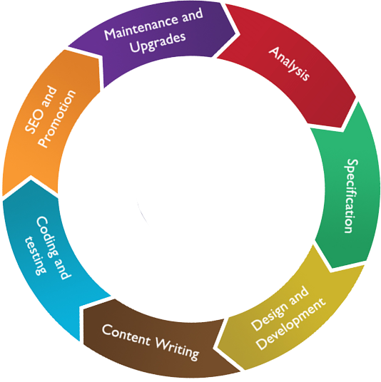
Input:
Kick off interview with client, initial mails and supporting docs by the client, discussion notes,
Online chat transcripts, recorded telephone conversations, and
Model sites/applications
Output:
Work plan,
Estimating cost
Team requirements (No of developers, designers, QA, DBA etc)
Hardware-software requirements
Supporting documents and
Final client approval to go ahead with the project.
WEB DESIGN LIFECYCLE

Slide 53
Input:
Reports from the analysis team.
Output:
Complete requirement specifications to the individuals and the customer/customer's representative (Technically, the project stakeholders)
WEB DESIGN LIFECYCLE

Slide 54
WEB DESIGN LIFECYCLE
Input:
Requirement specification.
Output:
Site design with templates, Images and prototype.

Slide 55
WEB DESIGN LIFECYCLE
Input:
Designed template.
Output:
Site with formatted content.

Slide 56
Input:
The site with forms and the requirement specification.
The site, Requirement specifications, supporting documents, technical specifications and technical documents.
Output :
Database driven functions with the site, Coding documents.
Completed application/site, testing reports, error logs, frequent interaction with the developers and designers.
WEB DESIGN LIFECYCLE

Slide 57
Input:
Site with unique and great content, Competitor study, keyword analysis.
Output:
Site submission after necessary meta tag preparation.
WEB DESIGN LIFECYCLE

Slide 58
Input:
Site/Application, content/functions to be updated, re-Analysis reports.
Output:
Updated application, supporting documents to other life cycle steps and teams.
WEB DESIGN LIFECYCLE

Slide 59
Site Mission

Slide 60


Getting started right
Every well designed web site has
  A well defined mission
  A set of targeted site users
Designers cannot intelligently think about design until above is known
Designers generally don’t determine above, but can assist in determination
  Designers should question client for needed info
  Often necessary to educate client about best way to proceed and why
If no understanding and agreement initially, project will fail or require a lot of later rework
Notes:
In this lecture, we'll focus on establishing a strong site mission.

Slide 61
Site Mission Statement
What is the owner of the site wanting the web site to accomplish? Why is it being created?
Synthesize into a short paragraph--Site Mission Statement
  SuperDog.com is the online home of the Super Dog comic character. It is a place for fun-loving people to share in the ongoing adventures of the Super Dog character, comment on events happening in the Super Dog universe, and buy Super Dog merchandise
  BuyANewHouse.com is place for people buying and selling a house without a realtor to meet, exchange information, and negotiate a purchase

Slide 62
Formulating a Mission Statement
Keep in mind:
  Many companies have established company mission statements
  What we are seeking is different from that, although related
  We want to know the mission of this site not the overall company
Once a general goal statement for site is established, mission statement can go on to discuss key components to be a part of the site

Slide 63
In Class Exercise
Assume you were in charge of the ETSU Web Site. Work with a neighbor to create a mission statement for your site
Begin by putting together a 2 sentence (or so) general goal statement, and the follow that up with at least 4 site components

Slide 64
Importance of Site Mission Statement
Site Mission Statement defines the target we're trying to hit as a designer
Site created must fit the mission
Designer and customer must have unified understanding of what is to be accomplished
I want…
He wants…

Slide 65
Importance of Site Mission Statement
Helps protect you from ‘mission-creep,’ also known as ‘requirements creep’
“ I know we agreed on this, but wouldn’t it be nice if it also…”

Slide 66
Importance of Site Mission Statement
Again, we’re looking at commercial website design
As with any other endeavor, it’s important to C-Y-A
“ If it ain’t wrote down, it didn’t happen”
~ Every cop, lawyer, and judge who ever lived

Slide 67
Summary
Structural tags
  <p></p>
  <br />
  <hr />
  <hn></hn> (n = 1, 2, 3, 4, 5, or 6)
Format tags
  <strong></strong>
  <em></em>
  <blockquote></blockquote>

Slide 68
Summary
Nesting tags
Special characters
Lists
  Ordered
  Unordered
  Definition

Slide 69
Summary
The Web Design Lifecycle represents a methodology of best practice steps to guide developers through the creation and maintenance of a web site
The WDLC is an iterative (cyclic) process that helps ensure success of the project

Slide 70


Slide 71
Lecture Quiz
1. What do we call <h1>Welcome!</h1>?
  Head
  Header
  Heading
  Headstone

Slide 72
Lecture Quiz
2. Display-wise, what is the difference between <b> and <strong>?
  <b> is a block level element; <strong> is not
  <b> is an inline element; <strong> is not
  <b> displays text as bold; <strong> is more bold
  None

Slide 73
Lecture Quiz
3. Which block level element do we use to display long quotations?
  <quot>
  <blockquote>
  <q>
  <cite>

Slide 74
Lecture Quiz
4. Which of the following is a block element?
  <p>
  <b>
  <em>
  <strong>

Slide 75
Lecture Quiz
5. What is the main element we use to group paragraphs, images, tables, etc.?
  <table>
  <span>
  <content>
  <div>

Slide 76
Lecture Quiz
6. Which list is used when the order of its items doesn’t matter?
  <ol>
  <ul>
  <dl>
  <cl>

Slide 77
Lecture Quiz
7. (True/False) A site mission statement is just a starting point…extra functions/features are typically added ‘on the fly’
True
False

Slide 78
Lecture Quiz
8. ‘Design Methodology’ means
A website is nothing more than a couple of folks writing a bunch of code
Creating a successful site is a fairly trivial endeavor
A website should be built following a defined series of steps that have proven to be successful in the past
A website is formulaic and doesn’t need input from clients or customers

Slide 79
Lecture Quiz
9. (True/False) Most websites are static and rarely change
True
False

Slide 80
Lecture Quiz
9. (True/False) Most websites are static and rarely change
True
False

Slide 81
Lecture Quiz
10. What are some of the changes that can occur to a website
    Target population
    Content
    Technology
    All of the above

Slide 82


Copyrights
Presentation prepared by and copyright of John Ramsey, East Tennessee State University, Department of Computing . (ramseyjw@etsu.edu)
Microsoft, Windows, Excel, Outlook, and PowerPoint are registered trademarks of Microsoft Corporation.
IBM, DB2, DB2 Universal Database, System i, System i5, System p, System p5, System x, System z, System z10, System z9, z10, z9, iSeries, pSeries, xSeries, zSeries, eServer, z/VM, z/OS, i5/OS, S/390, OS/390, OS/400, AS/400, S/390 Parallel Enterprise Server, PowerVM, Power Architecture, POWER6+, POWER6, POWER5+, POWER5, POWER, OpenPower, PowerPC, BatchPipes, BladeCenter, System Storage, GPFS, HACMP, RETAIN, DB2 Connect, RACF, Redbooks, OS/2, Parallel Sysplex, MVS/ESA, AIX, Intelligent Miner, WebSphere, Netfinity, Tivoli and Informix are trademarks or registered trademarks of IBM Corporation.
Linux is the registered trademark of Linus Torvalds in the U.S. and other countries.
Oracle is a registered trademark of Oracle Corporation.
HTML, XML, XHTML and W3C are trademarks or registered trademarks of W3C®, World Wide Web Consortium, Massachusetts Institute of Technology.
Java is a registered trademark of Sun Microsystems, Inc.
JavaScript is a registered trademark of Sun Microsystems, Inc., used under license for technology invented and implemented by Netscape.
SAP, R/3, SAP NetWeaver, Duet, PartnerEdge, ByDesign, SAP Business ByDesign, and other SAP products and services mentioned herein as well as their respective logos are trademarks or registered trademarks of SAP AG in Germany and other countries.
Business Objects and the Business Objects logo, BusinessObjects, Crystal Reports, Crystal Decisions, Web Intelligence, Xcelsius, and other Business Objects products and services mentioned herein as well as their respective logos are trademarks or registered trademarks of Business Objects S.A. in the United States and in other countries. Business Objects is an SAP company.
ERPsim is a registered copyright of ERPsim Labs, HEC Montreal.
Other products mentioned in this presentation are trademarks of their respective owners.

