Slide 1
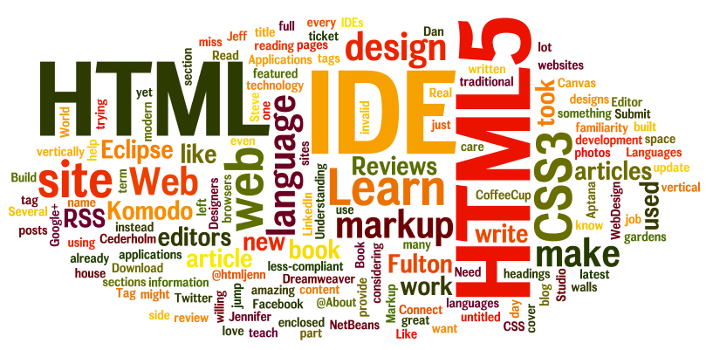
Tools & The Basics of HTML
Essentials of Web Design
CSCI 1210

Slide 2
Tools

Slide 3
How do we create websites?
There are several 'software tools' that we'll need this semester to create our web pages/sites
None of them are particularly special, but all are needed
Later in this lecture, we'll show you a website that will let you pick the applications you want (all we need, except one) and download/install them all at once
...which is nice

Slide 4
How do we create websites?
So what do you need to make a web page?
A text editor
That's it
For a couple of years, I used Notepad for making web pages, before I discoverd Microsoft FrontPage - but that's another story
After all, as we'll soon see, an HTML page is just a text file

Slide 5
How do we create websites?
A text editor:

Slide 6
Visual Studio Code
This semester we’ll be using Microsoft’s Visual Studio Code for our work
Arguably the best Integrated Development Environment
Free
Lots of nice features
Available from https://code.visualstudio.com/download

Slide 7
But you said we need several tools? What gives?
Well, yeah
But to make a simple page, we just need an editor
What if we want to view the page?
What if we want to add pictures?
What if we want other people to see our page?
What if we want to share our source code with others?

Slide 8
To view a page
We’ll need a browser
As you know, a web browser is an application used to, well, browse the web
There are many flavors
You're likely most familiar with Internet Explorer - Ewwwwww!
All of the development for this site was done using Google Chrome
Much of it was tested with Firefox as well

Slide 9
What about pictures?
Though Photoshop is probably the best photo editor, we'll be using GIMP
Gnu Image Manipulation Program
Open source photo editor (free)
Almost as good as PS (some argue better)
Plenty good enough for our needs, as we'll see

Slide 10
What about sharing (publishing)?
This is where it sometimes gets a little confusing for students
To 'publish' our finished pages, we have to upload them to a server account
You all (I hope!) already have accounts on the class web server
We will be using an application called FileZilla to transfer/upload our work to the server
FileZilla uses an Internet technology called the File Transfer Protocol to move files from one computer

Slide 11
What about sharing source code and files?
A lot of times, we want to be able to conveniently share and distribute projects
To do so, we typically create a compressed archive of the files, called a .zip file
A lot of your lab activities are going to start with one or several files that are partially completed
You'll download the archive to your working directory and extract (or 'unzip') the files from the archive

Slide 12
Ninite
Now, you could go to the websites for all of these applications, download their respective install files, and run each
That would work. But there's an easier way
There's a site named ninite.com. On ninite.com, you can select any number of open-source applications, download them as an executable bundle, and install them all with one double-click
On ninite.com, find and select Chrome (if you don't already have it), FileZilla, GIMP, 7-Zip, and any other application you think you might find useful. Click 'Get Your Ninite' to download the bundle

Slide 13
File Explorer
We’ll also use File Explorer a lot to organize our files and folders/subfolders
Obviously, it comes packaged with Windows (I hope you’re using a Windows machine… Apple makes things a little tougher for this class)
Understanding file systems is a critical component of computing, in general, and web development in particular

Slide 14
That's it!
So that's it for the software applications we will need this semester
You may have found some others that you'll find useful in the future
If, at the end of the semester, you decide you won't be using them anymore (I doubt it!), you can always uninstall them
There're a bunch that I use all the time

Slide 15
Operating Systems

Slide 16
Operating Systems
Wait…isn’t that another class?
Well, yes
But we have to understand that we’re using two operating systems this semester
What is an operating system, you ask?
Well, for now, it’s enough to know that an operating system is a group of software applications that provide an interface between the user and the computer’s underlying hardware

Slide 17
Operating Systems
Here’s where it matters:
Our personal computers run on the Windows operating system (I hope)
The class web server, however, runs on the Linux operating system
Both are similar in some respects, but very different in a couple of key ways

Slide 18
Operating Systems
The most important difference for us is case sensitivity
Windows doesn’t care
Linux very much does -
On a Windows machine, index.html and INDEX.HTML refer to the same file
On a Linux machine, they are treated as different files
So when you upload your work to the web server, it is very important that the file and folder names obey Linux’s constraints

Slide 19
Operating Systems
The easiest way to deal with this disparity is to adopt a convention
An agreement at the beginning of things to do the same things the same way, every time
Our convention, for this class, is to name everything in all lower-case letters
lab1.html NOT Lab1.html OR LAB1.HTML OR lab1.HTML
Or ANY uppercase character

Slide 20
Operating Systems
Also, we only want to use non-space characters in file/folder names
NO SPACES!
EVER!
lab1.html
NOT
lab 1.html

Slide 21
Operating Systems
Also, also … ‘/’ means something to Linux
It’s sort of the same thing as ‘C:\’ in Windows
So, ‘/’ is your root directory. It’s your home
You’ll have a couple of subdirectories - directories that are nested inside ‘/’

Slide 22
Operating Systems
There’s /homework
And
/labs
And
/images
And
/scripts

Slide 23
Operating Systems
Don’t mess with anything in
/js or /images
Those files are there to help you troubleshoot your files and help me grade your work
You’ll be adding subdirectories to /homework and /labs
One each for each assignment

Slide 24
Operating Systems
This may sound kind of trivial
But, trust me, you’ll dodge a lot of errors if you follow these conventions
If you’re interested in learning more about the nuances of Linux… join me for CSCI 2200 (Intro to Unix) and CSCI 4417 (Intro to System Administration)

Slide 25
HTML

Slide 26
What is HTML again?
HTML (Hypertext Markup Language)
“language of the web”
set of “tags” or “elements” designed to create the structure of a web page
HTML documents
“plain text” documents with the elements embedded for formatting

Slide 27
What is HTML again?
Basic HTML pages require no compiling
What is this ‘compiling’ of which you speak?
Basic HTML documents end in either .htm or .html file extensions

Slide 28
.htm vs .html
So what is the difference between index.htm and index.html?
Basically, just the letter ‘l’ :-)
The reason for the .htm extension dates back to when certain (*cough, cough…MS-DOS*) Operating Systems only allowed for 3 character extensions

Slide 29
.htm vs .html
In modern times, both .htm and .html behave, display, and act the exact same way
It is best practice to choose one or the other and stick with it
For this class – we will use .html

Slide 30
History of HTML
Originally, HTML was based on a language called Standard Generalized Mark-up Language (SGML). SGML is a standard that is defined for a markup language for documents
SGML helps to define elements that indicate which portion of the document is a paragraph, sentence, bolded, etc
It is also hideously complicated
Notes:
Source: http://www.w3.org/People/Raggett/book4/ch02.html
Source: http://www.w3.org/TR/#tr_HTML

Slide 31
History of HTML
HTML 1 was first released in 1991
Current accepted standard of HTML is HTML 5
The final revision and adoption of the standard was in October of 2014 (yes, that means we’ve had to revise all of our lecture materials)
The World Wide Web Consortium (W3C) is the governing body that determines standards for items such as HTML
Notes:
Source: http://www.w3.org/People/Raggett/book4/ch02.html
Source: http://www.w3.org/TR/#tr_HTML

Slide 32
History of HTML
All current browsers (latest versions of Internet Explorer, Chrome, Opera, Firefox, Safari, etc) support HTML5

Slide 33
History of HTML
All current browsers (latest versions of Internet Explorer, Chrome, Opera, Firefox, Safari, and, god help us, Edge, etc) support HTML5

Slide 34
HTML Tags
HTML documents are made up of various tags that define how the document will be structured
Tags are contained inside of the < > (angle brackets, lt/gt)
The beginning tag: <tagname>
The ending tag: </tagname>
‘Forward Slash’ … the one under the question mark key on standard keyboards

Slide 35
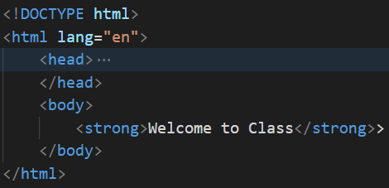
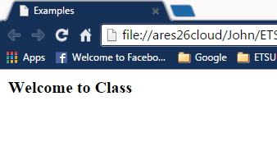
HTML Tags
Example: Take the text, “Welcome to Class”
If, in the source document, we wrap that with the bold (<strong></strong>) tags, thus: <strong>Welcome to Class</strong>, this is what the browser displays:

Slide 36
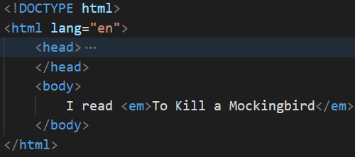
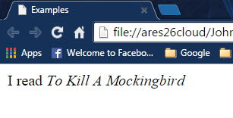
HTML Tags
Some tags exist in pairs and are called container tags
I read <em>To Kill A Mockingbird</em>
This is the equivalent to “turning on” and “turning off” formatting
If you forget the ending tag, the formatting will continue

Slide 37
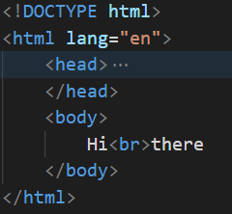
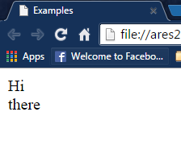
HTML Tags
Some tags do not exist in pairs and are called standalone tags (or void tags)
Hi <br> there
This is the equivalent to inserting something into the document
Does not require an ending tag
Note: <br /> is also valid, but now discouraged

Slide 38
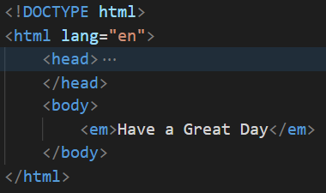
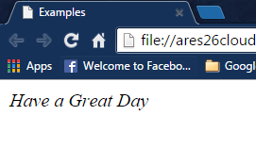
HTML Tags
To italicize “Have a Great Day” -
Use the <em></em> (emphasis) tag pair:
<em>Have a Great Day</em> displays

Slide 39
HTML Tags
<strong> vs. <b>; <em> vs. <i>
Appearance-wise, <strong> and <b> make text bold; <em> vs. <i> italicize text
The difference lies in adaptive technology
<strong> and <em> modify the playback voices for screen readers
Sometimes, you may just want to modify text’s appearance without the emphasis on the reader’s ‘voice’
When we talk about CSS, we’ll learn that we can (should) use CSS when all we want to do is modify the appearance of text content

Slide 40
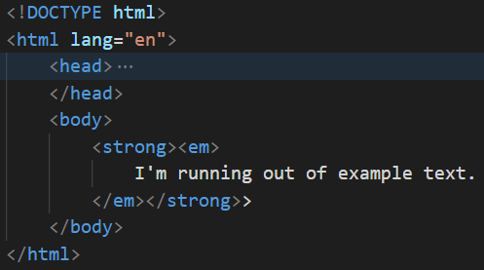
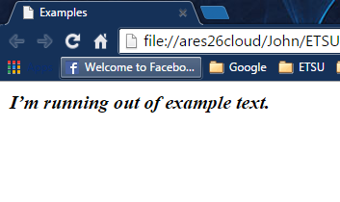
HTML Tags
Tags can be nested:
<strong><em>I’m running out of example text.</em></strong> looks like this (in a browser):

Slide 41
HTML Tags
Must use the last on, first off method. This is the last tag you have open should be the first tag closed
This would be incorrect: <strong>this is bold <em>this is bold and italic</strong></em> The reason, the last tag “on” or “open” is the <em> tag
Correct <strong>this is bold <em>this is bold and italic</em></strong>
this is bold this is bold and italic

Slide 42
HTML Tags
While HTML5 tags are not case sensitive (i.e. <HTML> is the same as <html> and <hTmL>), conventional and best practice states that all HTML tags and attributes should be in lowercase

Slide 43
HTML Tags
Many HTML tags have attributes
Attributes provide additional information about the tag
The attribute(s) are listed inside of the opening tag
With each attribute, you can assign a value with the equals sign followed by the value in quotation marks
<tag attribute="value" attribute2="value2">…</tag>

Slide 44
HTML Tags
For example:
<a href=“http://www.cs.etsu.edu”>Dept of Computing</a>
The <a>…</a> tag is used to create a link in a document. The attribute href identifies where a user will go when they click on the link.
The ‘a’ in the <a></a> tag stands for ‘anchor’
(‘href’ = ‘hypertext reference’)

Slide 45
HTML Tags? Or Elements?
Sometimes people will use the terms “tag” and “element” interchangeably
More correct: an element consists of both tags and the content between them
<title>Template</title>
tag
element
tag

Slide 46
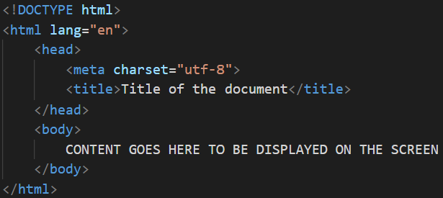
HTML5 Document Structure
DOCTYPE declaration – must be the first thing on the page! The <!DOCTYPE> declaration is not an HTML tag; it is an instruction to the web browser about what version of HTML the page is written in

Slide 47
HTML5 Document Structure
To begin an HTML document we start with the <!DOCTYPE html> declaration
This declaration is not a tag
Rather it is an indication to the browser that this document is a specific type of HTML
In this case <!DOCTYPE html> signifies that this is an HTML5 document

Slide 48
HTML5 Document Structure
HTML 5: <!DOCTYPE html>
XHTML (The old standard):
<!DOCTYPE html PUBLIC "-//W3C//DTD XHTML 1.0 Transitional//EN" "http://www.w3.org/TR/xhtml1/DTD/xhtml1-transitional.dtd"> <html xmlns="http://www.w3.org/1999/xhtml">

Slide 49
HTML5 Document Structure
The <html> container open tag. The lang=“en” attribute/value pair tells browsers loading this page that the language on this page is English.

Slide 50
HTML5 Document Structure
After the Document Type Declaration, we enter in our first tag – the <html>…</html> tags
This tag is used to signify to the browser that everything between the opening and closing of this tag is contained within the HTML element
I think of it as the “html container”

Slide 51
HTML5 Document Structure
The <head> tag. Interestingly, the HTML5 specification now makes this tag optional. Since the vast majority of existing web pages use a head section, in this class, we will also

Slide 52
HTML5 Document Structure
Inside of the <html>…</html> element there are two sections
The first section is <head>…</head>
Identifies descriptors for the document
This can include scripts, stylesheets, meta information, and the title of the document

Slide 53
HTML5 Document Structure
Meta tag(s). Contain information about the document, but don’t display when the page loads

Slide 54
HTML5 Document Structure
<meta> tags: provide metadata about the HTML document
Does not display on the page, but can be parsed by other applications, for example, search engines
'meta' means information about the document that’s contained within the document

Slide 55
HTML5 Document Structure
<head>
<meta charset=“utf-8”>
<title>Title of the document</title>
</head>
In the above example, meta is using the attribute charset with the value utf-8
It is the character encoding of the document
UTF-8 is the web standard*
*utf-8 (Universal Character Set + Transformation Format—8-byte 1,112,064 “characters” can be potentially coded by UTF-8)

Slide 56
HTML5 Document Structure
Other meta tags:
<meta name=“author” content=“Jack Ramsey”>
<meta name=“description” content=“template page”>
<meta name=“keywords” content=“template, starting page”>
<meta name=“last modified” content=“1/21/2016”>
<meta http-equiv="refresh" content="30">

Slide 57
HTML5 Document Structure
The title tag. All of the pages we create in this class will have titles.

Slide 58
HTML5 Document Structure
The <title> element: title of the document
Not necessarily the file name or any titles that are used in the document
<head>
<meta charset=“UTF-8”>
<title>Title of the document</title>
</head>
Always nested inside of the head element
Displays in the browser’s tab or top bar

Slide 59
HTML5 Document Structure
Closing head tag. The head element is a container element, so it has to have a closing tag

Slide 60
HTML5 Document Structure
The body tag. This is where the displayed content will be located

Slide 61
HTML5 Document Structure
The second section of the document is the <body>…</body>
This section is where various elements, images, tables, forms, text, etc. can be placed to be displayed on the screen

Slide 62
HTML5 Document Structure
<body>
CONTENT GOES HERE TO BE DISPLAYED ON THE SCREEN
Can include text, pictures, video, tables, styling code, Javascript, etc.
</body>

Slide 63
HTML5 Document Structure
The closing body and html tag. Again, <body> and <html> are container tags, and so they have to be paired with closing tags.

Slide 64
About the HTML Document
Text that is not inside of html tags is rendered as “default format” by the browser
Spacing:
Multiple spaces, soft and hard returns, and tabs are ignored by the browser
Whitespace makes the code easier to read, but is ignored by browsers

Slide 65
About the HTML Document
Example of proper spacing:
The indentation of text is intentional and required. It helps to visually identify what is contained within tags that are the next level to the left
Notice the indentation

Slide 66
About the HTML Document
Parent/child relationship:
The indentation causes the elements of the document to take the form of what is referred to as a parent/child relationship. Indented elements are the children of elements that are not indented, or are indented less

Slide 67
About the HTML Document
Parent/child relationship:
Thus, in this example, the <head> and <body> elements are children of the <html> element, while the <head> tag is the parent of the <meta> and <title> elements
Notes:
********* Start here (002) ****************

Slide 68
About the HTML Document
Comments:
<!-- this is an example of a comment -->
Please note there is a space between after the opening tag and a space before the closing tag
Comments begin with the <!-- opening tag and end with the --> closing tag

Slide 69
About the HTML Document
Comments:
Not displayed to the screen (generally speaking)
Comments are sent to the browser
DO NOT STORE SECURE INFORMATION IN COMMENTS
Passwords, credit card numbers, etc
Can be seen by viewing the page’s source
Useful for noting design information and future support of the page

Slide 70
About the HTML Document
Comments – What good are they?
Noting design information
Future support of the page
Page’s author may not be the next person who has to modify it

Slide 71
About the HTML Document
Comments:
For the purposes of this class, every document you submit should have the following comments in the <head> section of your document:

Slide 72
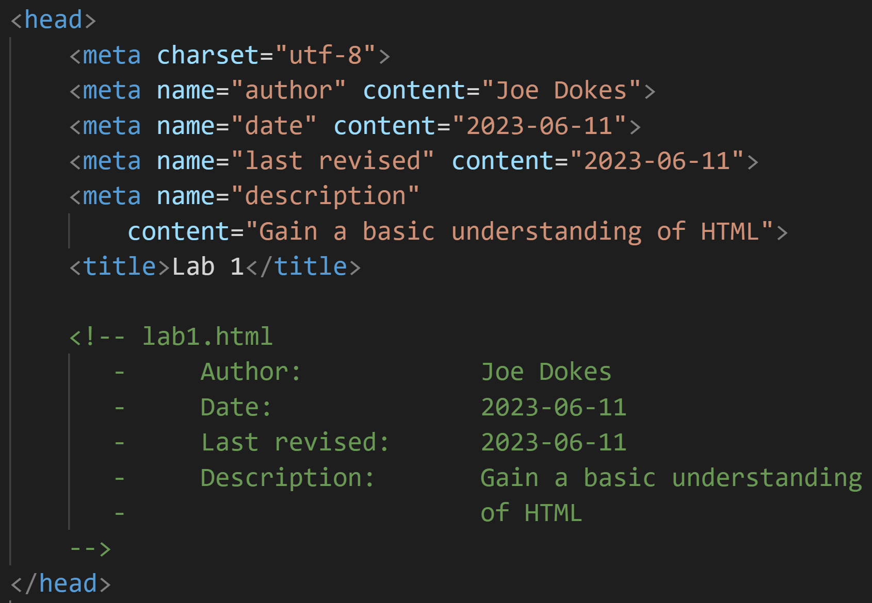
ALL OF OUR ASSIGNMENTS WILL INCLUDE THE APPROPRIATE INFORMATION IN THEIR HEAD ELEMENTS

Slide 73
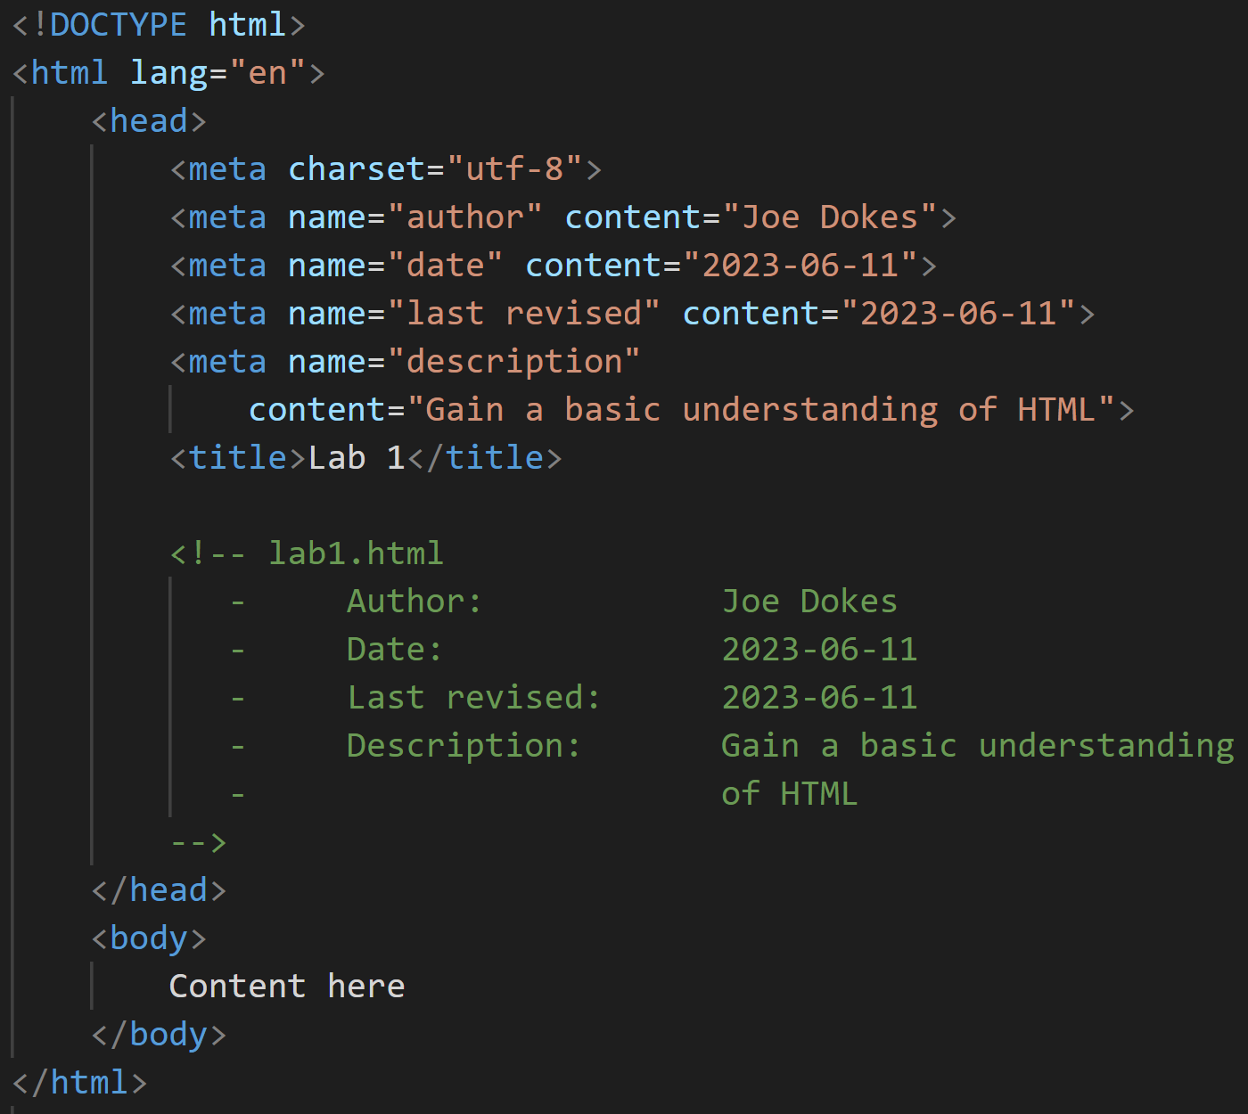

Slide 74
HTML Terms
Attributes – provide additional information about the tag:
<a href=“http://www.cs.etsu.edu”>Dept of Computing</a>
Tags – define the structure of the document:
<a href=“http://www.cs.etsu.edu”>Dept of Computing</a>
Elements – includes everything from the opening tag to the closing tag:
<a href=“http://www.cs.etsu.edu”>Dept of Computing</a>
Notes:
Source: http://www.w3schools.com/html/html_elements.asp

Slide 75
Lecture Quiz
1. What information is contained in an HTML document’s <head> section?
Meta information
Comments
Links to external resources
Title
All of the above

Slide 76
Lecture Quiz
2. What is the name of the editor we’ll be using for this class?
Notepad++
Brackets
Sublime
Vim
Nano
Visual Studio Code

Slide 77
Lecture Quiz
3. Which Operating System will we be interacting with this semester?
Mac OS
Windows
OS/2
MINIX
Linux
B and E above
A and B above

Slide 78
Lecture Quiz
4. Why is it important to use lower-case letters (only) in file & folder names?
Windows is case sensitive
Linux is case sensitive
Mac OS is case sensitive
It isn’t important. Don’t worry about it

Slide 79
Lecture Quiz
5. HTML documents have to be compiled before they can be viewed
True
False

Slide 80
Lecture Quiz
6. What is the current “official” version of HTML?
1
2
4
5
XHTML

Slide 81
Lecture Quiz
7. Which element could we use to italicize text?
<em>
<it>
<i>
<italic>
A & C above

Slide 82
Lecture Quiz
8. In HTML, what is an attribute?
Additional information about an element that is enclosed in its opening tag
href
May be required for the element to work
All of the above

Slide 83
Lecture Quiz
9. What’s the first thing (line #1) that appears in an HTML document?
<html lang=“en”>
<!DOCTYPE html>
<head>
<body>

Slide 84
Lecture Quiz
10. In the following screen shot, which element is <title>’s parent?
<html lang=“en”>
<!DOCTYPE html>
<head>
<body>

Slide 85
Lecture Quiz
11. In HTML, what symbols do we use to denote comments?
//
/* */
#
<!-- -->

Slide 86
Sources
HTML Image, Retrieved from http://www.techiwarehouse.com/cat/25/HTML
“A history of HTML”, World Wide Web Consortium, Retrieved from http://www.w3.org/People/Raggett/book4/ch02.html
“All Standards and Drafts”, World Wide Web Consortium, Retrieved from http://www.w3.org/TR/#tr_HTML
“HTML Element”, W3Schools, Retrieved From http://www.w3schools.com/html/html_elements.asp
“W3schools.com – the world’s largest web development site”, W3Schools, Retrieved from http://www.w3schools.com/

Slide 87
Copyrights
Presentation prepared by and copyright of John Ramsey, East Tennessee State University, Department of Computing . (ramseyjw@etsu.edu)
Microsoft, Windows, Excel, Outlook, and PowerPoint are registered trademarks of Microsoft Corporation.
IBM, DB2, DB2 Universal Database, System i, System i5, System p, System p5, System x, System z, System z10, System z9, z10, z9, iSeries, pSeries, xSeries, zSeries, eServer, z/VM, z/OS, i5/OS, S/390, OS/390, OS/400, AS/400, S/390 Parallel Enterprise Server, PowerVM, Power Architecture, POWER6+, POWER6, POWER5+, POWER5, POWER, OpenPower, PowerPC, BatchPipes, BladeCenter, System Storage, GPFS, HACMP, RETAIN, DB2 Connect, RACF, Redbooks, OS/2, Parallel Sysplex, MVS/ESA, AIX, Intelligent Miner, WebSphere, Netfinity, Tivoli and Informix are trademarks or registered trademarks of IBM Corporation.
Linux is the registered trademark of Linus Torvalds in the U.S. and other countries.
Oracle is a registered trademark of Oracle Corporation.
HTML, XML, XHTML and W3C are trademarks or registered trademarks of W3C®, World Wide Web Consortium, Massachusetts Institute of Technology.
Java is a registered trademark of Sun Microsystems, Inc.
JavaScript is a registered trademark of Sun Microsystems, Inc., used under license for technology invented and implemented by Netscape.
SAP, R/3, SAP NetWeaver, Duet, PartnerEdge, ByDesign, SAP Business ByDesign, and other SAP products and services mentioned herein as well as their respective logos are trademarks or registered trademarks of SAP AG in Germany and other countries.
Business Objects and the Business Objects logo, BusinessObjects, Crystal Reports, Crystal Decisions, Web Intelligence, Xcelsius, and other Business Objects products and services mentioned herein as well as their respective logos are trademarks or registered trademarks of Business Objects S.A. in the United States and in other countries. Business Objects is an SAP company.
ERPsim is a registered copyright of ERPsim Labs, HEC Montreal.
Other products mentioned in this presentation are trademarks of their respective owners.

