Slide 1
Logos
CSCI 1210

Slide 2
Logos: 7 Tips
Be creative
Understand the brand
Color is key
What’s in a name? (Can you use a logotype?)
Keep it easy and flexible
Don’t expect instant success
Use online resources and tools

Slide 3
Company Recognition
Easy visual recognition/identification
Web designers may be asked to create/help create logo for company/website
Many tools available, some free some not so much
Photoshop/Fireworks (definitely NOT free)
Free online photo editors from syllabus / Google
http://www.shopify.com/

Slide 4
"What’s important is to create something that you believe is different from anything already out there.”
~David Airey

Slide 5
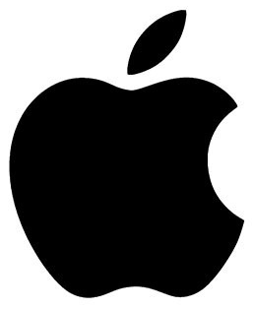
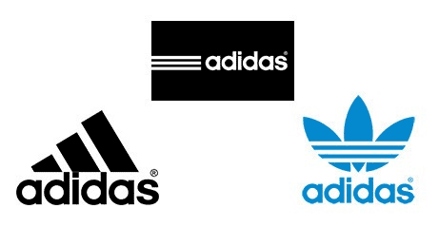
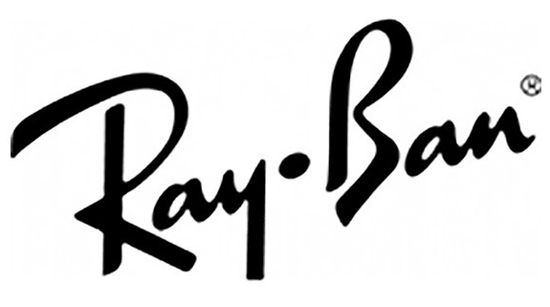
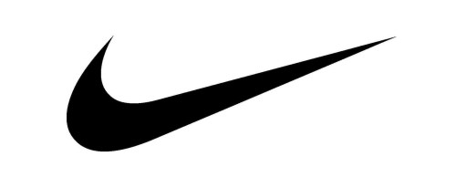
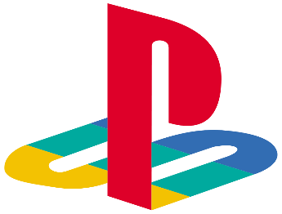
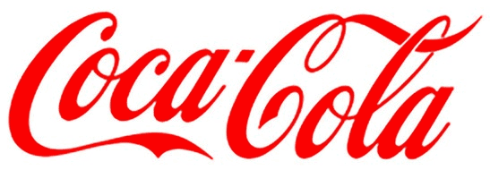
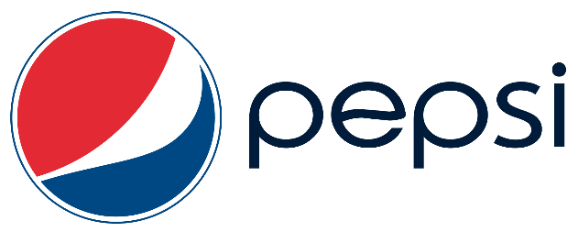
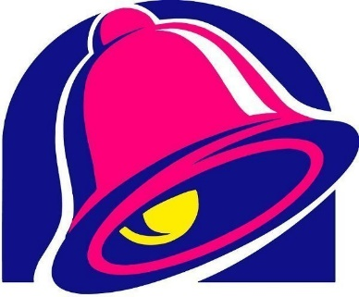

Slide 6
Effective Logo Design
A logo must be simple
A simple logo allows for easy recognition and allows the logo to be versatile and memorable
Effective logos feature something unexpected or unique without being overdrawn

Slide 7
Effective Logo Design
A logo must be memorable
Following closely behind the principle of simplicity is that of memorability
An effective logo should be memorable and this is achieved by having a simple yet appropriate logo

Slide 8
Effective Logo Design
A logo must be enduring
An effective logo should endure the test of time
The logo should be 'future proof', meaning that it should still be effective in 10, 20, 50+ years time

Slide 9
Effective Logo Design
A logo must be versatile
An effective logo should be able to work across a variety of mediums and applications

Slide 10
Effective Logo Design
A logo must be appropriate
How you position the logo should be appropriate for its intended purpose

Slide 11
Logos: Colors
Every color has a different implication and can bring nuance to your message
Red: energetic, sexy, bold
Orange: creative, friendly, youthful
Yellow: sunny, inventive, optimism
Green: growth, organic, instructional
Brown: rural, historical, steady
Blue: professional, medical, tranquil, trustworthy
Purple: spiritual, wise, evocative
Black: credible and powerful
White: simple, clean, pure
Pink: fun and flirty

Slide 12
Logos: Outsourcing
If your team lacks the services of a good graphic designer (Hint: hire one!), there are online resources available to create professional logos, for a fee.
https://99designs.com/logo-design

Slide 13
Some Logo Backstories - Android
Some speculation it was lifted from video game or Star Wars
Irina Blok – the Android designer who thought up the logo – clears up the question of what actually bought the little bugdroid into existence:
“This logo is designed to be international symbol for Android, and it is open source, just like the platform itself. There are no cultural references to any other characters or cultural icons… The process was very simple – we talked to the founder of android and did a research on the whole android/robot theme.”

Slide 14
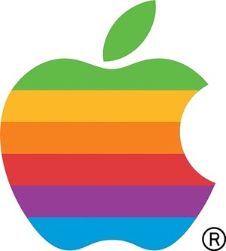
Some Logo Backstories - Apple
Apple’s logo has spawned a number of stories as it evolved over the years
Original (right, top) Robert Wayne, co-founder of Apple - for 11 days
Rob Janoff (right, bottom):
“I didn’t have much of a formal brief on the logo assignment, other than “don’t make it cute”. But I did know the selling points of the Apple Computer, and one of the biggest was colour capability. To me, that looked like colour bars on a monitor, which became the stripes in the logo. The order of the stripes, I’m sorry to say, had no particular grand plan other than I liked them that way. And, of course, the green stripe would be at the top where the leaf is…The bite is really about scale and the common experience of biting into an apple. It was a happy accident that ‘byte’ is a computer term.”

Slide 15
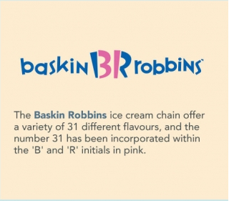
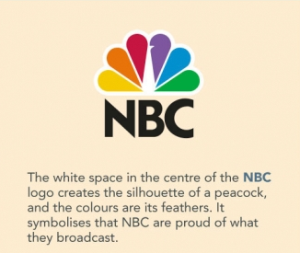
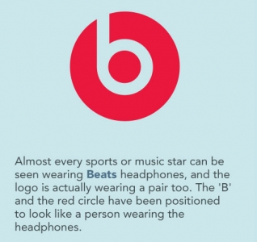
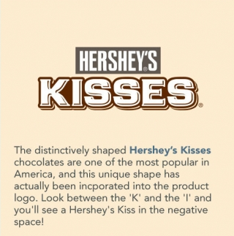
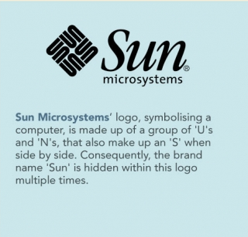
More Hidden Messages

Slide 16
Ten Minutes With Photoshop

Slide 17
Google Search Bar

Slide 18
Google Search Bar
You may want to add a search bar to your website
https://support.google.com/customsearch/answer/2630969?hl=en

Slide 19
Google Search Bar

Slide 20
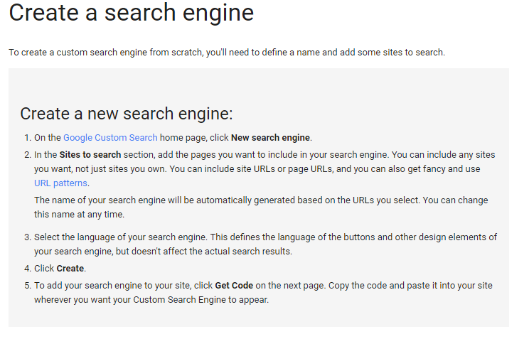
Google Search Bar

Slide 21
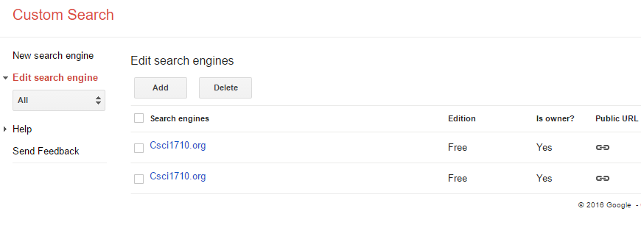
Google Search Bar

Slide 22
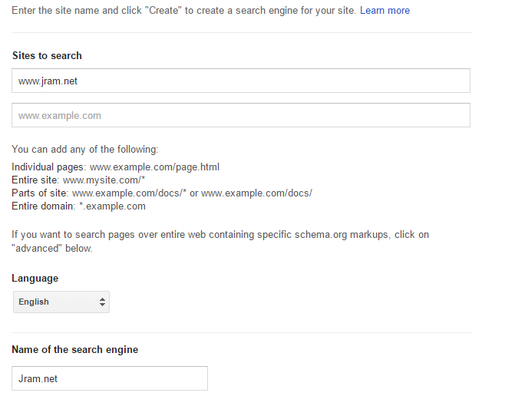
Google Search Bar
Then click ‘Create’ below

Slide 23
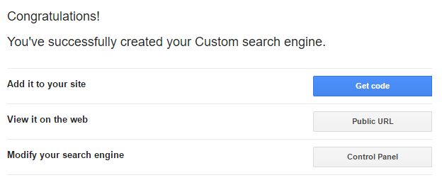
Google Search Bar

Slide 24
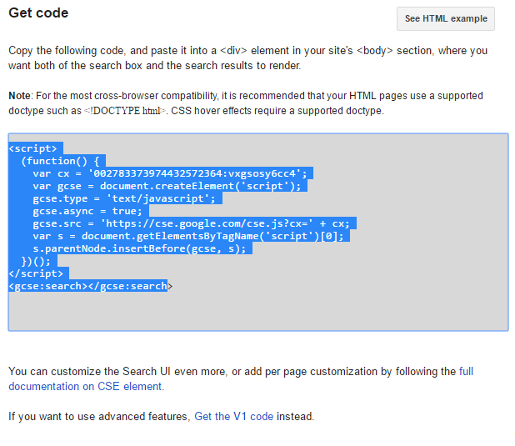
Google Search Bar

Slide 25
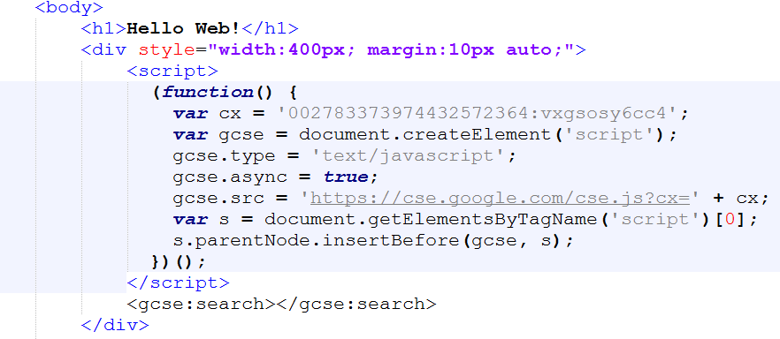
Google Search Bar

Slide 26
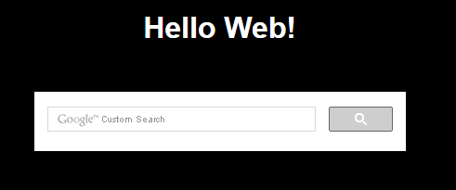
Google Search Bar

Slide 27
Error checking with the Validator

Slide 28
Error checking with the Validator

Slide 29
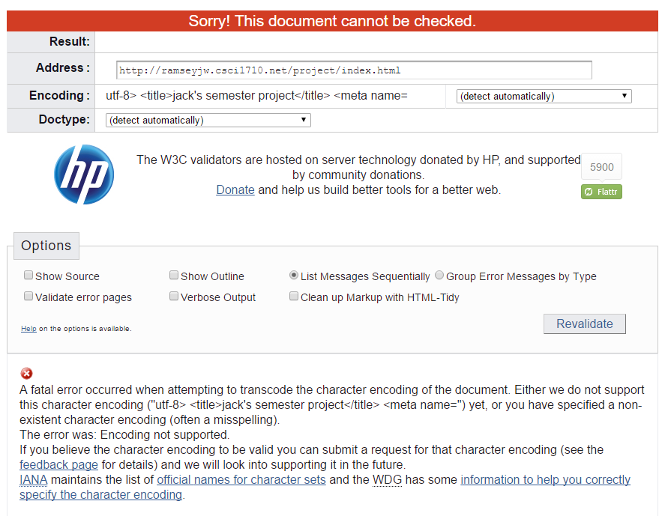
Error checking with the Validator

Slide 30
Error checking with the Validator

Slide 31
Error checking with the Validator

Slide 32
Error checking with the Validator

Slide 33
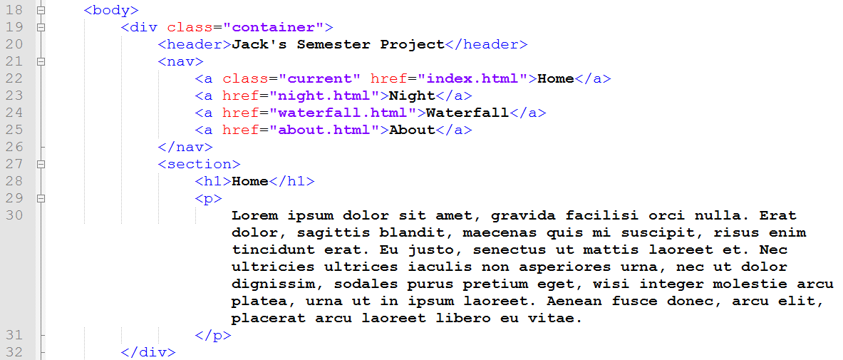
Error checking with the Validator

Slide 34
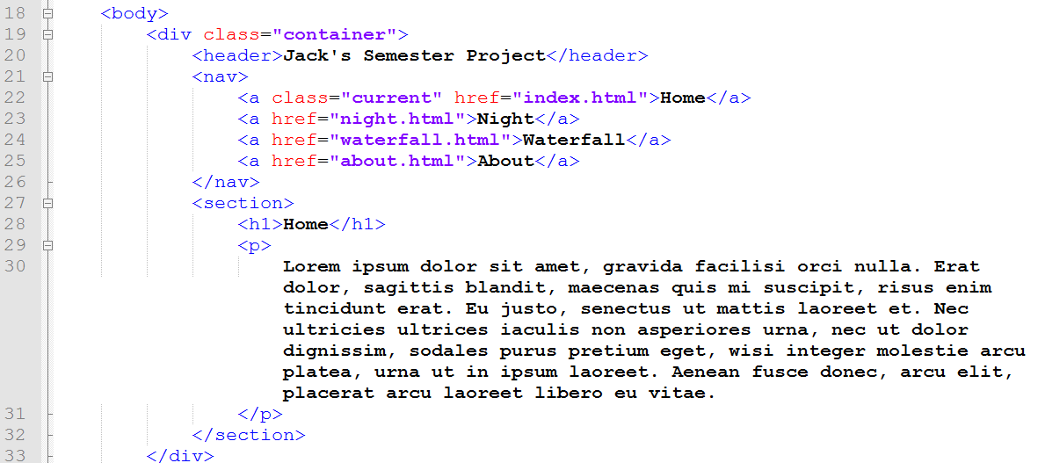
Error checking with the Validator

Slide 35
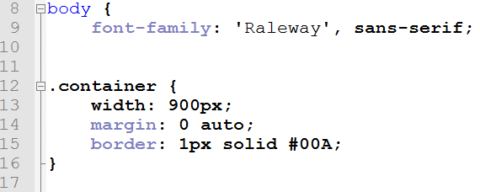
Error checking with the Validator

Slide 36
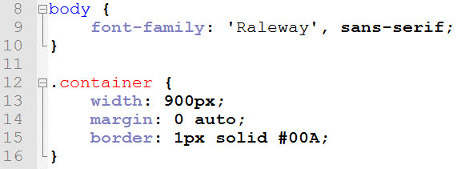
Error checking with the Validator

Slide 37
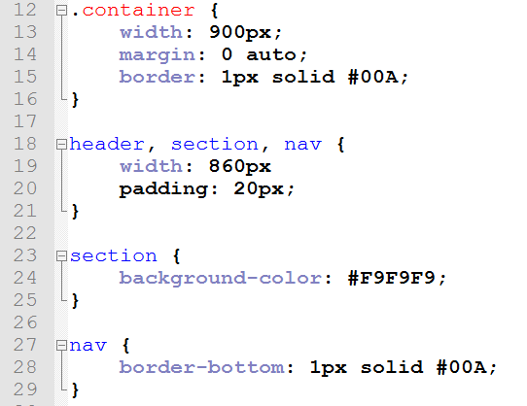
Error checking with the Validator

Slide 38
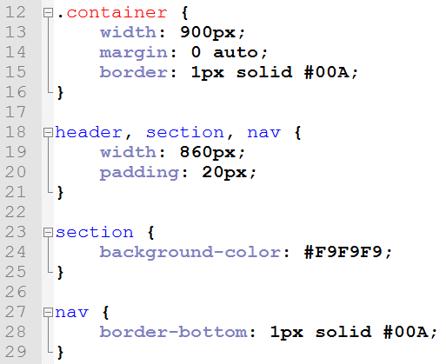
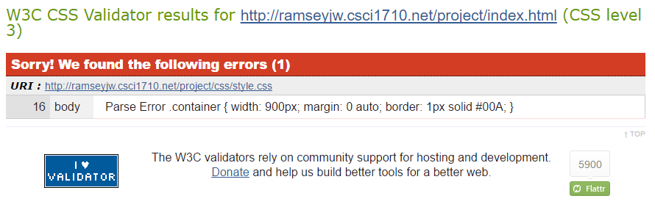
Error checking with the Validator

Slide 39
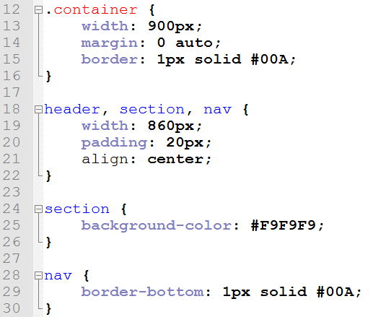
Error checking with the Validator

Slide 40
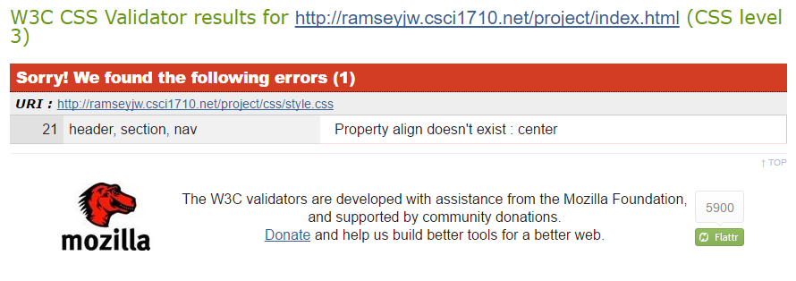
Error checking with the Validator

Slide 41
target=“_blank”
rel=“noopen”

Slide 42
target=“_blank”
Sometimes, when hyperlinking to an external resource, you’ll want the user
to be able to easily return to your site
There is an attribute/value pair for the anchor tag that will cause the browser
to open a new tab instead of overwriting the current one
target=“_blank” should be paired with rel=“noopen” to prevent a possible phishing attack

Slide 43
target=“blank”
Syntax: <a href="etsu.edu" target="_blank" rel="noopen">ETSU</a>

Slide 44
target=“_blank”
Don’t use this for internal navigation, however
The user’s display will quickly become cluttered with unnecessary browser tabs

Slide 45
Sources
“65 Expert Logo Design Tips”, Retrieved from http://www.creativebloq.com/graphic-design/pro-guide-logo-design-21221
“7 Killer Tips for Logo Design”, Retrieved from http://mashable.com/2014/04/30/logo-design-tips/
http://www.adweek.com/adfreak/40-brand-logos-hidden-messages-starting-most-famous-one-160798
http://thenextweb.com/dd/2012/09/08/the-stories-inspiration-behind-world-famous-logos/#gref

Slide 46
Copyrights
Presentation prepared by and copyright of John Ramsey, East Tennessee State University, Department of Computing . (ramseyjw@etsu.edu)
Microsoft, Windows, Excel, Outlook, and PowerPoint are registered trademarks of Microsoft Corporation.
IBM, DB2, DB2 Universal Database, System i, System i5, System p, System p5, System x, System z, System z10, System z9, z10, z9, iSeries, pSeries, xSeries, zSeries, eServer, z/VM, z/OS, i5/OS, S/390, OS/390, OS/400, AS/400, S/390 Parallel Enterprise Server, PowerVM, Power Architecture, POWER6+, POWER6, POWER5+, POWER5, POWER, OpenPower, PowerPC, BatchPipes, BladeCenter, System Storage, GPFS, HACMP, RETAIN, DB2 Connect, RACF, Redbooks, OS/2, Parallel Sysplex, MVS/ESA, AIX, Intelligent Miner, WebSphere, Netfinity, Tivoli and Informix are trademarks or registered trademarks of IBM Corporation.
Linux is the registered trademark of Linus Torvalds in the U.S. and other countries.
Oracle is a registered trademark of Oracle Corporation.
HTML, XML, XHTML and W3C are trademarks or registered trademarks of W3C®, World Wide Web Consortium, Massachusetts Institute of Technology.
Java is a registered trademark of Sun Microsystems, Inc.
JavaScript is a registered trademark of Sun Microsystems, Inc., used under license for technology invented and implemented by Netscape.
SAP, R/3, SAP NetWeaver, Duet, PartnerEdge, ByDesign, SAP Business ByDesign, and other SAP products and services mentioned herein as well as their respective logos are trademarks or registered trademarks of SAP AG in Germany and other countries.
Business Objects and the Business Objects logo, BusinessObjects, Crystal Reports, Crystal Decisions, Web Intelligence, Xcelsius, and other Business Objects products and services mentioned herein as well as their respective logos are trademarks or registered trademarks of Business Objects S.A. in the United States and in other countries. Business Objects is an SAP company.
ERPsim is a registered copyright of ERPsim Labs, HEC Montreal.
Other products mentioned in this presentation are trademarks of their respective owners.

