Slide 1
Forms
Essentials of Web Design
CSCI 1210

Slide 2
Two way communication
One way communication:
So far we have created HTML5 that the server sends to the client for display in a browser
Two way communication: How can the client send information back to the server?
Supplying name, address, and payment information for an online purchase.
Adding your name to a online guestbook

Slide 3
Sending Data from Client to Server
A form is used to collect data from the client for transmission
Form gathers all the information and submits it as a single "bundle" of information
Different types of form fields exist to permit collecting different types of information

Slide 4
Sending Data from Client to Server
When a form is submitted, it must be processed by the server using a program called a server-side script.
The program processes the information and replies in a fashion dictated by its programming

Slide 5
Sending Data from Client to Server

Slide 6
Sending Data from Client to Server

Slide 7
Sending Data from Client to Server

Slide 8
Creating a form
Form Element
All items in the form must be contained in a form element
There is only one set of <form> tags containing all the fields rather than a form tag around each item

Slide 9
Creating a form
Required form attributes:
action--specifies the URL that is to receive the transmitted information
method--specified the method to be used for transferring the information

Slide 10
Method
For the attribute method, we have two possibilities:
get
The value get sends form data as a part of the URL
It is added as a variable/value pair at the end of the URL after the question mark: https://www.google.com/search?q=dogs
Multiple variable/value pairs are separated by the ampersand symbol in the URL: https://www.google.com/search?q=dogs&gws_rd=ssl

Slide 11
Method
For the attribute method, we have two possibilities:
post
Sends the data to the server in a manner that is not visible to the end user

Slide 12
Get vs Post
When should we use the value get?
When should we use the value post?

Slide 13
Get vs Post
When should we use the value get?
When we would like the user to be able to bookmark the link so that they can return to that exact page without submitting the form.
When the data is not sensitive data
When should we use the value post?

Slide 14
Get vs Post
When should we use the value get?
When we would like the user to be able to bookmark the link so that they can return to that exact page without submitting the form.
When the data is not sensitive data
When should we use the value post?
When the data is sensitive data (social security number, username/password, credit card information, etc)

Slide 15
Get

Slide 16
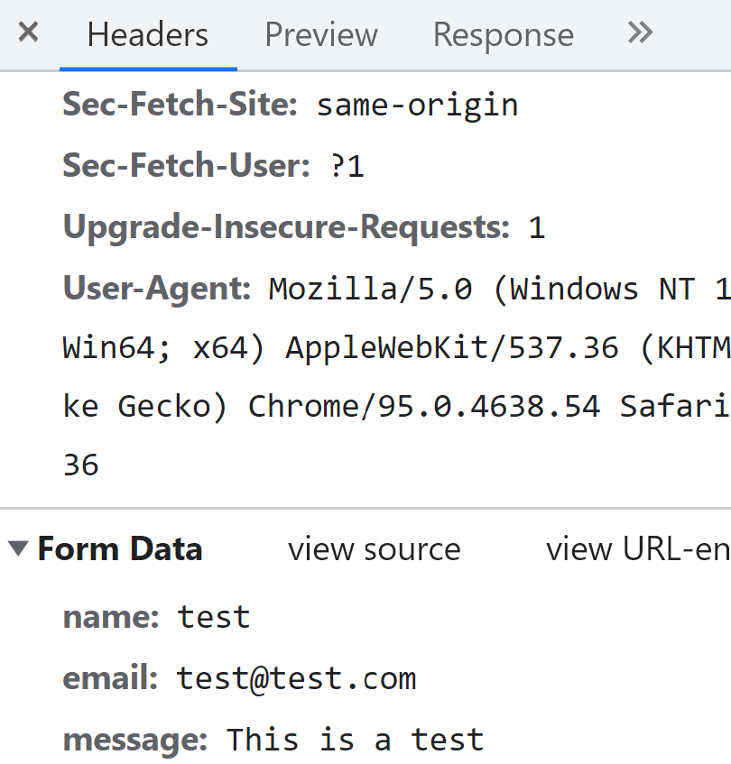
Post

Slide 17
Basic Form Example (Search Google)

Slide 18
Form Fields
Single line textbox
Password textbox
Date Selector
Email Address
Hidden Fields
Number Field
URL Field
File Selector
Datalists
Checkboxes
Radio Button
Submit Button
Reset Button
Multiple line textbox
Select List
*Today’s lecture / example

Slide 19
Input tag
The input tag is an inline, standalone tag

Slide 20
Input tag
Two critical attributes:
name – the attribute name is what is needed in order to reference the field once the form has been submitted
type – the attribute type identifies which input field is being created (textbox, password, checkbox, radio button, etc)

Slide 21
Input tag

Slide 22
Single Line Textbox
By default there is no label to direct users on what to input
We must add the descriptive text to instruct users:

Slide 23
Single Line Textbox
Attributes:
value – value allows you to assign a default value to the field
If the form is submitted without being changed by the end user, this value will be submitted
placeholder – this shows text in the box. Once the user begins typing in the field, the words are removed

Slide 24
Single Line Textbox
Attributes:
size – specifies the size of the box, in number of characters
maxlength – specifies the maximum number of characters
disabled – specifies if the input element is visible, but the end user is not allowed to fill out the box

Slide 25
Single Line Textbox
Attributes:
autofocus – specifies the element on the page that should receive focus when the form loads
required – specifies that the field must be completed before the form can be submitted

Slide 26
Single Line Textbox
Example:

Slide 27
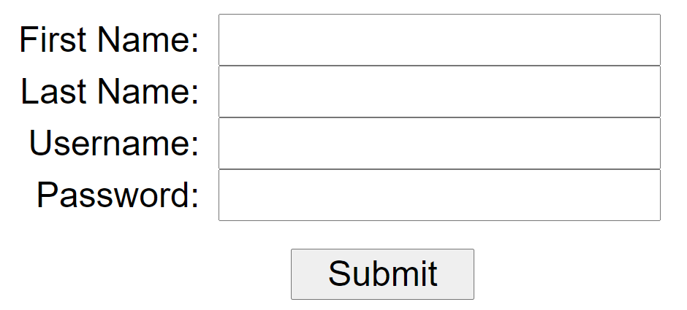
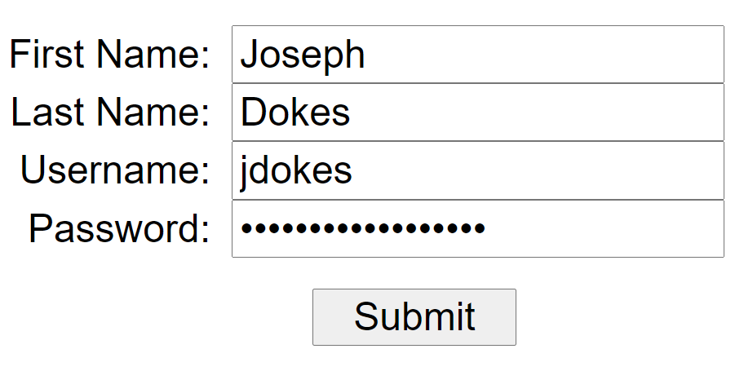
Password
The password field works the same as the textbox field and can utilize the same attributes
The difference between the two is that the password field masks the user input

Slide 28
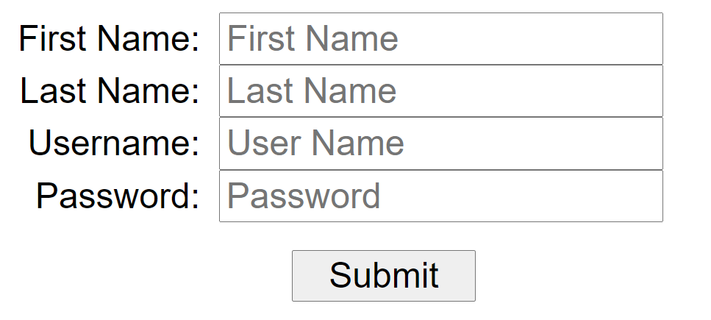
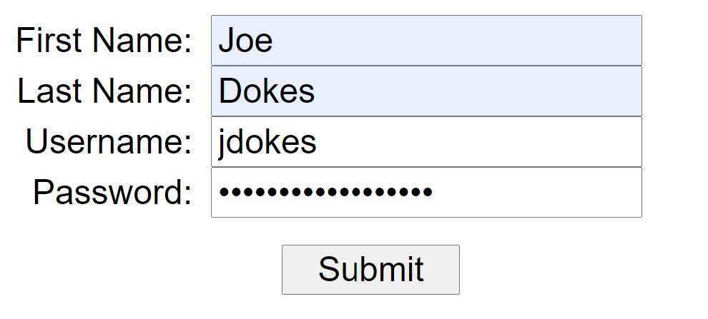
Password

Slide 29
Checkboxes
The checkbox allows a user to select 0, 1, or many options
With a checkbox, the name/value pair is only submitted if the end user selects the checkbox
Attribute:
checked – this will ensure that the box is checked by default

Slide 30
Checkboxes

Slide 31
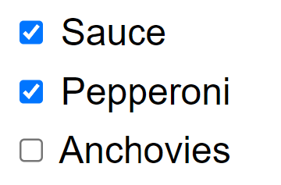
Checkboxes
Example:
However, if you click on the word, you cannot select the checkbox

Slide 32
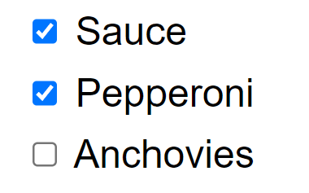
Checkboxes
Example:
Now, a user can click on the words associated with the checkbox -> The for=“” attribute/value pair corresponds to the id=“” a/v pair in the input element

Slide 33
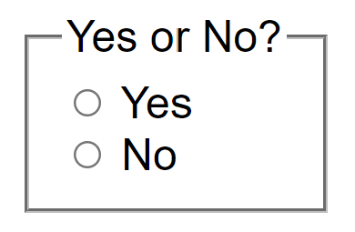
Radio Buttons
Radio buttons work in the same manner as checkboxes with one major difference, with radio buttons you can only select one option out of a grouping
In order to group, the attribute name must be the same for each option in the group

Slide 34
Radio Buttons

Slide 35
Radio Buttons
Often, we want to display radio buttons or checkbox groups together
We can do this with the fieldset element

Slide 36
Submit and Reset
The submit button allows the user to submit the field for processing. The location is determined by the attribute action in the <form> tag.
The reset button allows the user to clear out any user input and reset the field to the default values assigned for each field.
Attribute:
The attribute value can be utilized to change the text that appears on the button

Slide 37
Submit and Reset
Example:

Slide 38
Multiple Line Textbox
The <textarea> element allows for the creation of a multiline text area
If you want a default value associated with the textarea, place that text between the opening and closing of the tag

Slide 39
Multiple Line Textbox
Attributes:
cols – specifies the visible width of the text area
maxlength – specifies the maximum number of characters
rows – specifies the number of visible rows of text
readonly – specifies that the text area cannot be changed

Slide 40
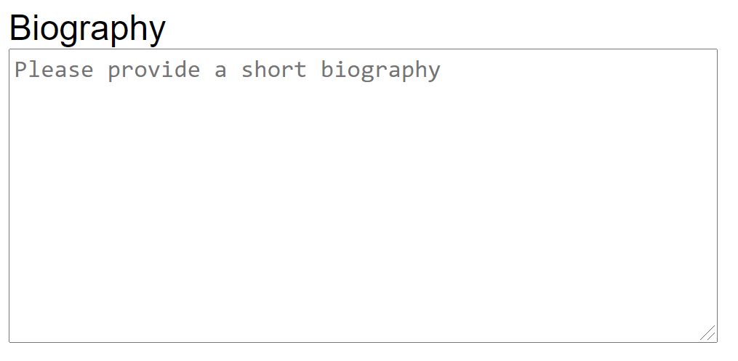
textarea
Example:

Slide 41
Select List
A select list is a drop down (or scrollable) list of predefined options that a user can select

Slide 42
Select List
For each option presented to the end user, you must use the <option>…<option> tag
The text between the opening and closing of the option tag is the text that is visible to the end user
The value associated with the selected option is what is submitted

Slide 43
Select List
Attributes for select tag
disabled – specifies that the drop-down list is visible but the user cannot select from the list
size – specifies the number of visible options
multiple – specifies that a user can select multiple options from the list
Attributes for option tag
selected – specifies the selected element by default when the page loads

Slide 44
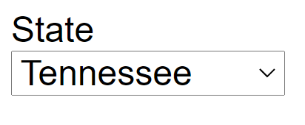
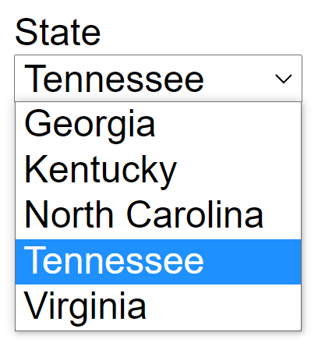
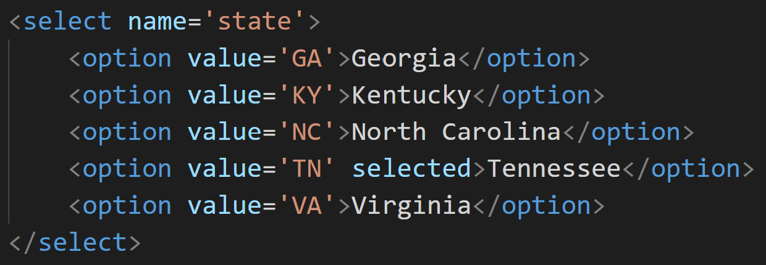
Select List
Example

Slide 45
Questions?

Slide 46
Some Final Thoughts…

Slide 47
CSS Uniformity Across Browsers

Slide 48
Web Design Frustrations
One of the biggest frustrations in Web Design is browsers
Browsers will display HTML/CSS in different manners, making it difficult for the same uniform look across browsers
Two possible solutions:
Creating CSS files specific for the various browsers
Utilizing CSS to equalize the display

Slide 49
Creating Unique CSS
<!--[if IE]> <link rel="stylesheet" type="text/css" href="all-ie-only.css" /> <![endif]-->
<!--[if !IE]><!--> <link rel="stylesheet" type="text/css" href="not-ie.css" /> <!--<![endif]-->
Not the most desired option
Not supported in IE10 and up
However, it does allow you to target specific version of IE

Slide 50
Normalize.css
Normalize.css is a small CSS file that provides better cross-browser consistency in the default styling of HTML elements (Gallagher 2012)
Utilized by sites such at Twitter, Bootstrap, TweetDeck, etc
Download: http://necolas.github.io/normalize.css/

Slide 51
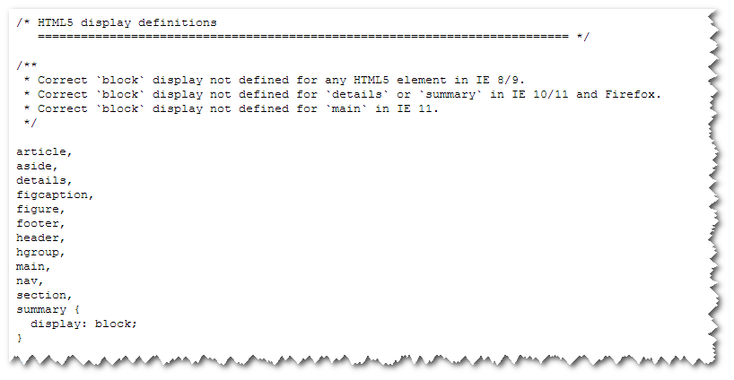
Normalize.css
Sample from the .css file:

Slide 52
Mobile Design

Slide 53
Mobile Technology
77% of American Adults have a smartphone*
While texting, talking, emailing and going online dominate, a majority of Americans also use their smartphones for social networking, taking photos or videos, and catching up with the news
How does your website compare? Is it mobile ready?
*http://www.pewinternet.org/fact-sheet/mobile/

Slide 54
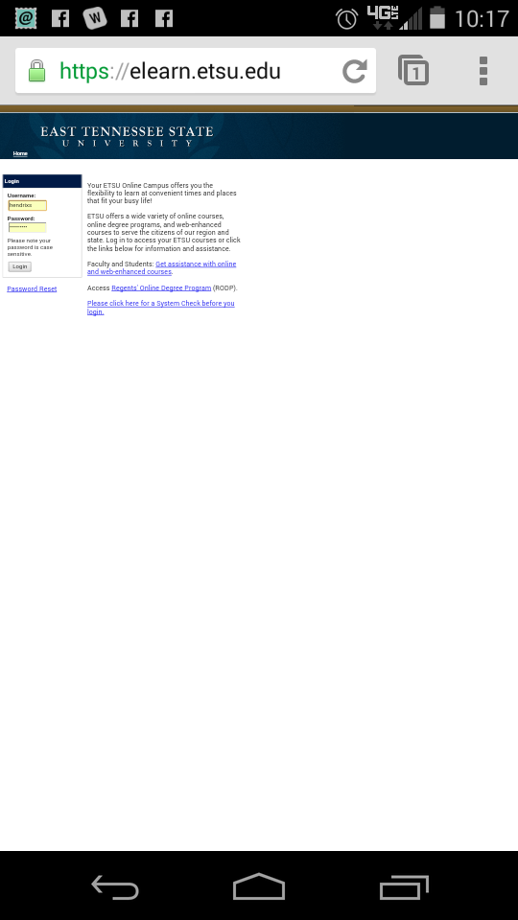
Mobile Technology
vs

Slide 55
Mobile Design Options
Three basic options:
Create a second site just for mobile users:
http://m.foxnews.com
http://foxnews.mobi
Recognize the device that is viewing the screen, and change CSS files:
CNN:
http://z.cdn.turner.com/cnn/tmpl_asset/static/www_homepage/2892/css/hplib-min.css for desktop
http://z.cdn.turner.com/cnn/tmpl_asset/static/mobile_phone/4047/css/lib-min.css for mobile
Utilize Responsive Design

Slide 56
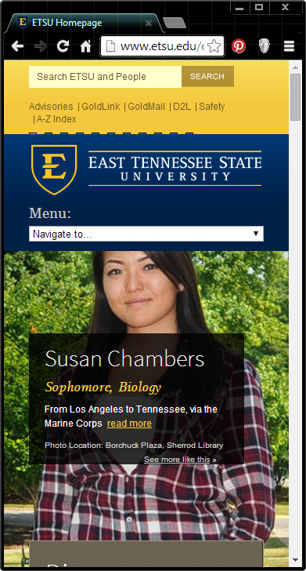
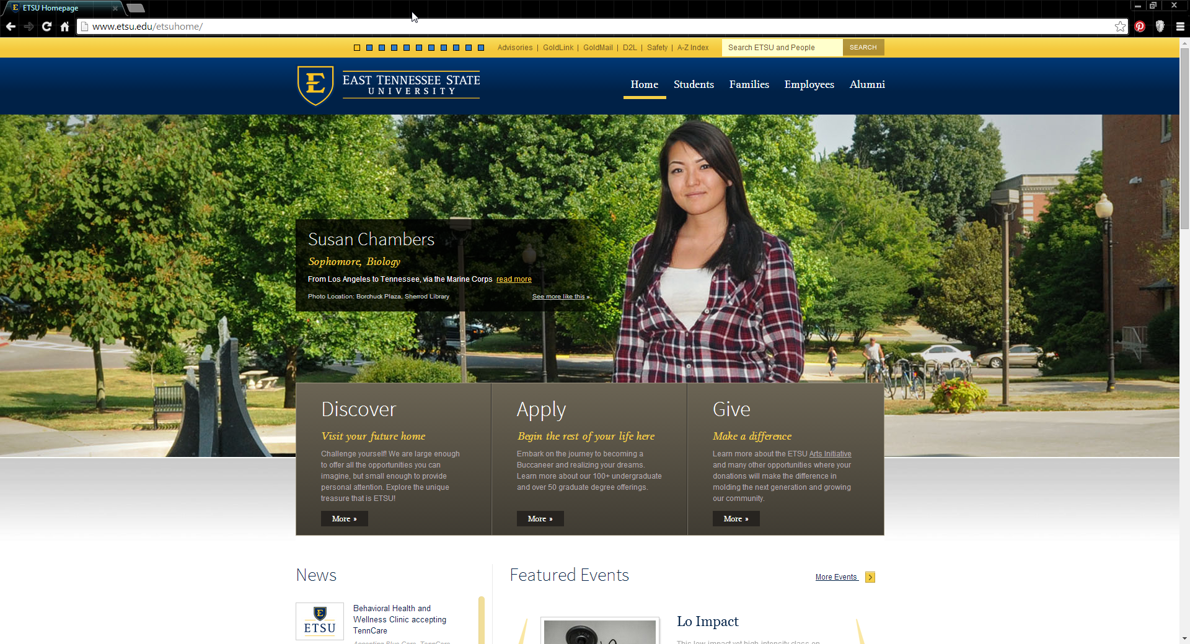
Responsive Design
Responsive Design does not change the CSS or the entire page, rather it scales the page to meet viewing window

Slide 57
Frameworks

Slide 58
What are CSS Frameworks
An CSS framework is a way to create dynamic web sites or web applications in a very quick manner
Provides a quick and easy method to create beautiful websites, standardizing components that are needed
Some examples:
Foundation - http://foundation.zurb.com/
HTML KickStart - http://www.99lime.com/elements/
HTML5 Boilerplate – http://html5boilerplate.com
Bootstrap – http://getbootstrap.com

Slide 59
Bootstrap
Bootstrap was originally created by team members from Twitter
One of the most popular HTML/Front-End Frameworks with a massive user community
Responsive Design built in
FREE :-)

Slide 60
Sources
Gallagher, N. (Feb 2012). “About Normalize.css”, NicholasGallagher.com, Retrieved from http://nicolasgallagher.com/about-normalize-css/
“Gestalt Principles: How Are Your Designs Perceived?”, VanseoDesign, Retrieved from http://www.vanseodesign.com/web-design/gestalt-principles-of-perception/
Levin, J. (Mar 2005). “Gestalt Principles and Web Design”, University of California San Diego, Retrieved from http://tepserver.ucsd.edu/~jlevin/gp/index.html.
“Mobile Technology Fact Sheet”, Pew Research Internet Project, Retrieved from http://www.pewinternet.org/fact-sheets/mobile-technology-fact-sheet/
“HTML Reference”, W3Schools, Retrieved from http://www.w3schools.com/tags/default.asp
“HTML Forms and Input”, W3Schools, Retrieved from http://www.w3schools.com/html/html_forms.asp
Stephen Hendrix, ETSU Department of Computing

Slide 61
Copyrights
Presentation prepared by and copyright of John Ramsey, East Tennessee State University, Department of Computing . (ramseyjw@etsu.edu)
Microsoft, Windows, Excel, Outlook, and PowerPoint are registered trademarks of Microsoft Corporation.
IBM, DB2, DB2 Universal Database, System i, System i5, System p, System p5, System x, System z, System z10, System z9, z10, z9, iSeries, pSeries, xSeries, zSeries, eServer, z/VM, z/OS, i5/OS, S/390, OS/390, OS/400, AS/400, S/390 Parallel Enterprise Server, PowerVM, Power Architecture, POWER6+, POWER6, POWER5+, POWER5, POWER, OpenPower, PowerPC, BatchPipes, BladeCenter, System Storage, GPFS, HACMP, RETAIN, DB2 Connect, RACF, Redbooks, OS/2, Parallel Sysplex, MVS/ESA, AIX, Intelligent Miner, WebSphere, Netfinity, Tivoli and Informix are trademarks or registered trademarks of IBM Corporation.
Linux is the registered trademark of Linus Torvalds in the U.S. and other countries.
Oracle is a registered trademark of Oracle Corporation.
HTML, XML, XHTML and W3C are trademarks or registered trademarks of W3C®, World Wide Web Consortium, Massachusetts Institute of Technology.
Java is a registered trademark of Sun Microsystems, Inc.
JavaScript is a registered trademark of Sun Microsystems, Inc., used under license for technology invented and implemented by Netscape.
SAP, R/3, SAP NetWeaver, Duet, PartnerEdge, ByDesign, SAP Business ByDesign, and other SAP products and services mentioned herein as well as their respective logos are trademarks or registered trademarks of SAP AG in Germany and other countries.
Business Objects and the Business Objects logo, BusinessObjects, Crystal Reports, Crystal Decisions, Web Intelligence, Xcelsius, and other Business Objects products and services mentioned herein as well as their respective logos are trademarks or registered trademarks of Business Objects S.A. in the United States and in other countries. Business Objects is an SAP company.
ERPsim is a registered copyright of ERPsim Labs, HEC Montreal.
Other products mentioned in this presentation are trademarks of their respective owners.

